Slide 1
RADIOLOGY
Halley Park, MD
Attending, Pediatric Radiology
Nicklaus Children’s Pediatric Specialists
Nicklaus Children’s Hospital
Miami, Florida

Slide 2
Disclosure of Relevant Relationship
Dr. Park has not had (in the past 24 months) any relevant conflicts of interest or relevant financial relationship with the manufacturers of products or services that will be discussed in this CME activity or in his presentation.
Dr. Park will support this presentation and clinical recommendations with the “best available evidence” from medical literature.
Dr. Park does not intend to discuss an unapproved/investigative use of a commercial product/device in this presentation.

Slide 3
READY, SET, GO…
1
Click the “Join ARS Sessions” button in the Course Portal “OR”
Text NCHCME to 37607 “OR”
Go to pollev.com/nchcme
2
3

Slide 4
Diagnostic Imaging for the Pediatrician
Halley Park, MD
Pediatric Radiologist
Nicklaus Children’s Hospital
Miami, Florida
May 2023
Many thanks to Dr. Rachel Pevsner and Ricardo Restrepo

Slide 5
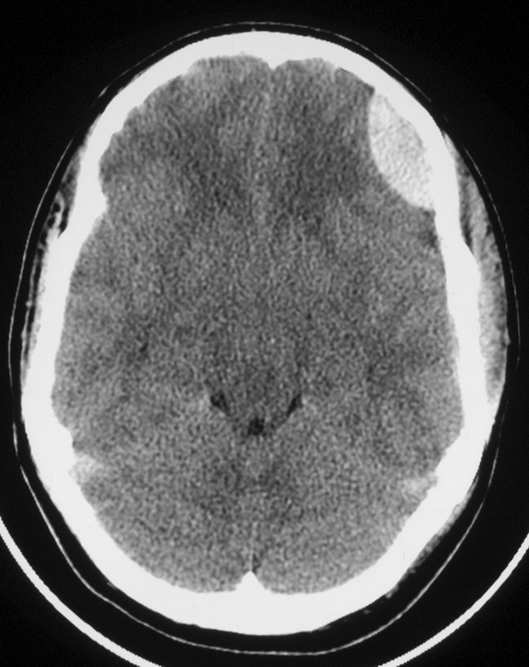
Case 1: 14y M lethargic 2 days, fall off bicycle
Diagnosis?
A. Subdural Hematoma
B. Epidural Hematoma
C. Subarachnoid hemorrhage
D. Hemorrhagic contusion
E. Subdural abscess

Slide 6
Notes:
Poll Title: Do not modify the notes in this section to avoid tampering with the Poll Everywhere activity. More info at polleverywhere.com/support 1. Case 1 - 14 y M lethargic 2 days, fall off bicycle - What is the diagnosis? https://www.polleverywhere.com/multiple_choice_polls/nMsO50x9OoX4c8touSVpv?state=opened&flow=Default&onscreen=persist

Slide 7
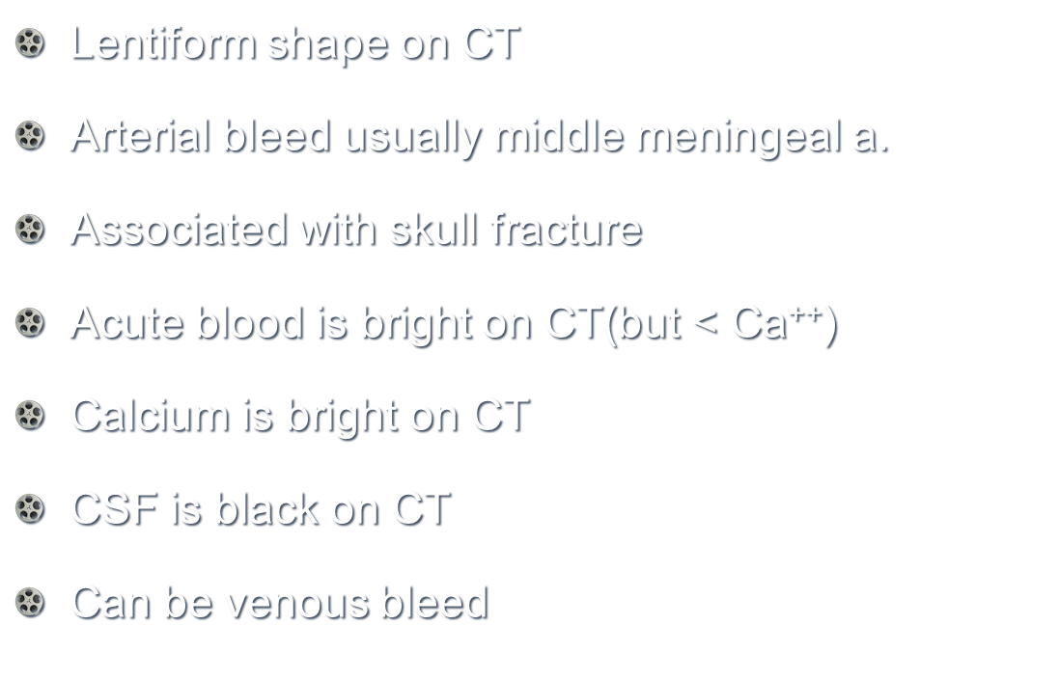
Case 1: Diagnosis?
Epidural Hematoma
Edema

Slide 8
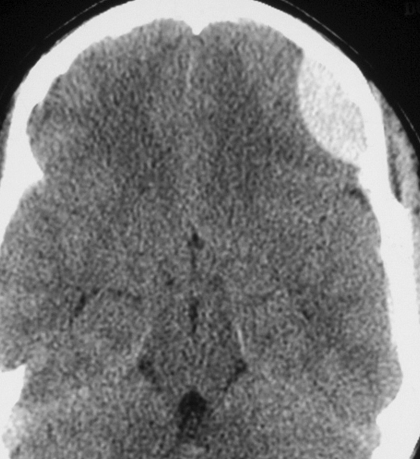
Epidural vs Subdural Hematoma
Epidural: lentiform
Subdural: crescentic
Acute: Very bright
Subcute: slightly bright
CT for head trauma: NO IV contrast!!
Can obscure small petechial bleed or contusion

Slide 9
Case 2: 4-week M, vomiting and failure to thrive
Mushroom cap
(Duodenal bulb)
Diagnosis?
A. Duodenal atresia
B. Pyloric stenosis
C. Midgut volvulus.
D. Duodenal web
E. Intussusception
Double tract sign
(puckered lumen of hypertrophic pyloric channel)

Slide 10
Notes:
Poll Title: Do not modify the notes in this section to avoid tampering with the Poll Everywhere activity. More info at polleverywhere.com/support 2. 4-week M, vomiting and failure to thrive. What is our diagnosis? https://www.polleverywhere.com/multiple_choice_polls/24lpkZf2qTJHXlVuxrTA5?state=opened&flow=Default&onscreen=persist

Slide 11
Pyloric stenosis: US
Midgut volvulus: UGI
Thick muscularis
2 wks – 3mo. M>F
Non bilious “projectile” vomiting
metabolic alkalosis
Hypokalemic, hypochloremic
Dx: Ultrasound (study of choice)
Pylorus thickness > 3mm
Elongated channel>15mm
Occasionally dx on UGI
Corkscrew duodenum
Variable: usually < 2 years
Bilious vomiting
Child is toxic, acidotic
Dx: UGI series
Corkscrew appearance

Slide 12
Case 3: Irritable Toddler w/bloody stools RLQ ileo-colic intussusception.
What is next?
A. CT scan
B. Air enema & surgical consult
C. Barium enema
D. Send the patient to the OR
E. Chest radiograph
US of RLQ: Donut sign

Slide 13
Notes:
Poll Title: Do not modify the notes in this section to avoid tampering with the Poll Everywhere activity. More info at polleverywhere.com/support 3. Case 3: Irritable Toddler w/bloody stools RLQ ileo-colic intussusception. What is your next step? https://www.polleverywhere.com/multiple_choice_polls/pdxEb5UdRzRithP2FHSxn?state=opened&flow=Default&onscreen=persist

Slide 14
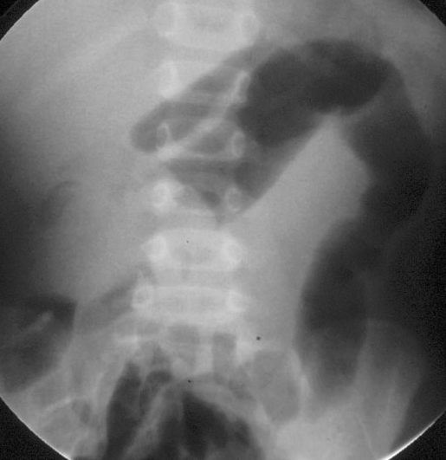
Case 3: Ileo-colic intussusception. What is next? Air enema and surgical consult
Imaging of choice: ultrasound
Air enema therapy: small risk of perforation
Around 10% recurrence rate
Small % are not reducible
IV and fluid bolus before Tx
Surgery should be on stand by
Cresent sign
AIR ENEMA REDUCTION

Slide 15
Case 4: 8-yr w/seizures, mental retardation, adenoma sebaceum
A. CMV
B. Hyperparathyroidism
C. Tuberous Sclerosis
D. Oligodendrogliomas
E. Von Hippel Lindau

Slide 16
Notes:
Poll Title: Do not modify the notes in this section to avoid tampering with the Poll Everywhere activity. More info at polleverywhere.com/support 4. Case 4: 8-yr w/seizures, mental retardation, adenoma sebaceum. What is your diagnosis?? https://www.polleverywhere.com/multiple_choice_polls/QsOtYYi6a5gOwQjOqVwR2?state=opened&flow=Default&onscreen=persist

Slide 17
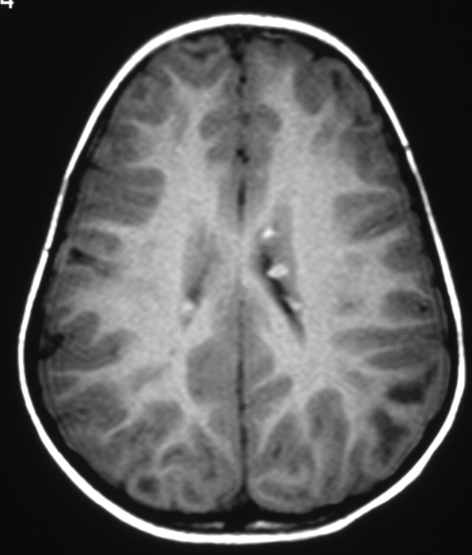
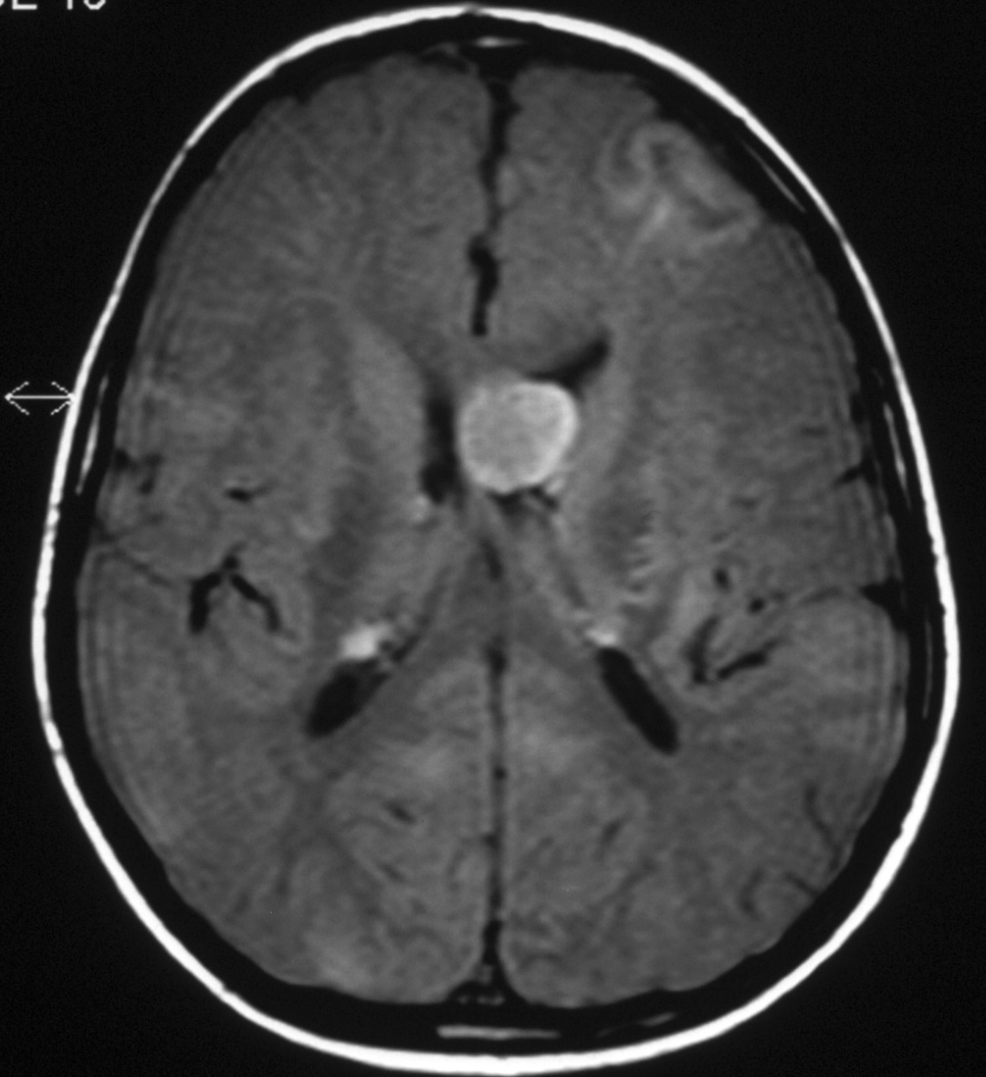
Tuberous Sclerosis
Giant cell astrocytoma: Foramen of Monroe
Subependimal tubers

Slide 18
Tuberous sclerosis
Seizures, mental retardation, adenoma sebaceum
Hamartomas(tubers) are seen in different organs particularly brain and kidneys(angiomyolipomas)
Giant cell astrocytomas, renal cysts, renal cell carcinoma, bone islands
angiomyolipomas > 4 cm at risk bleed

Slide 19
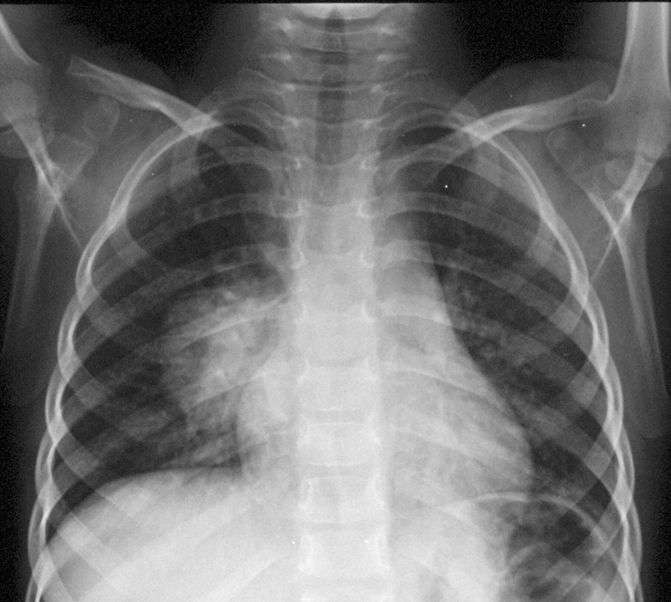
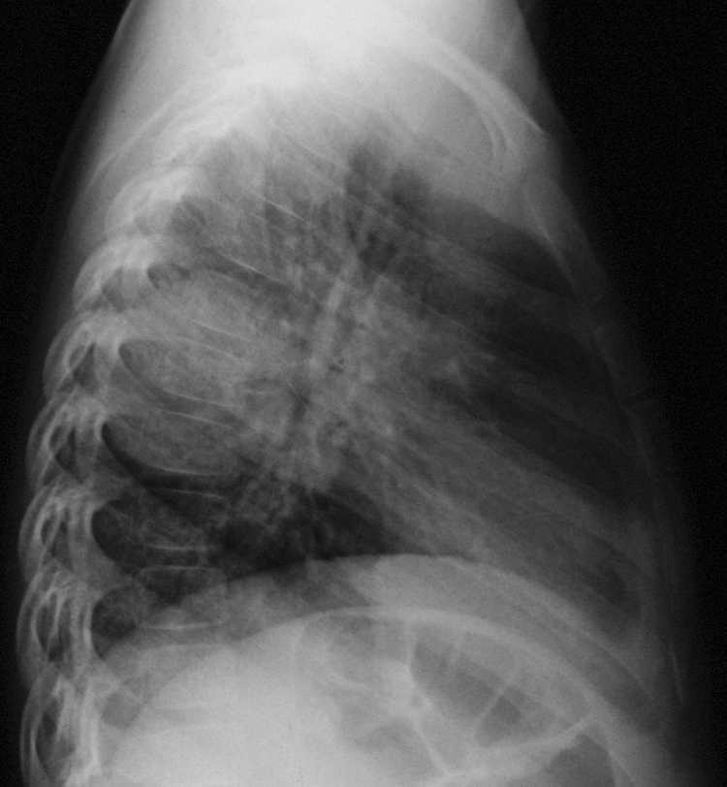
Case 5: 5-yr F w/chest pain and cough for a week
A. Round pneumonia
B. Mediastinal teratoma
C. Congenital lobar emphysema
D. Croup
E. Neurogenic tumor

Slide 20
Notes:
Poll Title: Do not modify the notes in this section to avoid tampering with the Poll Everywhere activity. More info at polleverywhere.com/support 5. Case 5: 5-yr F w/chest pain and cough for a week. What is your diagnosis? https://www.polleverywhere.com/multiple_choice_polls/cjHUOIYg2m1GDX3ihECZL?state=opened&flow=Default&onscreen=persist

Slide 21
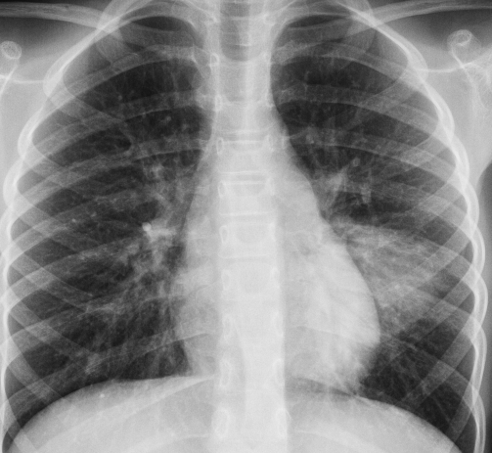
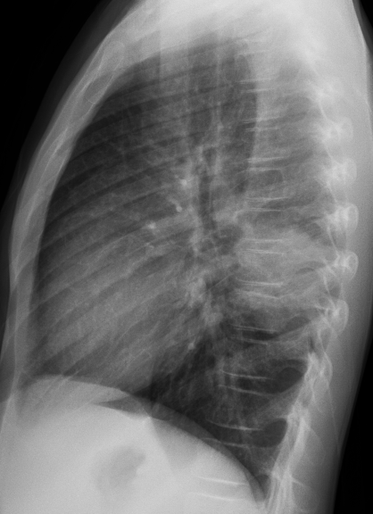
Round Pneumonia
Pneumococcus
Usually between 2 – 8 y
if older suspect immunodeficiency, atypical organism or neoplasm
Lower lobes
Touching the pleura
Clinical history must correlate with findings
Another example:
7 yr old F w/cough & fever

Slide 22
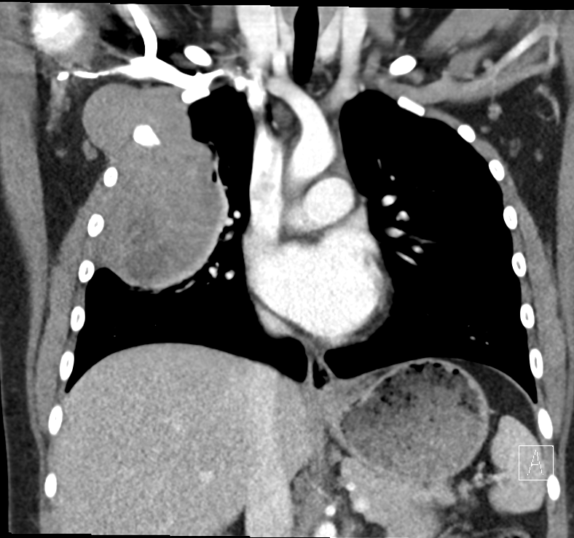
Pitfall case 12 yr old with chest pain and shoulder pain
Initial xray read as pneumonia
One month later
Osteosarcoma of chest wall
Notes:
Mrn 1118132290 Garcia, karim

Slide 23
Case 6: 6yr w/headaches, vomiting, diplopia & Rt fascial weakness & Lt hemiparesis
A. Pontine Glioma
B. Multiple sclerosis
C. Brain abscess

Slide 24
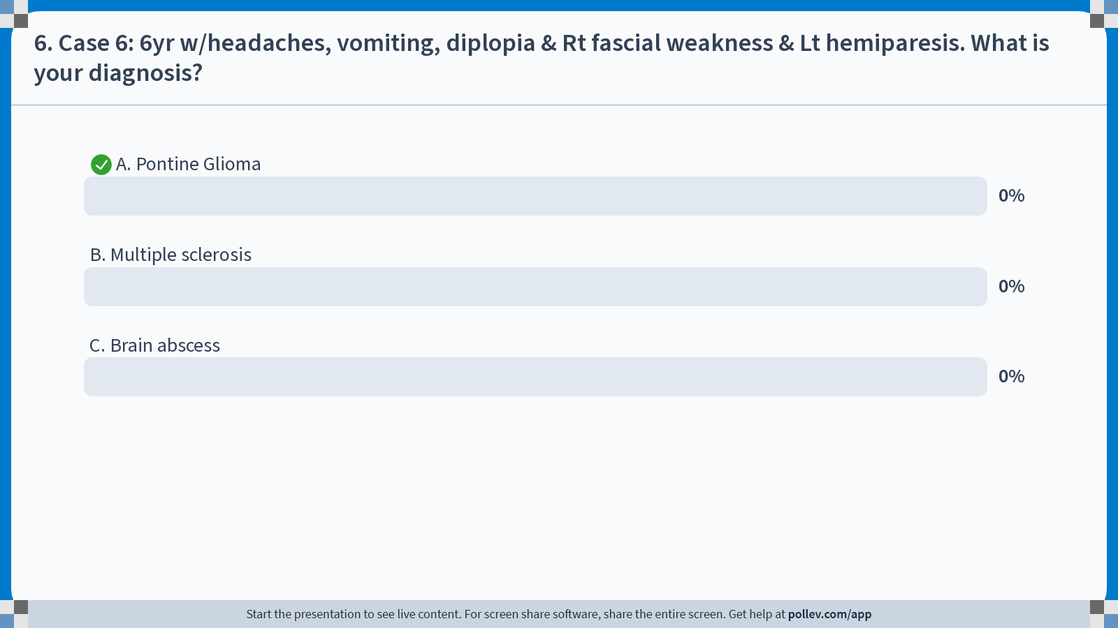
Notes:
Poll Title: Do not modify the notes in this section to avoid tampering with the Poll Everywhere activity. More info at polleverywhere.com/support 6. Case 6: 6yr w/headaches, vomiting, diplopia & Rt fascial weakness & Lt hemiparesis. What is your diagnosis? https://www.polleverywhere.com/multiple_choice_polls/2Mvp4HYSXeaov4xyTLCTL?state=opened&flow=Default&onscreen=persist

Slide 25
Pediatric Brain Tumors
Most common site for tumors is the posterior fossa
Most common peds brain tumors (in order):
pilocytic astrocytoma
medulloblastoma
ependymoma
Ependymoma:
Midline
partially calcified posterior fossa mass

Slide 26
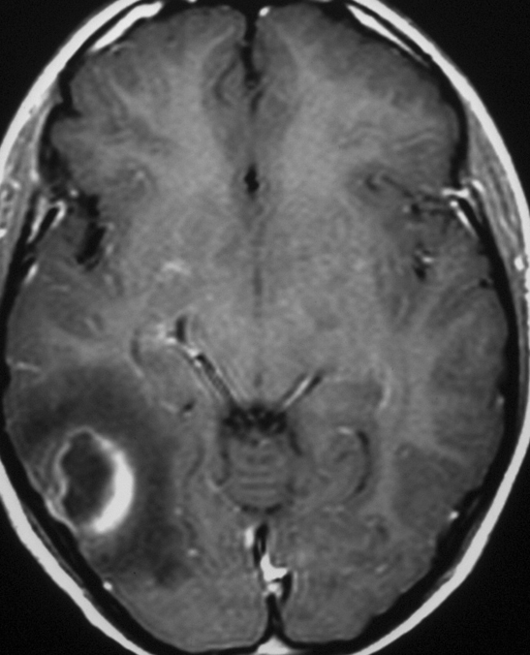
Contrast for tumors & infection
Cerebral abscess:
rim enhancing lesion surrounding edema
Patient also had Renal abscess
CT
MRI

Slide 27
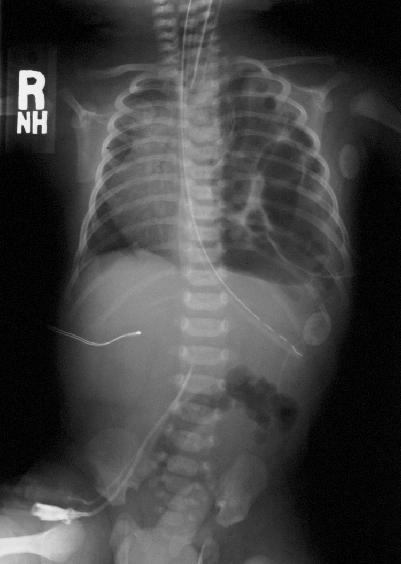
Case 7: Which one is commonly observed in this term newborn with severe respiratory distress?
A. Persistent pulmonary hypertension
B. Pyloric stenosis
C. Tension pneumothorax
D. Systolic murmur

Slide 28
Notes:
Poll Title: Do not modify the notes in this section to avoid tampering with the Poll Everywhere activity. More info at polleverywhere.com/support 7. Case 7: Which one is commonly observed in this term newborn with severe respiratory distress? https://www.polleverywhere.com/multiple_choice_polls/jpFWcBrORERQ7YMqv6DDl?state=opened&flow=Default&onscreen=persist

Slide 29
Persistent pulmonary hypertension
Associated with:
Congenital diaphragmatic hernia
Meconium aspiration
Occasionally with severe RDS
Idiopathic
Congenital diaphragmatic hernia

Slide 30
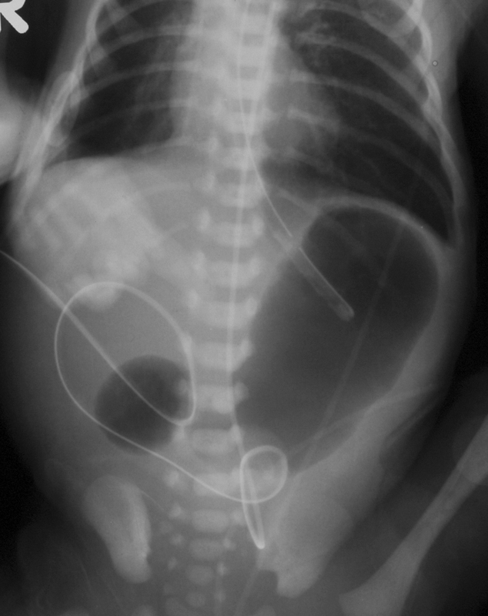
Case 8: 1-day old baby with vomiting
A. Pyloric stenosis
B. Duodenal atresia
C. Ileal atresia
D. Duodenal hematoma
E. T-E fistula

Slide 31
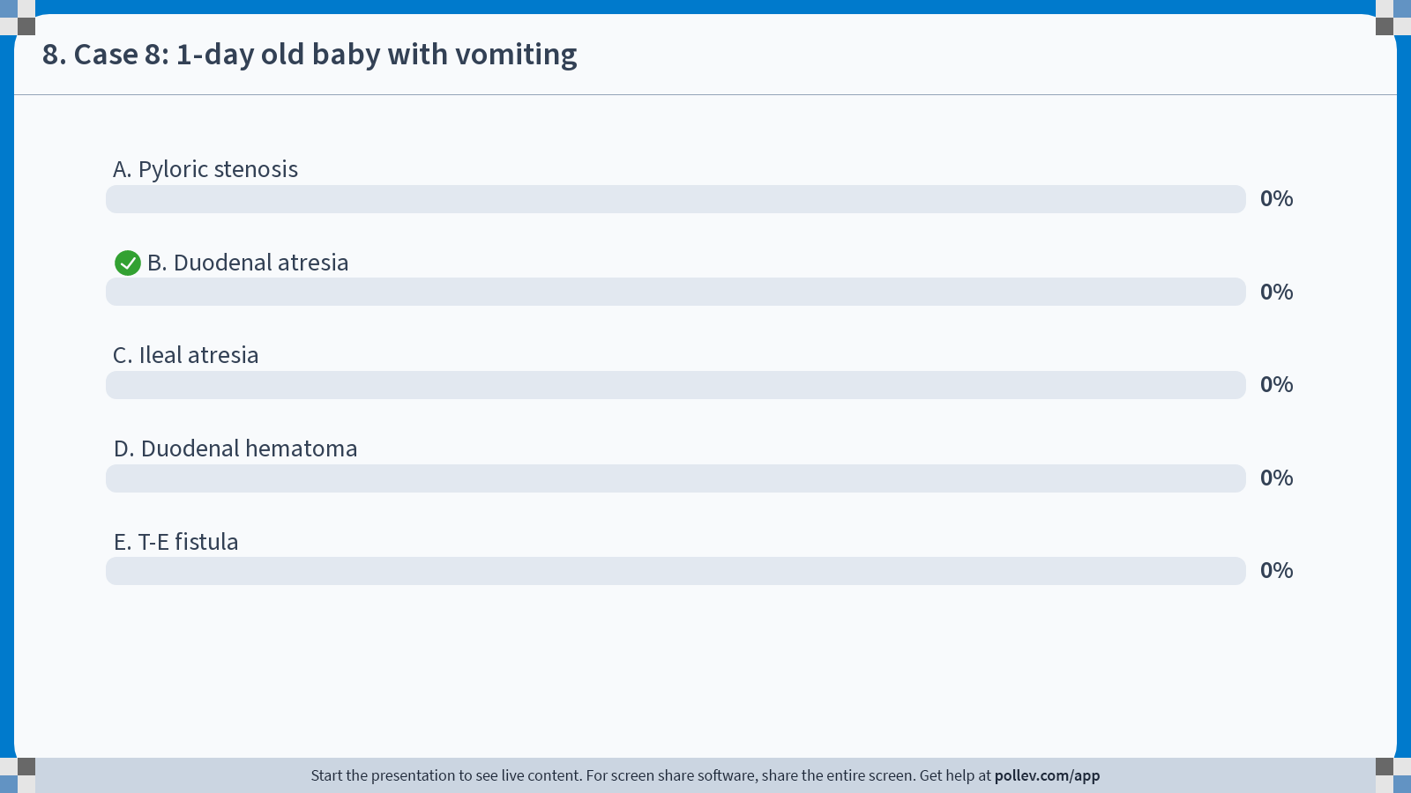
Notes:
Poll Title: Do not modify the notes in this section to avoid tampering with the Poll Everywhere activity. More info at polleverywhere.com/support 8. Case 8: 1-day old baby with vomiting https://www.polleverywhere.com/multiple_choice_polls/WhXYIJqWftQwMoetbm6xo?state=opened&flow=Default&onscreen=persist

Slide 32
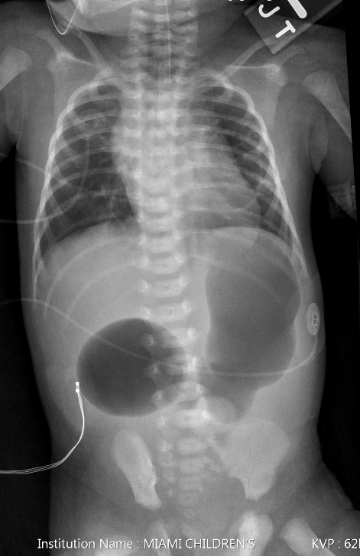
Duodenal atresia
Double Bubble Sign
No air in bowel distally
Bilious vomiting (obstruction distal to ampulla of vater)
No further imaging necessary
Associated with Down Syndrome (30%) and part of VACTERL
Due to failure canalization of duodenum
1day old trisomy & TEF

Slide 33
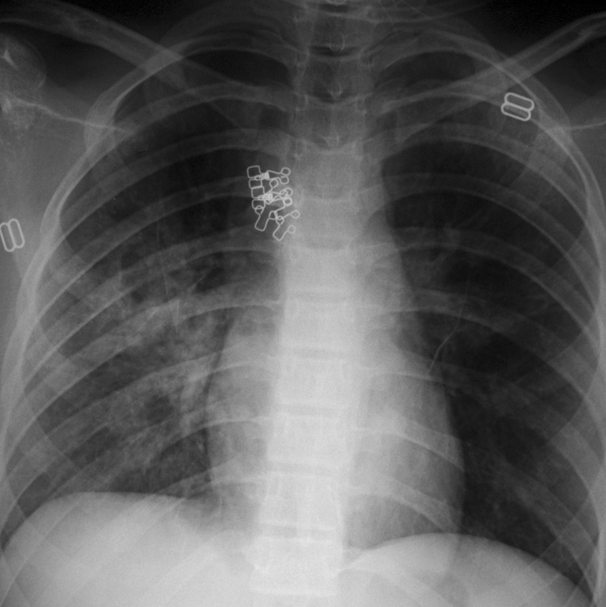
Case 9: Adolescent girl fell from a horse & has difficulty breathing and hemoptysis
Aspiration
Pneumothorax
Traumatic pneumatocele
CPAM
Necrotizing pneumonia

Slide 34
Notes:
Poll Title: Do not modify the notes in this section to avoid tampering with the Poll Everywhere activity. More info at polleverywhere.com/support 9. Case 9: Adolescent girl fell from a horse & has difficulty breathing and hemoptysis https://www.polleverywhere.com/multiple_choice_polls/uJkR7UDwVKeApUDHUH5sc?state=opened&flow=Default&onscreen=persist

Slide 35
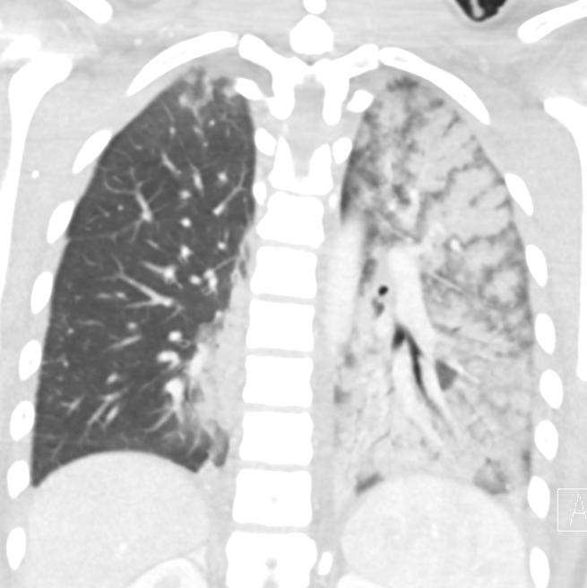
Traumatic pneumatocele/Pulmonary contusion
Ground glass opacity usually in the lung bases
Alveolar rent causes intraparenchymal air leak
Associated with rib/clavicle fracture
Cavity with an air fluid level classically seen(traumatic pneumatocele)
Hemoptysis
MVA Rollover 17yr f other occupants perished,
Neg CXR, but CT showed extensive contusion & hemorrhage

Slide 36
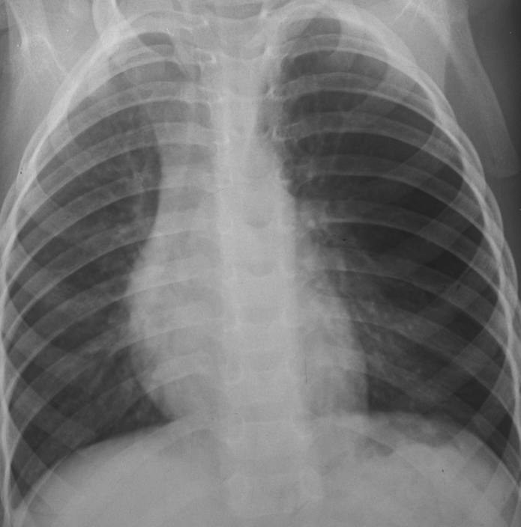
Cystic pulmonary masses: Congenital Cystic Pulmonary Adenomatoid Malformation: CPAM

Slide 37
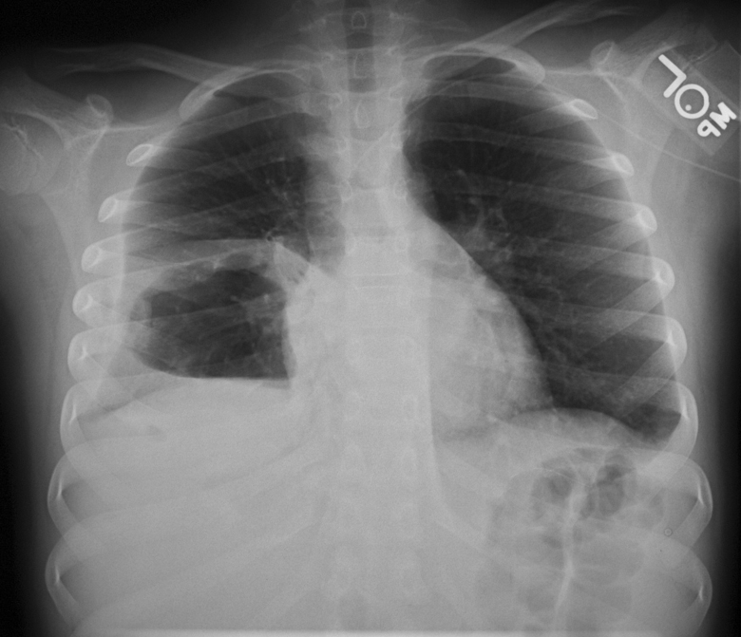
Cystic Pulmonary masses: Pulmonary abscess

Slide 38
IV Contrast (CT & MRI)
In general for evaluation of
vascular structures: vascular rings
infection
inflammation
tumor
Congenital lung malformations: CPAM, sequestration, etc
Exception: Sinusitis

Slide 39
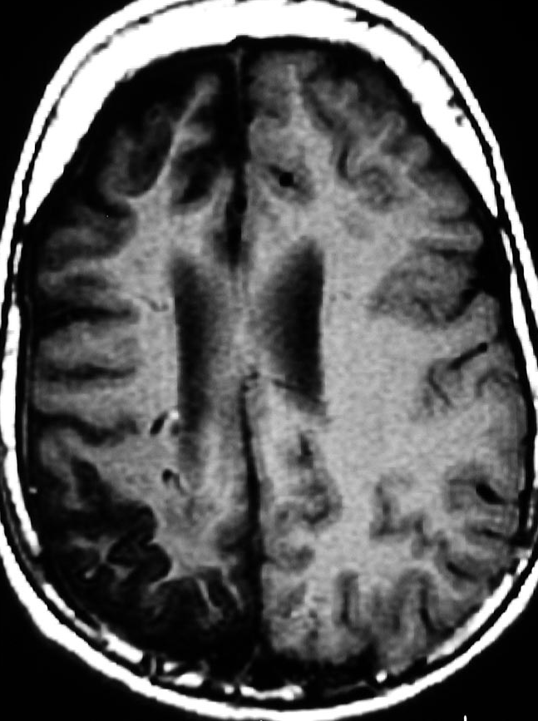
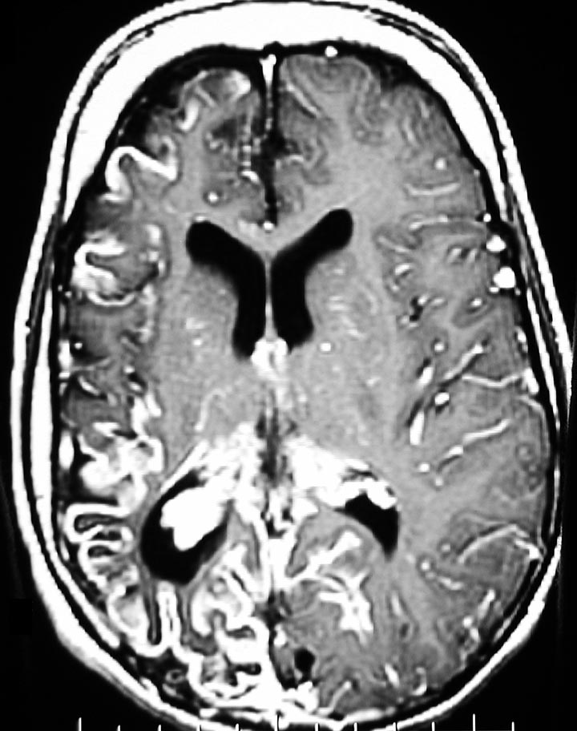
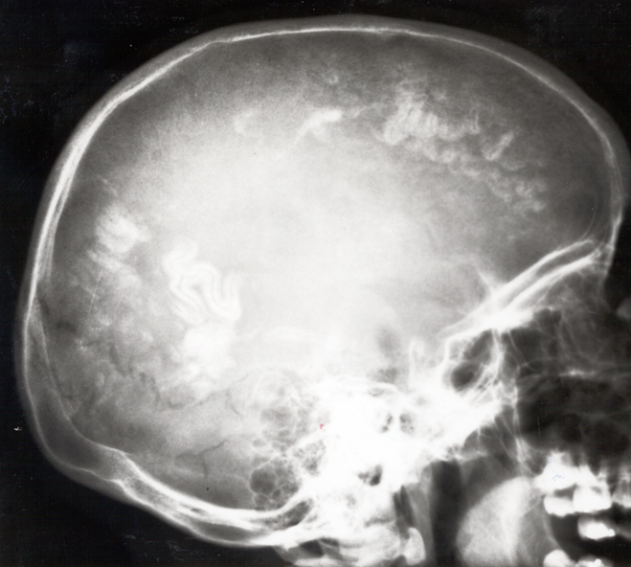
Case 10: Which one of the following associated findings is most likely seen in this patient with glaucoma:
calcifications
Hypopigmented skin lesions
Port wine stain
Agenesis of corpus callosum
Periostitis of the long bones
leptomeningeal angiomatosis

Slide 40
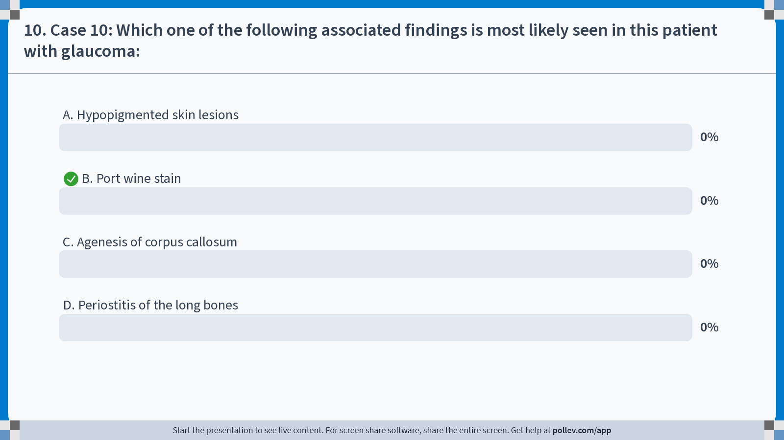
Notes:
Poll Title: Do not modify the notes in this section to avoid tampering with the Poll Everywhere activity. More info at polleverywhere.com/support 10. Case 10: Which one of the following associated findings is most likely seen in this patient with glaucoma: https://www.polleverywhere.com/multiple_choice_polls/KcX50zdn17RuL4h9Ahj0D?state=opened&flow=Default&onscreen=persist

Slide 41
Sturge Weber Syndrome
Phakomatosis/neurocutaneous disorder
Seizures
Nevus(port wine stain) in the distribution of the ophtalmic branch of the trigeminal nerve
Ipsilateral leptomeningeal angiomatosis
High incidence of mental retardation
Glaucoma/buphthalmos
leptomeningeal angiomatosis

Slide 42
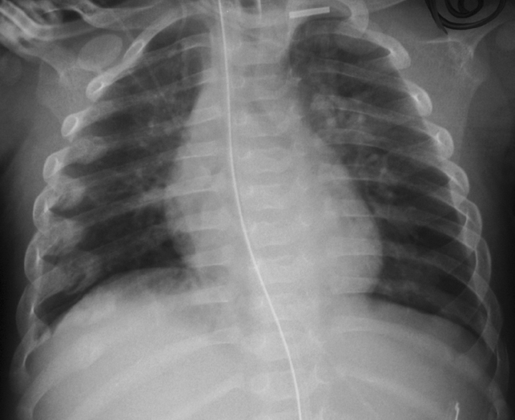
Case 11: 2 mo. Infant with hypotonia
A. Osteogenesis imperfecta
B. Thanatophoric dysplasia
C. Congenital syphilis
D. Non accidental trauma
E. Osteopetrosis

Slide 43
Notes:
Poll Title: Do not modify the notes in this section to avoid tampering with the Poll Everywhere activity. More info at polleverywhere.com/support 11. Case 11: 2 mo. Infant with hypotonia https://www.polleverywhere.com/multiple_choice_polls/IFhZfOdu2W0KCCjhbXdAZ?state=opened&flow=Default&onscreen=persist

Slide 44
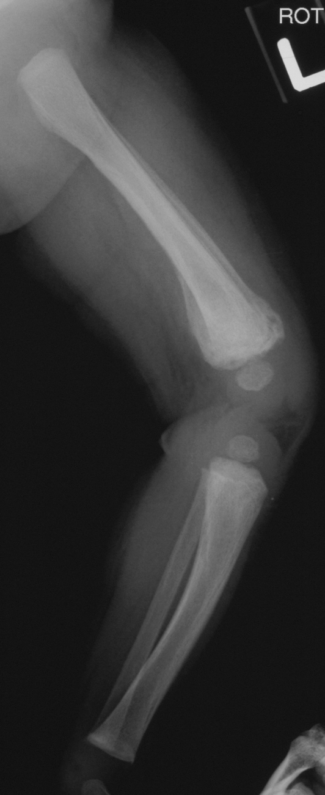
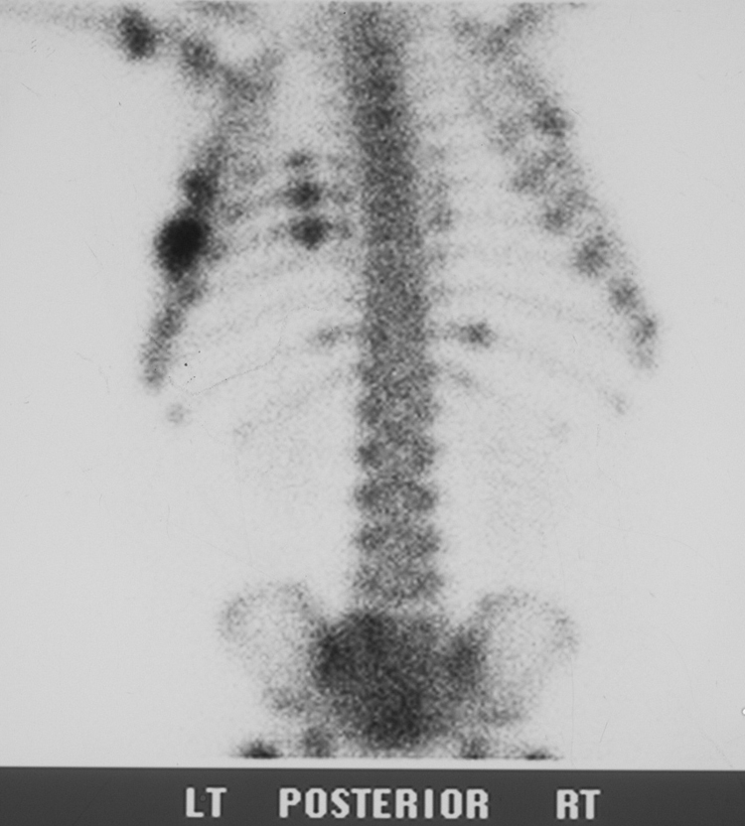
Child Abuse
Multiple fractures in different stages of healing

Slide 45
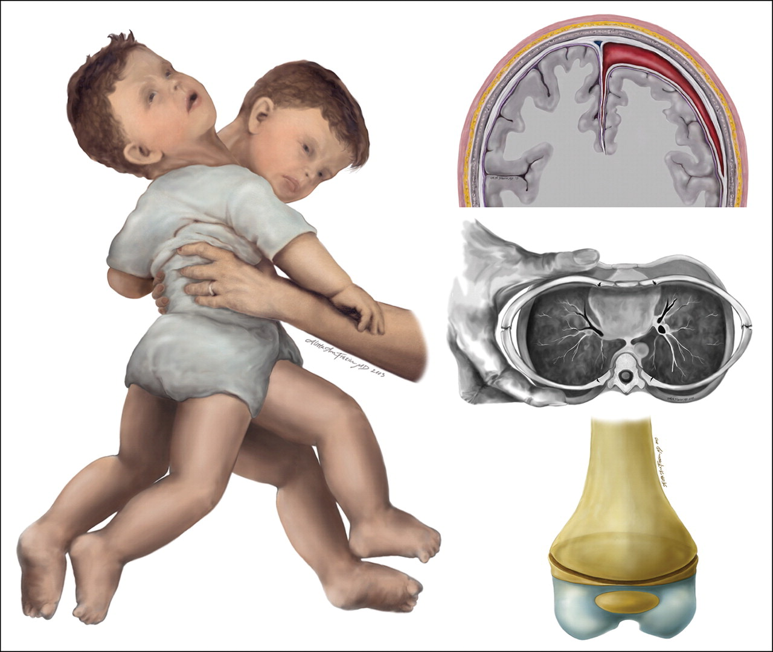
Mechanism of Injury
Published in: Gael J. Lonergan; Andrew M. Baker; Mitchel K. Morey; Steven C. Boos; RadioGraphics 2003, 23, 811-845.
DOI: 10.1148/rg.234035030

Slide 46
7-25-08
NAHI: Acute SDH, diffuse edema & ischemia
supposedly hit by brother with toy truck
Bone Survey: multiple rib fractures
Notes:
Patient transferred from homestead supposedly hit by brother with toy truck

Slide 47
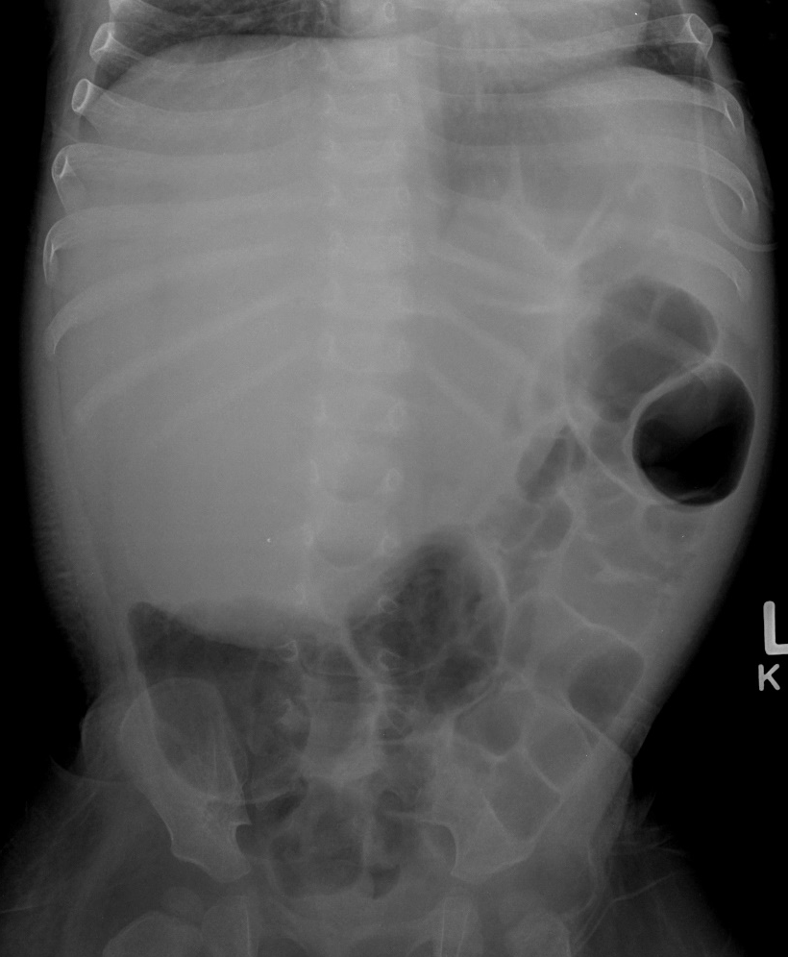
Case 12: One yr old infant with abdominal distention
The best tumor marker to diagnose this tumor is?
Alpha-fetoprotein
Beta HCG
CEA
CA 125

Slide 48
Notes:
Poll Title: Do not modify the notes in this section to avoid tampering with the Poll Everywhere activity. More info at polleverywhere.com/support 12. Case 12: One yr old infant with abdominal distention https://www.polleverywhere.com/multiple_choice_polls/yR5roTiqGKJwUyERdqSuY?state=opened&flow=Default&onscreen=persist

Slide 49
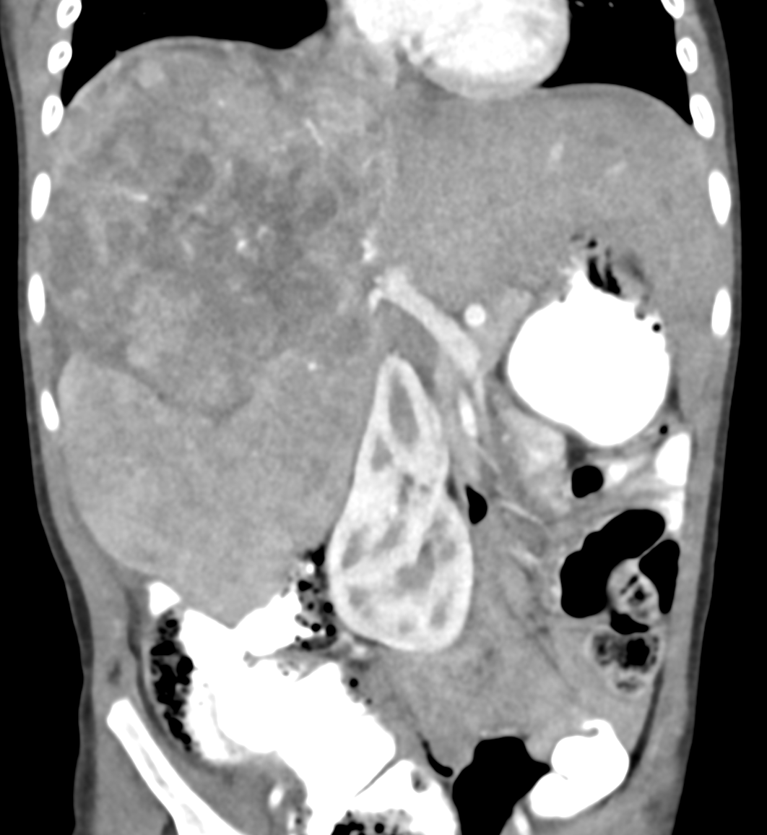
Hepatoblastoma
Most common primary liver tumor of childhood
43% of total liver masses
Usually seen in infants and children < 3 yrs
Most common presentation is a painless mass
Serum AFP levels elevated in > 90% of pts.
Predisposing conditions:
Beckwith-Wiedmann syndrome
Trisomy 18
familial polypois coli,
Gardner syndrome
2yr m, mass incidentally found on appy US,
Palpable & firm on clinical exam in RLQ
Notes:
I biopsied mass US guided next day, just had case last week

Slide 50
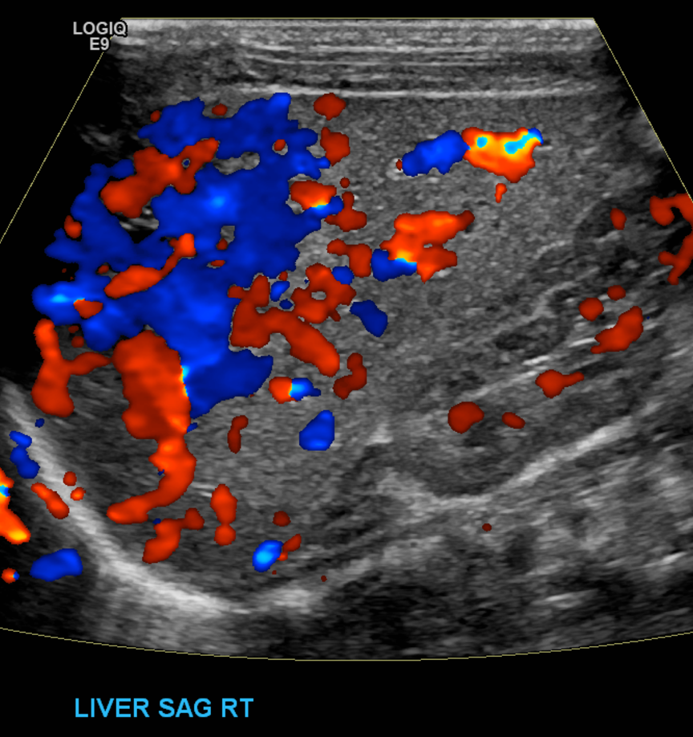
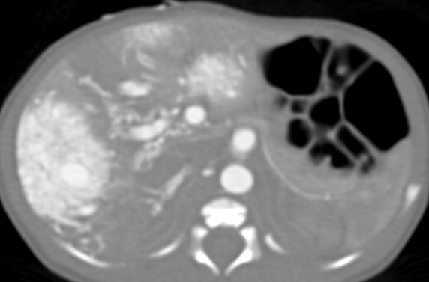
Liver neoplasms
Liver 3rd most common site primary tumor in peds after kidney & adrenals
2/3 of primary liver tumors are malignant, most common:
Hepatoblastoma
HCC (hepatocellular carcinoma)
Undifferentiated Embryonal Sarcoma
1/3 of hepatic primary tumors benign, most common:
Infantile hemangioma
FNH (focal nodular hyperplasia)
Mesenchymal hamartoma
New born: multifocal hepatic hemangiomas & high output cardiac failure due to significant arteriovenous shunting.
Tx: High Dose Propanol & steroids

Slide 51
Case 13: Teenager with rectal bleeding, diarrhea, and anorexia
Thickend colonic walls, no small bowel involvement
A. Crohn’s
B. Ulcerative Colitis
C. Irritable Bowel Syndrome
D. Lactose Intolerance

Slide 52
Notes:
Poll Title: Do not modify the notes in this section to avoid tampering with the Poll Everywhere activity. More info at polleverywhere.com/support 13. Case 13: Teenager with rectal bleeding, diarrhea, and anorexia https://www.polleverywhere.com/multiple_choice_polls/1GhDwABpaGfSAlL7cB4LF?state=opened&flow=Default&onscreen=persist

Slide 53
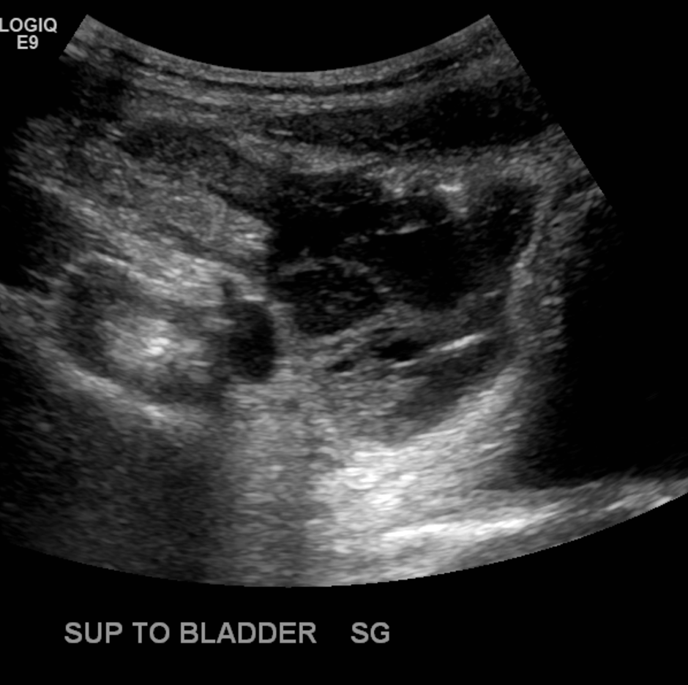
Case 14: 14yr M with vomiting, fever & RLQ pain
A. Perforated Appendicitis
B. Ulcerative Colitis
C. Crohn’s Disease
D. Sprue
Complex collection appendix not seen
extensive inflammation RLQ

Slide 54
Notes:
Poll Title: Do not modify the notes in this section to avoid tampering with the Poll Everywhere activity. More info at polleverywhere.com/support 14. Case 14: 14yr M with vomiting, fever & RLQ pain https://www.polleverywhere.com/multiple_choice_polls/Pc0Ea2gtKeblyTKCGR6wn?state=opened&flow=Default&onscreen=persist

Slide 55
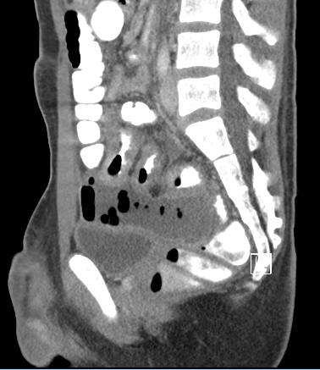
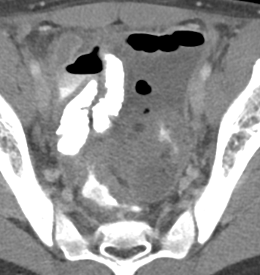
Case 14: Perforated Appendicitis
Appendicitis
Dx is not often straight forward
1/3rd kids atypical presentation
Complications: abscess, peritonitis, sepsis, bowel obstruction
Peds higher incidence perforation
Deep pelvic abscess
US guided transrectal drainage with TPA

Slide 56
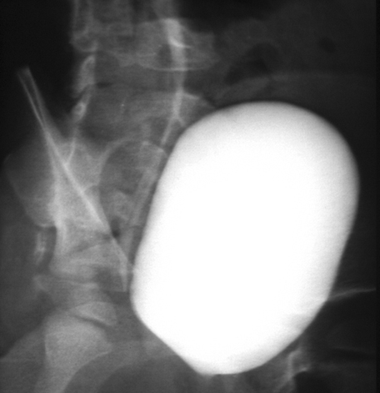
Case 15: 2 mo old infant w/ fever.
A. Prominent Column of Bertin
B. Reflux into a duplicated collecting system
C. Posterior urethral valves
D. Myelomeningocele

Slide 57
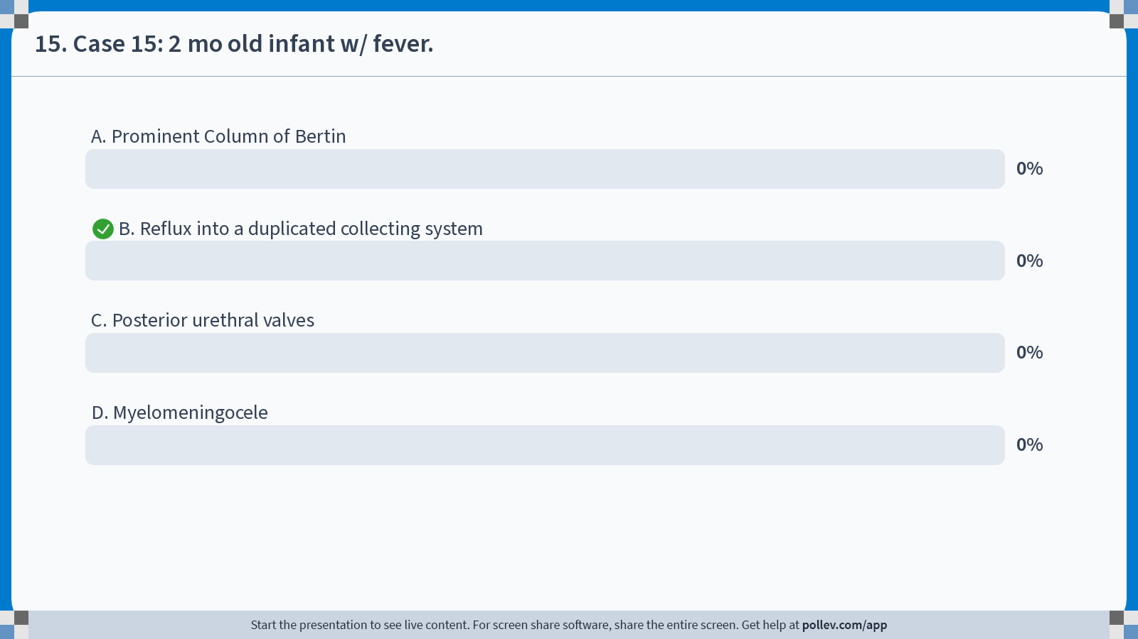
Notes:
Poll Title: Do not modify the notes in this section to avoid tampering with the Poll Everywhere activity. More info at polleverywhere.com/support 15. Case 15: 2 mo old infant w/ fever. https://www.polleverywhere.com/multiple_choice_polls/nChRWpNGZR1iSKGz12hTu?state=opened&flow=Default&onscreen=persist

Slide 58
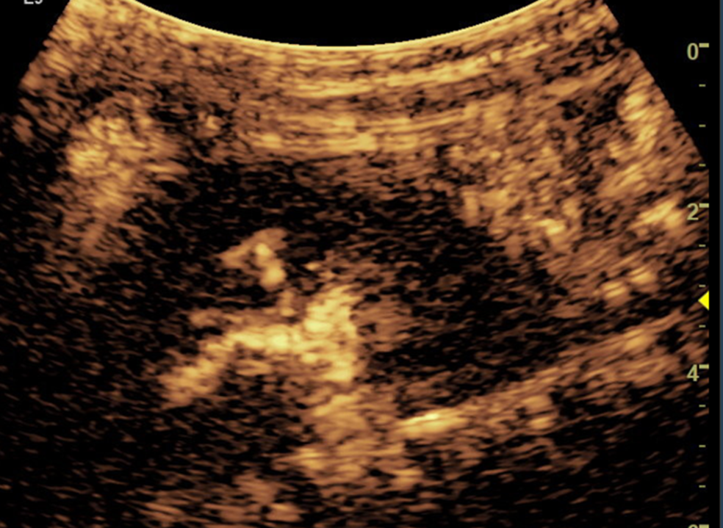
Companion case VUR
Left kidney grade 3 reflux on 4th n& 5th cycle filling
20mo old Uneplained recurrent UTI
VCUG negative
Contrast enhanced voiding urosonography (ceVUS) was positive

Slide 59
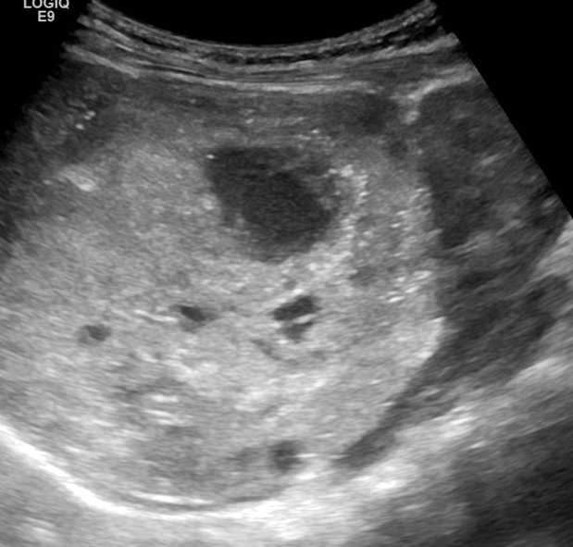
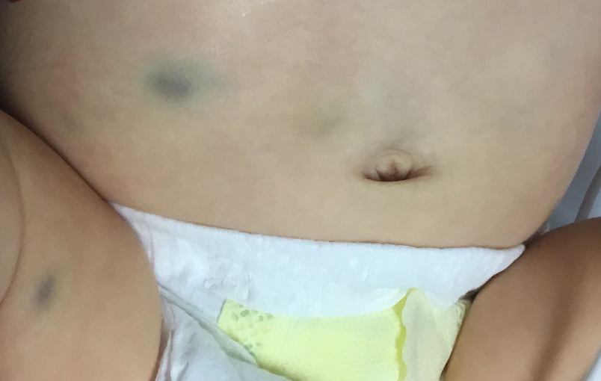
Bonus: 3mo old right eye hematoma & bruising. DX?
kidney
Suprarenal mass
Notes:
Ufaev 1119150900

Slide 60
Neuroblastoma
Most common malignancy in infant
Commonly originates in medulla adrenal gland/retroperitoneal mass
Paraneoplastic syndrome: opsoclonus-myoclonus
Elevated urine catecholamines
Surrounds vascular structures w/out invading
50% calcification
Bilateral suprarenal masses, liver mets
MIBG: bone & skin mets

Slide 61
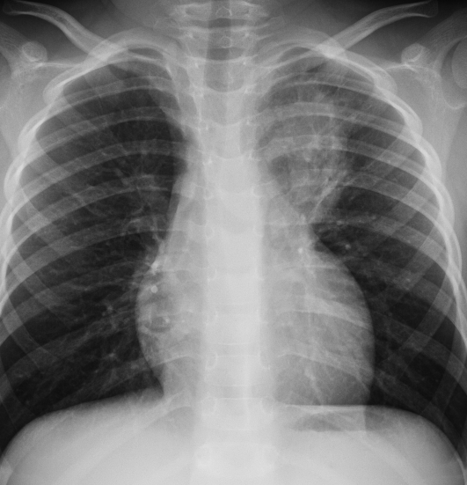
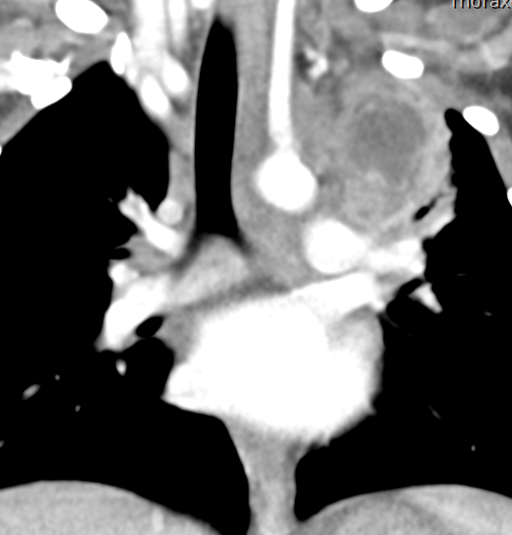
Bouns: 6 yr M w/ hemoptysis. Just finished 6 mo course of observed tx for TB. What do you do next?
t
Tuberculoma with caseating necrotic Lymph nodes
Notes:
Ct alsoshowed calcifications 60283112

Slide 62
Limping child
review

Slide 63
7 year old limping and hip pain for 3 days
Ddx?
Notes:
Sanchez, demiz 1116140527

Slide 64
Mri next morning
NEXT STEP?

Slide 65
Joint aspiration: Toxic (transient synovitis) synovitis

Slide 66
3 yr old rt hip pain for 1 week and fever US. Arrived in am from NY requested by er
DDX?
Brodies abcess

Slide 67
F/U MRI: Septic joint & osteomyelitis
T1 Fsat +C
STIR

Slide 68
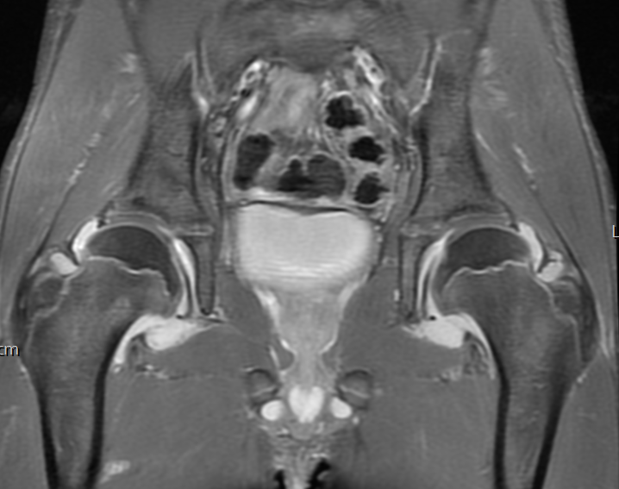
JIA: 12 yr M, lt hip pain & limping 24 hrs s/p recent fall.
Stir-trace jt fluid
T1 FS +C: Thick enhancing synovium

Slide 69
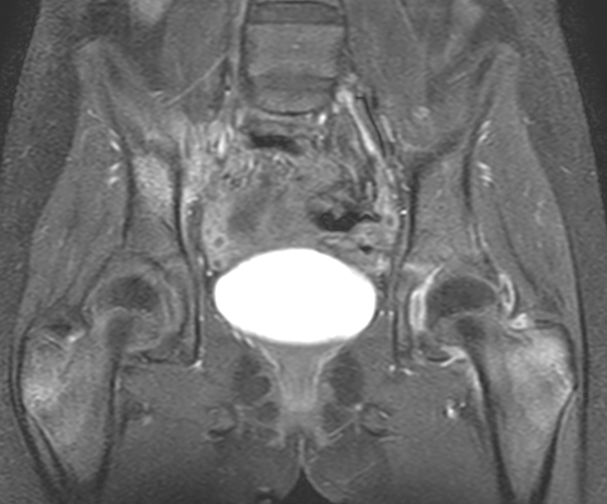
CNO: 12 yr F Gymnast w/nontraumatic right buttock pain x 4 days. HX of ulcerative colitis
Multiple areas enhancing BM edema
Dramatically improved now on methotrexate

Slide 70
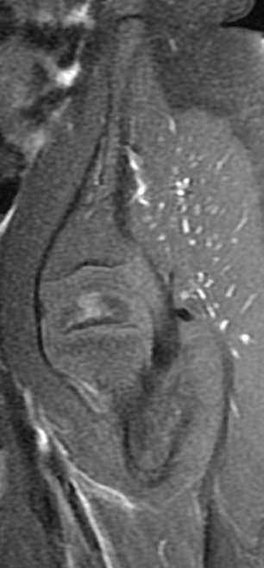
2 yr old limping. DDX?
MRI
3 wks later
T1 +C
Early Legg-Calve-Perthes Disease
Notes:
Mrn 1238445

Slide 71
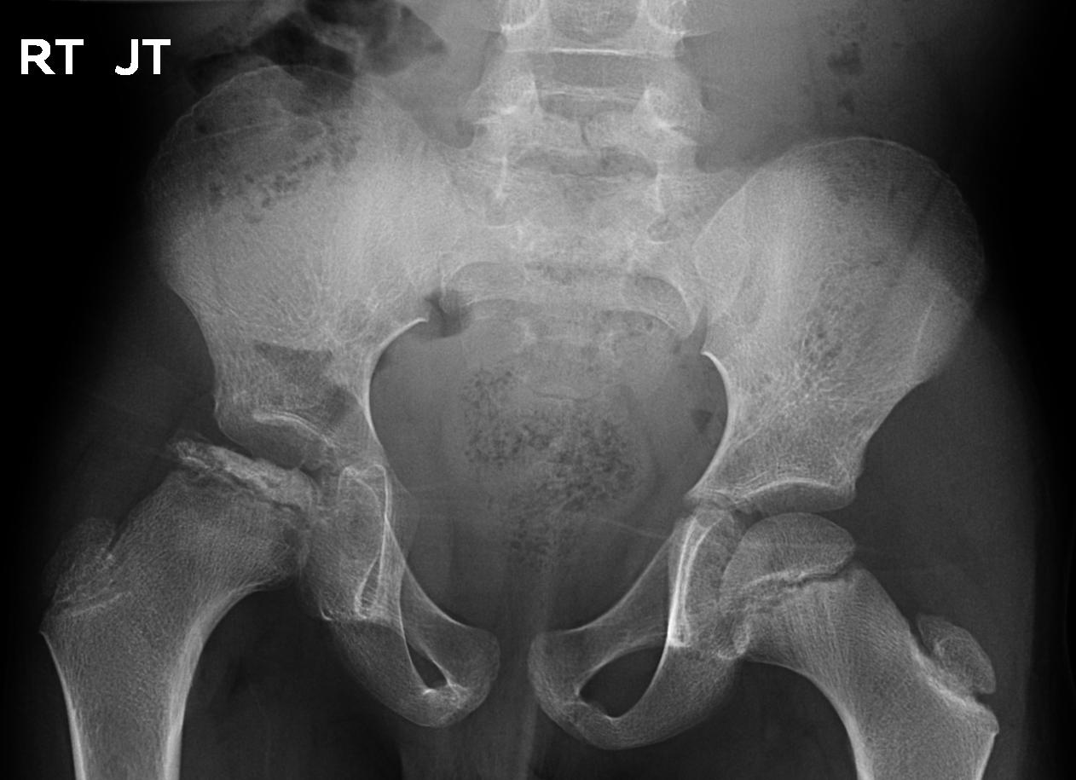
Perthes: early at 6yr, 7yrs fragmentation phase, 12yrs progressive

