Slide 1
RHEUMATOLOGY
Yonit Sterba, MD
Attending, Pediatric Rheumatology
Nicklaus Children’s Pediatric Specialists
Nicklaus Children’s Hospital
Miami, Florida

Slide 2
Disclosure of Relevant Relationship
Dr. Sterba has not had (in the past 24 months) any relevant conflicts of interest or relevant financial relationship with the manufacturers of products or services that will be discussed in this CME activity or in his presentation.
Dr. Sterba will support this presentation and clinical recommendations with the “best available evidence” from medical literature.
Dr. Sterba does not intend to discuss an unapproved/investigative use of a commercial product/device in this presentation.

Slide 3
Topics You Need to Know
Systemic Lupus Erythematosus*
Juvenile Idiopathic Arthritis*
Vasculitis Syndromes (focus on Kawasaki and HSP)*
Dermatomyositis
Scleroderma
Ankylosing Spondylitis
Reactive Arthritis and Post-infectious arthritis
Sarcoidosis
Hypermobility Syndrome
Functional Joint Complaints
Marfan’s
Ehlers-Danlos

Slide 4
Question 1
A 16-year-old girl comes to your office for a follow-up visit from the emergency department, where she went for the acute onset of knee pain and swelling. The emergency department physician had ordered an antinuclear antibody test, which was positive at 1:320. Further history reveals that she has had intermittent joint pains for several weeks and dark-colored urine. Findings on her physical examination are normal except for an effusion in her right knee. You decide that further evaluation for systemic lupus erythematosus (SLE) is warranted.
Of the following, the MOST specific test in helping you make the diagnosis of SLE is:
Lupus anticoagulant
Anti double stranded DNA antibody
Anti-Ro measurement
Complement measurement
VDRL (venereal disease research laboratory)

Slide 5
A 14-year-old girl presents with a 2-month history of joint pain that is responding poorly to over-the-counter anti-inflammatory medications. She reports some sores in her mouth and mild swelling around her eyes and ankles. On physical examination, her temperature is 37.0°C, heart rate is 76 beats/min, respiratory rate is 14 breaths/min, and blood pressure is 130/86 mm Hg. She has oral ulcers, mild periorbital and pretibial edema, and mild swelling of her wrists and knee joints. Laboratory findings include:
Sodium, 136 mEq/L (136 mmol/L)
Potassium, 4.8 mEq/L (4.8 mmol/L)
Chloride, 100 mEq/L (100 mmol/L)
Bicarbonate, 22 mEq/L (22 mmol/L)
Blood urea nitrogen, 24.0 mg/dL (8.6 mmol/L)
Creatinine, 1.3 mg/dL (114.9 mcmol/L)
Albumin, 2.5 g/dL (25.0 g/L)
Hemoglobin, 10.1 g/dL (101.0 g/L)
White blood cell count, 3.0x103/mcL (3.0x109/L)
Platelet count, 190x103/mcL (190x109/L)
Urinalysis: 3+ blood, 3+ protein, with 20 to 50 red blood cells/high-power field
Antinuclear antibody titer: 1:1,280
Anti-double-stranded DNA titer: 1:640
Of the following, the next BEST step in management is to:
A. Admit the patient for intravenous cyclophosphamide treatment
B. Initiate treatment with ibuprofen
C. order a 24-hour urine for protein collection
D. refer the patient for a renal biopsy
E refer the patient for bone marrow aspiration

Slide 6
Systemic Lupus Erythematosus

Slide 7
SYSTEMIC LUPUS ERYTHEMATOSUS Clinical Manifestations
ACR Criteria (4/11 to meet criteria)
“A RASH POINTs MD”
Arthritis
Renal disease
ANA positive
Serositis
Hematologic disorder
Photosensitivity
Oral ulcers
Immunologic disorder
(dsDNA, Anti-Sm, Antiphospholipid Ab)
Neurologic symptoms
Malar rash
Discoid rash

Slide 8
SYSTEMIC LUPUS ERYTHEMATOSUS Clinical Manifestations: Updated Criteria 2019

Slide 9
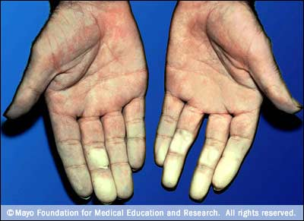

Slide 10
SYSTEMIC LUPUS ERYTHEMATOSUS
Antinuclear Antibody (ANA) and SLE
ANA test is almost 100% SENSITIVE, but NOT SPECIFIC
Approximately 20-30% of healthy children can have positive ANA
ANA’s occur in other autoimmune conditions as well (JIA, scleroderma, Sjogren’s, autoimmune thyroid disease)
Anti dsDNA and Anti Sm tests are SPECIFIC for SLE

Slide 11
SYSTEMIC LUPUS ERYTHEMATOSUS
Course and Complications
Wide spectrum of severity based on organs involved
Lupus nephritis is a common complication
Spectrum of severity
Multiple Classes of lupus nephritis (I-VI)
Renal and Neurologic involvement tend to lead to the most morbidity
Immunosuppression occurs from disease and medications
Following anti-dsDNA and complement levels is helpful in disease management
C3 and C4 levels drop in active disease
Treatment (immunosuppression) is based on systems involved and severity of disease
Hydroxychloroquine for essentially all patients
Prednisone +/- additional immunosuppressive meds based on severity

Slide 12
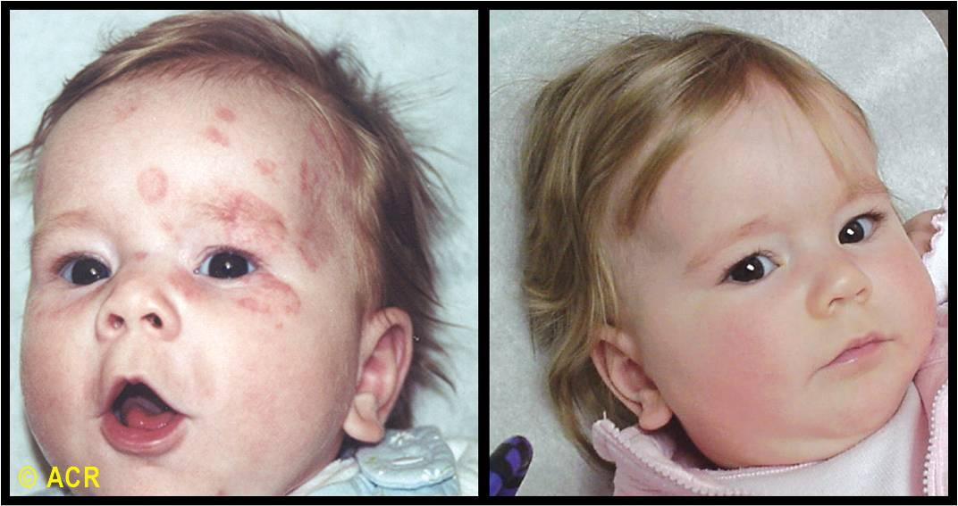
NEONATAL LUPUS
Maternal Anti-Ro (SSA), Anti- La (SSB)
Cross placenta (IgG)
Lead to inflammation/scarring
Clinical Manifestations:
Rash
Thrombocytopenia
Heart Block
Treatment:
Rash and Thrombocytopenia self resolve
Cardiac pacing for complete heart block

Slide 13
You treat a 15-year-old girl in your practice who has juvenile idiopathic arthritis (JIA). She is brought in by her mother today with complaints of a low-grade fever and diffuse pain. On physical examination, she has a temperature of 38.0°C and a heart rate of 100 beats/minute. As she sits on the examination table, she leans forward. During auscultation of her lungs, she complains of pain with deep inspiration.
Of the following, the MOST likely explanation for her symptoms is:
a) Costochondritis
b) Gastritis
c) Pericarditis
d) Pneumonia
e) Pulmonary Embolism

Slide 14
Juvenile Idiopathic Arthritis

Slide 15
Juvenile Idiopathic Arthritis
Definition
Arthritis of UNKNOWN ETIOLOGY
Lasting 6 weeks or more
Occurring in child <16
Other causes investigated and ruled out
Differential Diagnosis
Infectious arthritis
Septic Arthritis
Viral Arthritis
Post infectious reactive arthritis
Acute Rheumatic Fever
Post Strep Reactive Arthritis
Reactive Arthritis (formerly “Reiters”)
Lyme disease
Malignancy
Leukemia
Neuroblastoma
Hemophilia
Mucopolysaccaroidosis

Slide 16
Juvenile Idiopathic Arthritis

Slide 17
Juvenile Idiopathic Arthritis
JIA SUBTYPE | # joints involved | Distinguishing features
Systemic | any | Fever, rash, adenopathy, serositis, splenomegaly, cytopenias
Oligoarticular | 4 or fewer | Younger age, female predominance, highest UVEITIS risk
Polyarticular | 5 or greater | Slightly older age
Enthesitis Related | any | Male predominance, HLA B27 positivity, included ankylosing spondylitis, relationship with IBD
Psoriatic | Any | +/- psoriasis, dactylitis, spondylitis
Undifferentiated | any | Satisfies none or multiple categories

Slide 18
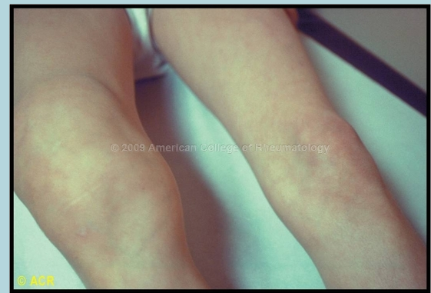
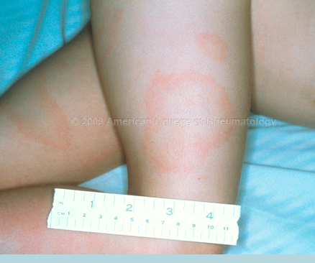
Other important causes of arthritis
Lyme Arthritis
ALWAYS on the differential of monoarthritis
Most commonly affects the knee
Late manifestation of lyme disease (think months later)
Most likely will never have noticed any tick bite or ECM rash
Understand early vs. late manifestations
Diagnosis based on serology with confirmatory western blot
Treatment: 4 weeks antibiotics (Doxy or Amox based on age)

Slide 19
Other important causes of arthritis
Acute Rheumatic Fever vs. Post Strep Reactive Arthritis
Know JONES criteria!
Very painful arthritis, can mimic septic arthritis
VERY responsive to NSAIDs
No debate about the importance of penicillin prohpylaxis
Doesn’t meet JONES criteria
Less painful arthritis, more persistent, non-migratory
NOT really responsive to NSAIDs
Most people prophylax for some period of time

Slide 20
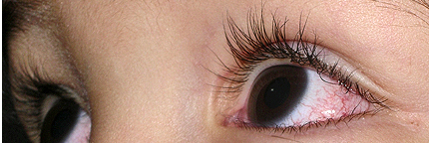
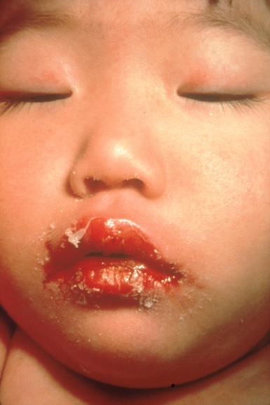
An 18-month-old boy is brought to the clinic with fever and irritability. His mother explains that he has had a fever for the past week and a red rash on his extremities. On physical examination, he has a temperature of 39.2°C; he is irritable; his eyes are injected without discharge (Item Q197A); and his lips are dry, red, and cracked (Item Q197B). All other findings are within normal limits. Of the following, the MOST appropriate next step in this patient's care is to
A) administer intravenous antibiotics
B) administer intravenous gamma globulin
C) obtain blood cultures
D) obtain electrocardiography
E) perform a lumbar puncture and culture the cerebrospinal fluid

Slide 21
Vasculitis

Slide 22
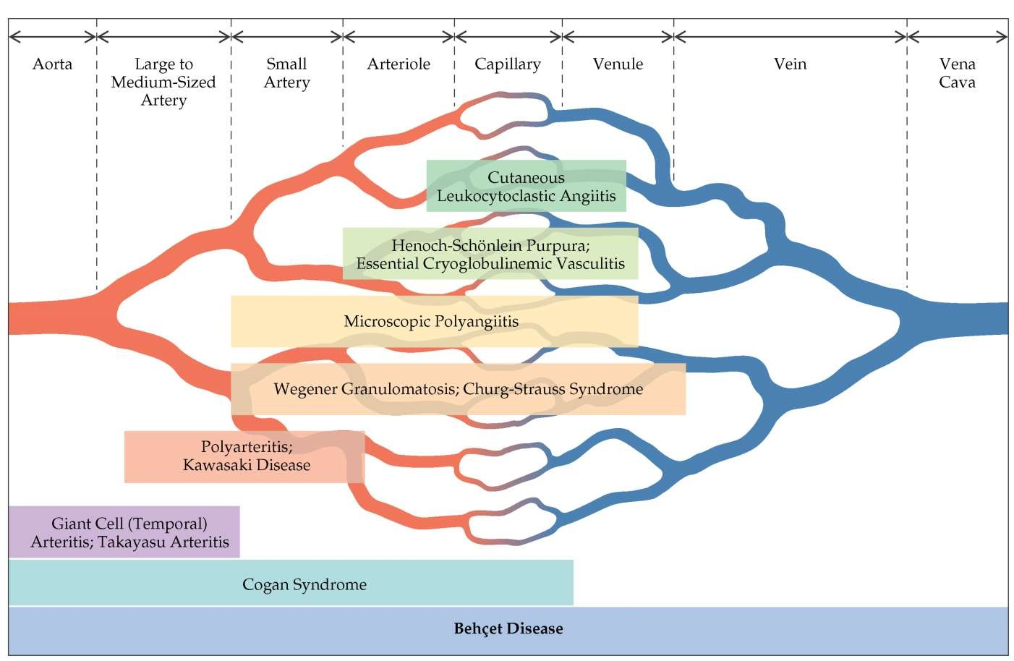
Vasculitis
HSP and Kawasaki:
-most common vasculitides in childood
-usually acute, self limited illnesses

Slide 23
Kawasaki Disease
Clinical Manifestations:
Most commonly young child (toddler age)
Must have at least 5 days of fever + 4/5:
- Cervical adenopathy (≥1.5cm)
- Mucous membrane changes (dry, cracked lips or “strawberry tongue”)
- Conjunctivitis (“limbic sparing”)
- Rash (basically any type)
- Extremity changes (edema, desquamation)
Lab findings:
sterile pyuria
Elevated acute phase reactants (can remain high for weeks)
Thrombocytosis
Leukocytsosis

Slide 24
Kawasaki Disease
DDX:
Infection
Systemic JIA
Immune/Drug reaction
Serum Sickness
Other vasculitis (PAN)

Slide 25
Kawasaki Disease
Treatment:
Goals: avoid cardiac complications and calm ongoing inflammation
Don’t need definitive diagnosis to start treatment
Ideally IVIG + Aspirin before within first 10 days of illness
IVIG: 2mg/kg (can give repeat dose)
Aspirin 80-100mg/kg/day for 24-48 hours
Low dose aspirin (3-5mg/kg/day until ESR&CRP normalize)
Lifetime aspirin if coronary aneurysm present
ECHO: Baseline
Follow up at 2-3 weeks
Follow up at 6-8 weeks

Slide 26
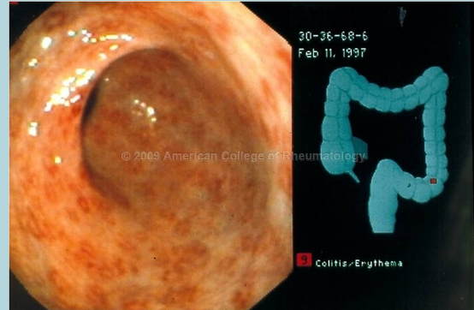
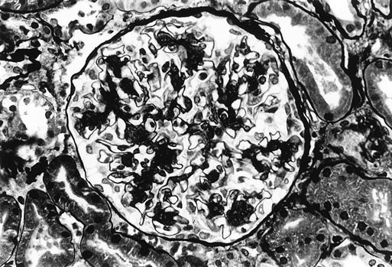
Henoch-Schonlein Pupura (HSP)
Clinical Manifestations:
Skin:
palpable purpura
rash 1st feature only ¾ patients
Lower legs/buttock mostly (dependent area)
Joints:
Arthritis
Arthralgia
Periarticular swelling
May refuse to ambulate, especially young kids
GI Tract:
Abdominal pain*
Intussusception: ileo-ileal
Guaiac positive stool common
Renal:
Microscopic hematuria +/- proteinuria
Gross hematuria and nephrotic range proteinuria less common

Slide 27
Henoch-Schonlein Pupura (HSP)
Diagnosis
Usually clinical
Skin biopsy
usually reserved for atypical presentation
IgA deposition in post-capillary venules
Pathology described as “leukocytoclastic vasculitis”
Treatment and Prognosis
Mostly supportive care
Hospitalization: severe abdominal pain or PO intolerance, severe joint involvement, intussusception or GI bleeding, severe renal involvement
NSAIDs for pain control (unless severe GI or Renal involvement)
Steroids reserved for significant abdominal pain (doesn’t prevent renal disease
Prognosis generally very good
Small % patient go on to long term kidney disease
Monthly BP checks and U/A for 6 month after diagnosis!

Slide 28
Dermatomyositis

Slide 29
Dermatomyosits
Clinical Manifestations:
Typically school age child
Skin findings:
Heliotrope rash “violacious rash to eyelids or face”
Gottron’s papules “erythematous papules on extensor surfaces”
Nailfold changes
Lipodystrophy
Proximal muscle weakness
Difficulty with stairs, brushing hair, getting on the bus
Voice changes or dysphagia***
These are worrisome signs of pharyngeal muscle involvement
Risk of aspiration
Calcinosis
Deposition of calcium substances in soft tissues

Slide 30
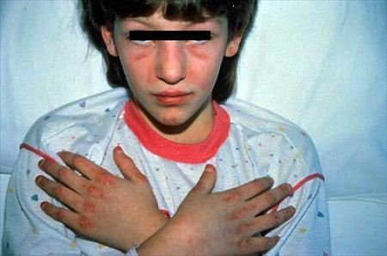
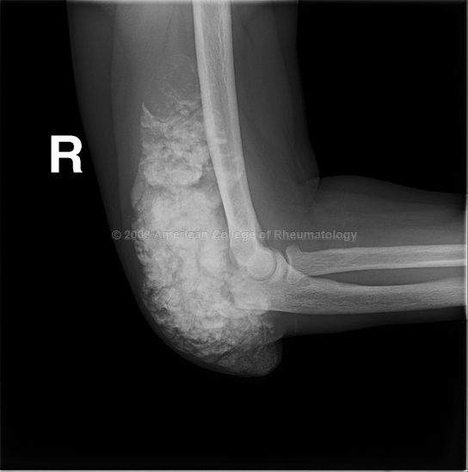
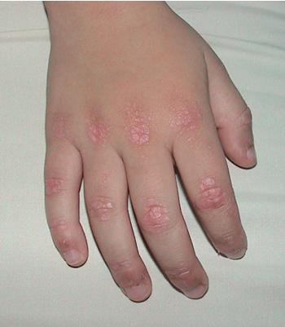
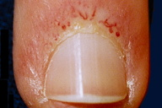
Dermatomyositis

Slide 31
Dermatomyositis
Treatment:
High dose steroids
IVIG
Methotrexate
Polymyositis vs Dermatomyositis : NO RASH in PM
Muscle sx very similar
PM super rare in kids
No increased risk of malignancy in juvenile dermatomyositis (like there is in adults)

Slide 32
Scleroderma

Slide 33
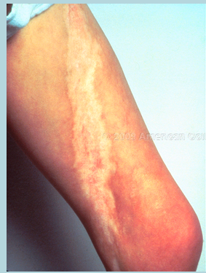
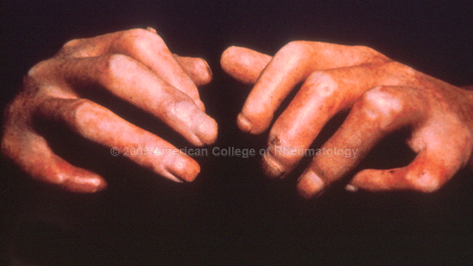
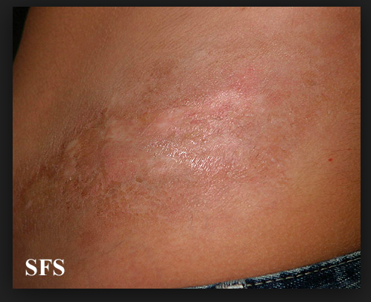
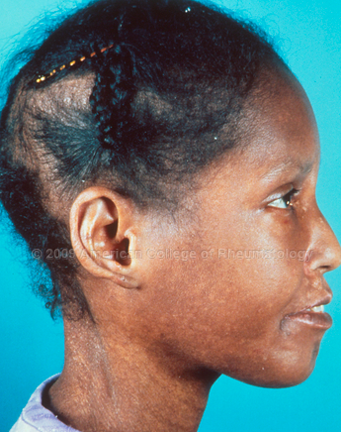
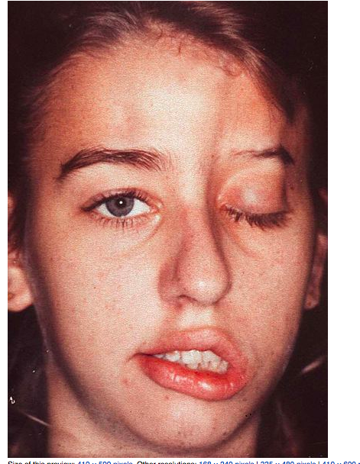
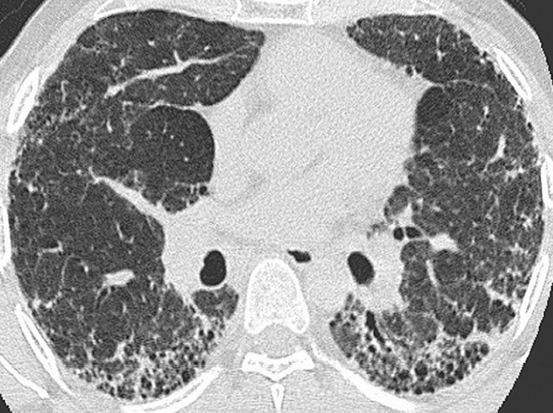
Scleroderma
Localized Scleroderma
Linear morphea
Circumscribed morphea
Generalized morphea
Mixed
En Coup de Sabre
Systemic Sclerosis
Limited Diffuse
(formerly CREST)

Slide 34
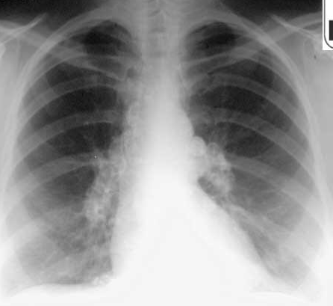
A previously healthy 11-year-old girl has had a dry hacking cough for 3 months associated with fatigue, occasional fevers (temperature of 38.4°C), and a 4-kg weight loss. On physical examination, the tired-appearing child has multiple firm, non-tender posterior cervical, axillary, and inguinal nodes; her respiratory rate is slightly elevated; and she has occasional wheezes. Small nodules are visible along the iris-pupil margin, and an ophthalmologist recently diagnosed anterior uveitis. Laboratory findings of note include:
Hemoglobin, 10.9 g/dL (109 g/L)
White blood cell count, 16.0x103/mcL (16.0x109/L)
Erythrocyte sedimentation rate, 32 mm/hr
Calcium, 12.3 mg/dL (3.1 mmol/L)
Serum angiotensin converting enzyme, 110 units/L (normal, 5 to 89 units/L)
A purified protein derivative test is negative. Chest radiography shows bilateral hilar adenopathy but no obvious parenchymal disease (Item Q227).
Of the following, the MOST useful test(s) for establishing the diagnosis is(are):
A) ANA and Rheumatoid Factor
B) Bone marrow biopsy
C) EBV serology
D) Immunofluorescence and ELISA for mycoplasma pneumonia
E) Lymph node biopsy

Slide 35
Sarcoidosis

Slide 36
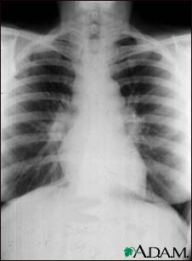
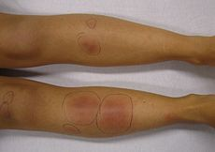
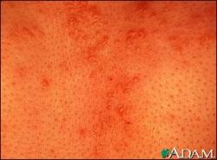
Sarcoidosis
Systemic granulomatous disease
Non-caseating granulomas
More common in African Americans
Can affect just about any system: Most commonly
General: weight loss, fatigue, malaise
Skin: E. nodosum, rash, nodules
Eyes: uveitis, scleritis, nodules
Lungs: cough, chest pain, dyspnea, abnormal PFT’s
Lymphadenopathy
Also can have cardiac, neuro, endocrine invlolvement
In kids more often: rash, arthritis, uveitis
Labs: Elevated ACE, elevated Ig’s, hypercalciuria, hypercalcemia

Slide 37
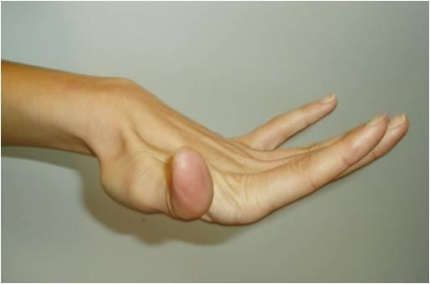
A 3-year-old boy is brought to the clinic by his parents due to concerns about how easily he bruises. They say that since he began walking at 18 months, he frequently has large, purple bruises that appear with no known history of trauma. They do not believe that he falls more frequently than other children his age, and they deny a family history of easy bruising. On physical examination, the normally grown child has prominent eyes, a delicate and narrow nose, and numerous bruises in various stages of healing, primarily overlying his shins but also scattered elsewhere on his body. He has translucent skin over the chest, with prominent vascular markings, and his fingers are slender and hypermobile (Item Q39B).
Of the following, the condition that is MOST consistent with this boy's features is
A) Ehlers Danlos
B) Hemophilia A
C) Von Wilibrand disease
D) Stickler’s
E) Marfan’s

Slide 38
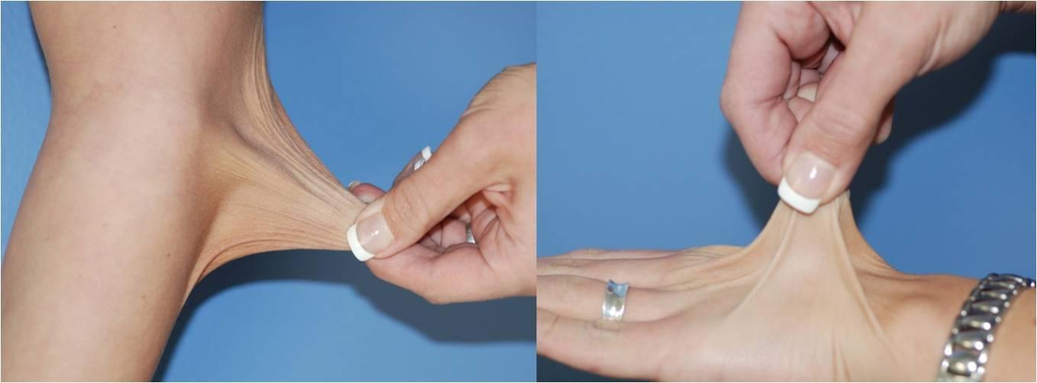
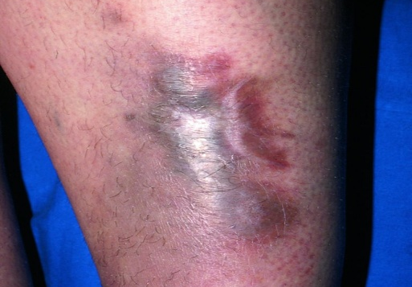
Ehlers Danlos
Multiple subtypes
Etiology: genetic defects in collagen or collagen modifier genes
Clinical Features:
- Joint hypermobility
- Skin extensibility
- Wide atrophic scars (“cigarette paper scars”)
- Easy bruising
Diagnosis
Genetic testing
Collagen analysis (skin biopsy)

Slide 39
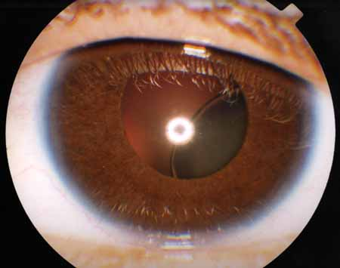
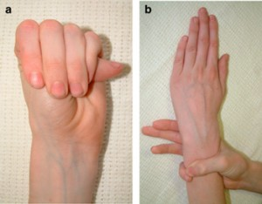
Marfan Syndrome
Variable severity
Etiology: genetic defects in Fibrillin 1 gene
Fibrillin 1 expressed in skin, heart, muscle, cornea, bone, lungs, kidney and vasculature
Clinical Features:
- Tall stature
- Joint hypermobility
- Kyphoscoliosis
High arched palate
Lens dislocation (ectopia lentis)
- Pectus carinatum or excavatum
*Cardiac*: aortic root dilation, MV prolapse, conduction defects
Skin: striae
Diagnosis:
- clinical scoring system
- genetic testing

Slide 40
A 6-year-old boy complains of achy pain in his lower legs about 1-2 times per night per week that is relieved with massage and heat. He has had no fever, rash, fatigue, joint swelling, weight loss, or other systemic symptoms. The pain is always better in the morning, and he remains very active. He has had no unusual or compulsive leg movements associated with the pain. Findings on physical examination, including thorough joint, muscle, and neurologic evaluation, are normal. Of the following, the MOST appropriate next step in the care of this child is to:
A) Obtain a bone scan
B) Obtain CBC,ESR,RF
C) Prescribe Calcium and Vit D
D) Prescribe muscle stretching, analgesia and warmth
E) Refer to orthopedist

Slide 41
What if the question said he gets pain in one leg, worse at night that sometimes wakes him from sleep and is always relieved with an NSAID?
Think osteoid osteoma

Slide 42
Benign Causes of Joint Pain
Joint complaints are very common in childhood
85% of children asked at a well visit will say they have joint pain
Always look for red flags: night waking, unilateral pain, no relief with simple measure, growth disturbance
Think of:
Hypermobility syndrome
“Benign joint pains”
Growing pains
Usually reassurance to child and parent that it will improve with time if sufficient treatment. PRN NSAID ok too.

Slide 43
Don’t worry, the boards are a walk in the park!

