Slide 1
METABOLISM
Sajel Lala Kana, MD FAAP FACMG
Attending, Genetics & Metabolism
Nicklaus Children’s Pediatric Specialists
Nicklaus Children’s Hospital
Miami, Florida

Slide 2
Disclosure of Relevant Relationship
Dr. Lala Kana (or spouse/partner) has not had (in the past 12 months) any conflicts of interest to resolve or relevant financial relationship with the manufacturers of products or services that will be discussed in this CME activity or in his presentation.
Dr. Lala Kana will support this presentation and clinical recommendations with the “best available evidence” from medical literature.
Dr. Lala Kana does not intend to discuss an unapproved/investigative use of a commercial product/device in this presentation.

Slide 3
OVERVIEW OF METABOLIC DISORDERS
Classification
Clinical presentation
Newborn screen
Common metabolic disorders
Principles of treatment

Slide 4
CLINICAL PRESENTATION
Overwhelming illness in the neonatal period
Vomiting (?pyloric stenosis)
Acute acidosis, anion gap (ORGANIC ACIDEMIA)
Massive ketosis
Hypoglycemia (FATTY ACID OXIDATION DEFECTS, HYPERINSULINISM)
Coagulopathy
Coma
Seizures, especially myoclonic
Chronic hiccups (NON KETOTIC HYPERGLYCINEMIA)
Unusual odor (MSUD)
Extensive dermatosis (especially monilial)
Family history of siblings dying early
Notes:
Monilial = yeast

Slide 5
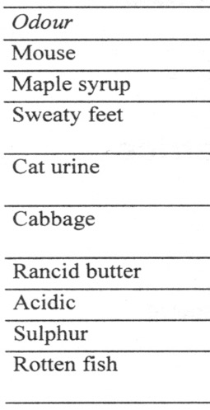
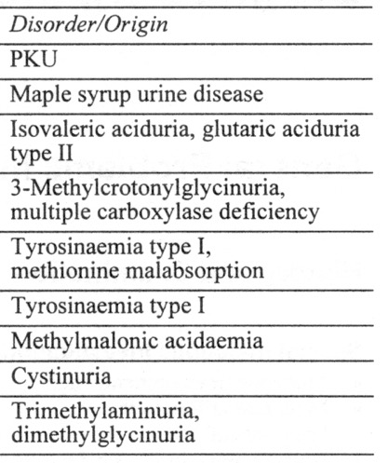
URINE AND BODY ODORS

Slide 6
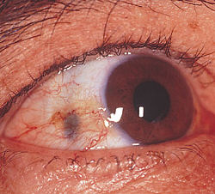
URINE COLOR
COLOR | SUBSTANCE | DISORDER
BROWN | MET-HB | MYOGLOBINURIA
BLUE | INDICAL | HARTNUP
RED | RBC, RED BEET, PORPHYRINS | HEMATURIA, FOOD, PORPHYRIA
BROWN | HOMOGENTISATE | ALKAPTONURIA
Ochronosis
Notes:
Ochronosis = accumulation of homogentisic acid in tissues

Slide 7
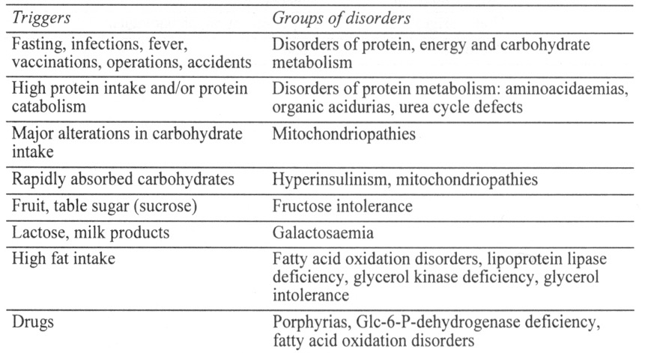
SPECIFIC TRIGGERS OF
METABOLIC DECOMPENSATION

Slide 8
LABORATORY SCREENING TESTS
Lactate
Ammonia
Plasma Amino Acids
Urinary Organic Acids /Urine Acylglycines
Acylcarnitine Profile
Carnitine
Biotinidase

Slide 9
EXPANDED NEWBORN SCREENING
Detect presymptomatic
Reduce mortality/morbidity

Slide 10
NORMAL DEVELOPMENT
AT 5 MONTHS
NEUROREGRESSION
DX’ed WITH GLUTARIC ACIDURIA 1

Slide 11
DISORDERS RECOMMENDED FOR NEWBORN SCREENING USING TANDEM MASS SPECTROMETRY
Amino acidemias
PKU
MSUD
HCY
ASA
Citrulinemia
Tyrosinemia I and II
Organic Acidemias
PA
IVA
3-MCCD
HMG
SKAT
GA 1
MMA
MCD
Fatty acid oxidation defects
Carnitine metabolism (CAT, CUD, CPTI and II)
SCAD
GAII/MADD
MCAD
LCHAD
TFP
VLCAD
Endocrine Disorders
CAH
CH
Enzyme disorders:
GALT
BIOT
Hemoglobinopathies
Hgb SC, BARTS, Sickle B thal.
False positives- parental nutrition, antibiotics False negatives- rare, enzyme immaturity

Slide 12
Newborn screen
Normal
Symptoms Persist
Genetic consult
No symptoms
Abnormal
Confirmatory test
Negative
Reassure
Positive
Heterozygous
Counsel
Disease
Management
Genetic consult

Slide 13
OVERVIEW OF METABOLIC DISORDERS
Classification
Clinical presentation
Newborn screen
Common metabolic disorders
Principles of treatment

Slide 14
AMINO ACIDOPATHIES

Slide 15
PHENYLKETONURIA (PKU)
1:10000 (Caucasians)
Deficiency of phenylalanine hydroxylase (PAH)
Sx:
Developmental delay
Seizures
Eczema
Microcephaly
Dx:
Classic PKU - phenylalanine levels >20
Hyperphenylalanemia - phenylalanine levels 2-20
Tx:
Low phenylalanine diet (lifelong)
Palynziq injections – pegvaliase-pqpz (phe metabolizing enzyme)

Slide 16
PHENYLKETONURIA: MATERNAL PKU
Teratogenic effects on the fetus from maternally-elevated phenylalanine (mother not on diet)
Microcephaly, cleft lip/palate, congenital heart defects, and IUGR
Dietary management/treatment must begin prior to conception

Slide 17
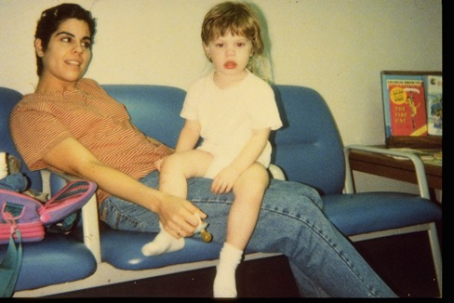
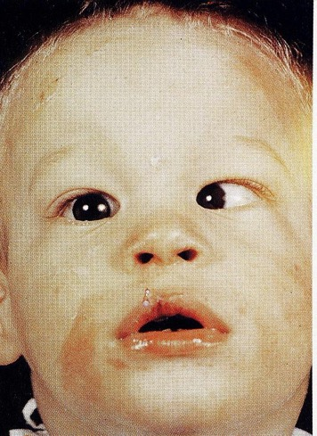
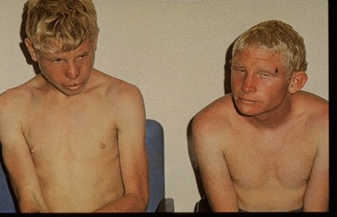
UNTREATED PKU
TREATED PKU
strabismus
Blond hair
Eczema

Slide 18
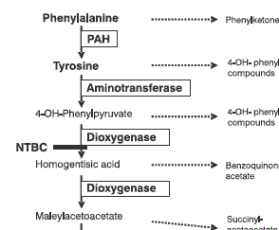
TYROSINEMIA TYPE I
1:110000 live births
Deficiency of fumarylacetoacetase hydrolase (FAH)
Sx:
Liver, Kidney, Skeletal (rickets), Neurologic abnormalities
40% hepatic carcinoma by 5 years
Dx:
PAA - increased Tyrosine
NBS: Succinylacetone +
Tx:
NTBC
Low phenylalanine
Low tyrosine diet
Notes:
Liver: failure, cirrhosis, ascites, coagulopathy, fasting intolerance
Kidney: enlargement, dysfunction (renal Fanconi syndrome)
Skeletal: rickets
Neurologic: crises secondary to porphyria disturbances
Hepatic: carcinoma (40% by 5 years)

Slide 19
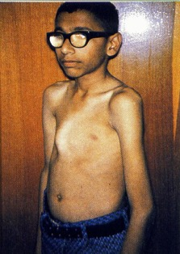
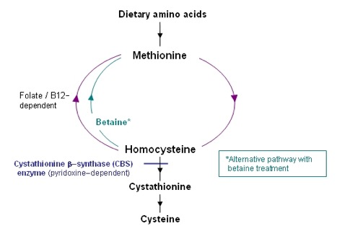
HOMOCYSTINURIA
1:300000 live births
Deficiency of cystathione B synthetase
Sx:
Marfanoid: unusually tall, long limbs/arachnodactyly, pectus, osteoporosis, scoliosis, myopia, dislocated lenses, ID, psych abnormalities, seizures, thromboembolism
Dx:
Plasma amino acids - increased methionine
Increased homocysteine
Tx:
B6, B12, folate, betaine, Methionine restriction
Notes:
Betaine = methyl donor (trimethylglycine)

Slide 20
ORGANIC ACIDEMIAS

Slide 21
ORGANIC ACIDEMIAS
~1:100000 live births
Sx:
1st week: poor feeding, vomiting, lethargy, hypotonia, metabolic acidosis (HIGH AG)
Later onset: lethargy, vomiting, FTT, seizures, acute metabolic decompensation associated with intercurrent illness
Cerebral OA (GA1) – later onset
Hyperammonemia
Metabolic acidosis (HIGH anion gap)
BM suppression, dehydration
Dx:
Acylcarnitine profile + Urine Organic Acids
Tx:
Stop insult (PROTEIN)
Divert metabolism from protein to carb/fat (high glucose, high lipid!)
Fix source of catabolism (ex. infection, trauma, surgery)
Ammonia scavengers

Slide 22
UREA CYCLE DISORDERS

Slide 23
UREA CYCLE DEFECTS
1:30000 live births
Sx:
1st week: poor feeding, tachypnea, vomiting, lethargy (hyperammonemia)
Seizures
Neonatal coma
Dx:
Hyperammonemia
Respiratory alkalosis
Absence of ketoacidosis
Normal/low BUN
Tx:
Stop insult (PROTEIN)
Divert metabolism from protein to carb/fat (high glucose, high lipid!)
Ammonia scavengers

Slide 24
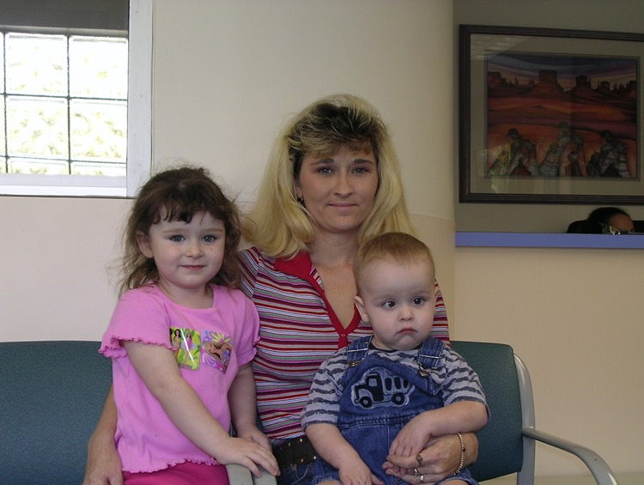
OTC – X-LINKED!
Carrier OTC
Normal
OTC- post Liver Transplant

Slide 25
CAUSES OF HYPERAMMONEMIA
Urea cycle defects
Organic acid abnormalities
Fatty acid oxidation defects - MCAD/LCHAD
Mitochondrial - pyruvate dehydrogenase deficiency

Slide 26
FATTY ACID OXIDATION DEFECTS

Slide 27
FATTY ACID OXIDATION DEFECTS
Clinical:
Hypoglycemia
Liver dysfunction
Recurrent vomiting, lethargy, coma
SIDS/Reyes like episodes
Cardiomyopathy
Myoglobinuria
HELLP Syndrome in mothers and LCHAD in babies
Biochemical:
Hypoketotic hypoglycemia
Low carnitine
Abnormal organic acids, acylcarnitines, acylglycines
+/- Hyperammonemia
Treatment:
Carnitine
Low fat diet
Avoid fasting

Slide 28
FATTY ACID OXIDATION DEFECTS
MCAD- NBS diagnosis
VLCAD- Diagnosed at 16 months

Slide 29
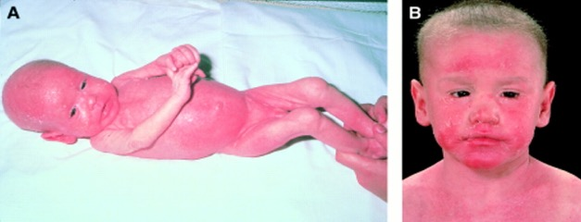
BIOTINIDASE DEFICIENCY
Treated
Sx:
Seizures, hypotonia, ataxia
Developmental delay
Vision problems, hearing loss
Cutaneous abnormalities (e.g., alopecia, skin rash, candidiasis)
Older children and adolescents:
Motor limb weakness, spastic paresis, and decreased visual acuity
Untreated

Slide 30
CANAVAN DISEASE
AR; 1:40 carrier frequency (Ashkenazi Jewish; 3 mutations ~98% of alleles)
Sx:
Progressive leukodystrophy, macrocephaly, ID, seizures, optic atrophy
Dx:
Increased urinary NAA
Tx:
Symptomatic
Notes:
N-acetylaspartic acid

Slide 31
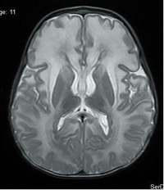
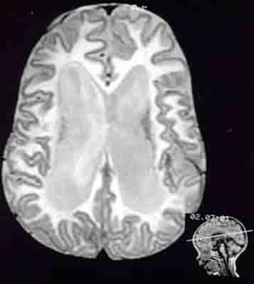
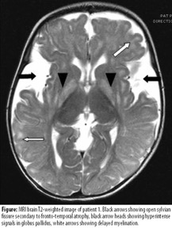
CAUSES OF MACROCEPHALY
Alexanders disease
L-2 hydroxyglutaric aciduria
Canavan
Glutaric aciduria- 1
Canavan- demyelination with diffuse white matter changes

Slide 32
PEROXISOMAL DISORDERS
Zellweger (Increased VLCFA)
Neonatal Adrenoleukodystrophy (increased VLCFA)
Refsum (Increased phytanic acid)

Slide 33
CARBOHYDRATE METABOLISM

Slide 34
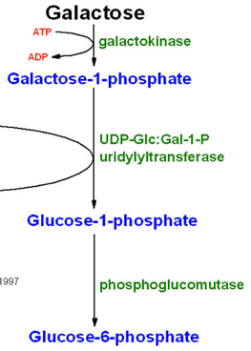
GALACTOSEMIA
Autosomal recessive
Gal-1-P-uridyl transferase (GALT) deficiency
Sx:
Vomiting, diarrhea, liver disease, cataracts, E coli sepsis, infertility, speech delay
Hyperchloremic metabolic acidosis
Dx: Gal-1-P RBC, galactosuria
Tx:
Lactose-free diet

Slide 35
CAUSES OF CATARACTS
Galactosemia
Homocystinuria
Fabry disease
Lowe syndrome
Zellweger syndrome

Slide 36
GLYCOGEN STORAGE DISEASE TYPE I (VON GIERKE)
Hepatic glucose-6-phosphatase deficiency
Sx:
Hypoglycemia in early infancy
Protuberant abdomen due to (hepatomegaly)
Doll's facies or cherubic face
Dx:
Liver biopsy for enzyme activity
DNA analysis
Tx:
Frequent feeds
Raw cornstarch (older kids)
Nocturnal glucose infusions

Slide 37
GLYCOGEN STORAGE DISEASE TYPE 2 (POMPE)
Acid maltase deficiency
Sx:
Cardiomegaly, increased CPK, macroglossia Hypotonia
EKG:
Short PR interval, large QRS complex
Tx:
Enzyme replacement- Myozyme

Slide 38
CAUSES OF CARDIOMYOPATHY
Pompe
Glycogen storage type 3
Fatty acid oxidation defects
Mucopolysaccharidosis

Slide 39
LYSOSOMAL STORAGE DISORDERS

Slide 40
DYSMORPHIC FEATURES
Coarse Facial Features
Dysostosis Multiplex
High forehead
Open and wide fontanel Upslanting eyes ‘Down’s Like’ Picture, FTT
Pudgy cheeks seizures, pili torti progressive CNS deficits, wormian bones
Inv nipples, unusual
fat pads, hypotonia Seizures
Hepatomegaly
Cerebellar atrophy
Microcephaly anteverted nares ptosis, 2-3 syndactyly ambigous genitalia
Lysosomal Storage Disease
Carbohydrate Deficient Glycoprotein Syndrome
Disorders of Sterol Synthesis
Peroxisomal Disorders
Menke’s Disease
Urine for MPS
Urine for Oligosaccharides
Cholesterol &
7 dehydrocholesterol
VLCFA
Copper
Cerruloplasmin
Isoelectric Focusing of Transferrin
MPS – Mucopolysaccharidosis
VLCFA – Very Long Chain Fatty Acids
Notes:
A

Slide 41
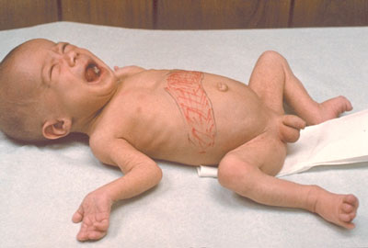
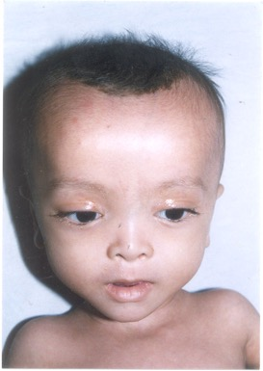
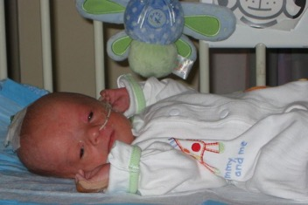
DYSMORPHIC FEATURES
HIGH FOREHEAD
OPEN AND WIDE FONTANEL UPSLANTING PALPEBRAL FISSURES
FTT, SEIZURES
GLAUCOMA, RETINAL DEGENERATION IMPAIRED HEARING
PEROXISOMAL DISORDERS
ZELLWEGER SYNDROME
INCREASED VLCFA

Slide 42
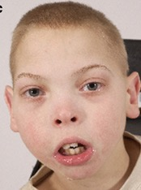
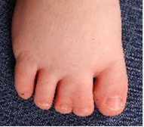
DYSMORPHIC FEATURES
Microcephaly anteverted nares ptosis, 2-3 syndactyly ambigous genitalia
Disorders of Sterol Synthesis
Cholesterol &
7-dehydrocholesterol

Slide 43
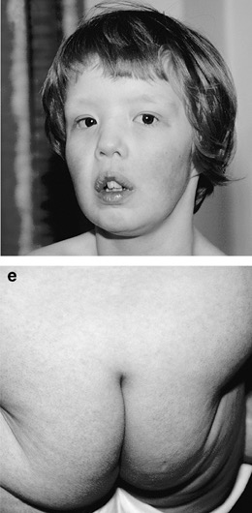
DYSMORPHIC FEATURES
INV NIPPLES, UNUSUAL
FAT PADS, HYPOTONIA SEIZURES
HEPATOMEGALY
CEREBELLAR ATROPHY
CARBOHYDRATE DEFICIENT GLYCOPROTEIN SYNDROME
ISOELECTRIC FOCUSING OF TRANSFERRIN

Slide 44
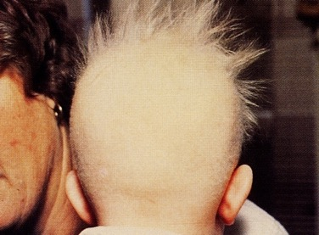
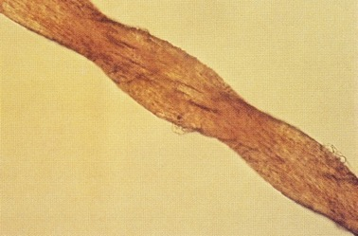
DYSMORPHIC FEATURES
PUDGY CHEEKS SEIZURES, PILI TORTI PROGRESSIVE CNS DEFICITS, HYPOTONIA, WORMIAN BONES, SUBDURAL HEMATOMA
Kinky Hair
MENKE’S DISEASE
X-LINKED RECESSIVE
Pili torti
LOW COPPER
LOW CERRULOPLASMIN

Slide 45
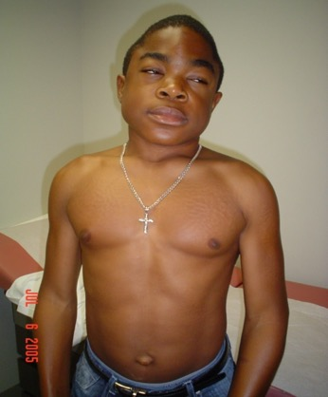
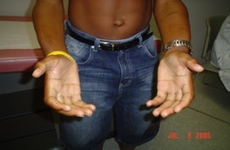
DYSMORPHIC FEATURES
COARSE FACIAL FEATURES
DYSOSTOSIS MULTIPLEX
LYSOSOMAL STORAGE DISEASE
URINE FOR MPS
URINE FOR OLIGOSACCHARIDES

Slide 46
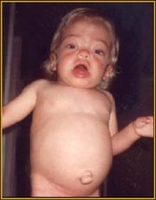
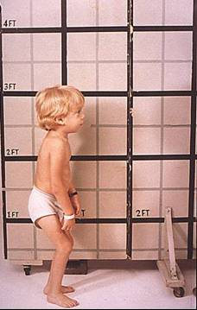
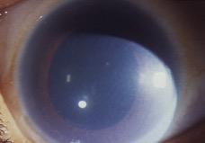
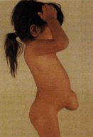
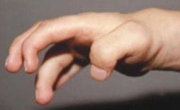
HURLER SYNDROME (MPS I)
Autosomal recessive
Iduronidase deficiency
Sx:
Corneal clouding
Intellectual disability
Coarse Facies
Dysostosis multiplex
Dx:
Dermatan sulfate + Heparin sulfate - urine
Tx:
ERT
Hepatosplenomegaly²
Short stature²
Corneal clouding³
Skeletal deformities (Gibbus)¹
Umbilical/inguinal hernia³
Carpal tunnel syndrome²
Notes:
This slide depicts some of the more overt signs and symptoms of MPS I. Ideally, a diagnosis should be made and treatment initiated prior to the development of these signs and symptoms, as they are generally irreversible.
Patients at the severe end of the spectrum demonstrate skeletal manifestations of MPS I early in life, by about 6 months of age. At that time, it is common to observe mild bone abnormalities (detected by radiological methods), particularly within the hip; ovoid vertebrae; and widening of the ribs. At the clinical level, skeletal involvement does not become obvious until the age of 10 to 14 months, when a gibbus deformity of the back, or dorsolumbar kyphosis, is observed in severely affected patients. The joints may become stiffened by the age of 2 years and progressive arthropathy affects all joints. Reduced range of motion of virtually all joints is present to some degree. In addition, infiltration of the joints causes stiffness and pain. The hands take on a characteristic claw deformity resulting from both phalangeal dysostosis and synovial thickening. Carpal tunnel syndrome and other nerve entrapments or nerve compressions are common in many patients with MPS I. Most patients lack typical symptoms until severe compression occurs, making early diagnosis of carpal tunnel syndrome challenging. Eventually, progressive skeletal dysplasia involving all bones is seen in all types of MPS I. The enlarged liver and spleen, in addition to abnormal connective tissue, may cause hernias to develop. Inguinal and umbilical hernias are common in MPS I. They are occasionally present at birth or develop within the first several months of life, and are often one of the first clinical signs noted. It is important to check the liver and spleen of a child that presents with a hernia or protruding abdomen. Also as a result of GAG storage, progressive corneal clouding is common in MPS I, and can begin as early as the first year of life. Clouding of the cornea has a ground-glass appearance and may lead to blindness. Other common ocular problems include retinal degeneration, which results in decreased peripheral vision and night blindness, glaucoma, and optic nerve disease that may lead to blindness.
Clarke LA. Clinical diagnosis of lysosomal storage diseases. In: Applegarth DA, Dimmick JE, Hall JG, eds. Organelle Diseases: Clinical Features, Diagnosis, Pathogenesis and Management. London, England: Chapman and Hall Medical; 1997:37.
Cleary MA, Wraith JE. The presenting features of mucopolysaccharidosis type 1H (Hurler syndrome). Acta Paediatr. 1995;84:337.
Neufeld EF, Muenzer J. The mucopolysaccharidoses. In: Scriver C, Beaudet A, Sly W, Valle D, eds. The Metabolic and Molecular Bases of Inherited Disease. New York, NY: McGraw-Hill; 2001:3421-3452.

Slide 47
HUNTER SYNDROME (MPS II)
X-linked recessive
Iduronate sulphatase deficiency
Sx:
NO corneal clouding
Intellectual disability
Coarse Facies
Dysostosis multiplex
Dx:
Dermatan sulfate + Heparin sulfate - urine
Tx:
Elaprase (ERT)

Slide 48
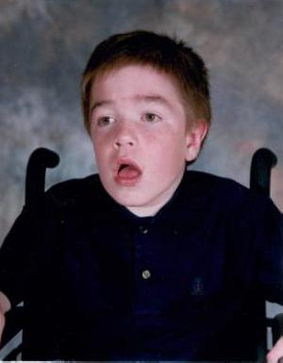
SANFILIPPO (MPS III)
Autosomal recessive
Many “flavors” (IIIA, IIIB, IIIC, IIID)
Sx:
Intellectual disability
ADHD
Sleep disturbance
Severe behavior problems
Mild skeletal changes
Dx:
Heparan sulfate – urine
Tx:
ERT
Gene therapy
Notes:
- Four clinically indistinguishable biochemically distinct forms

Slide 49
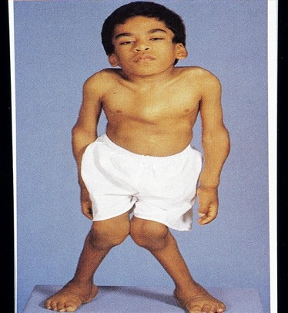
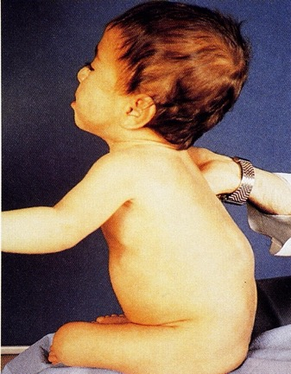
MORQUIO SYNDROME (MPS IV)
Autosomal recessive
Many “flavors” (A, B, C)
Sx:
Short trunk dwarfism
Valvular heart disease
Odontoid hypoplasia
Normal intelligence
Dx:
Keratin sulfate - urine
Tx:
ERT
cloudy cornea
knock knees
odontoid hypoplasia
Kyphosis

Slide 50
MAROTEAUX-LAMY SYNDROME (MPS VI)
Arylsulphatase B deficiency
Sx:
Growth arrest - 1-3 years
Corneal clouding
Coarse facies
Joint stiffness
Dysostosis multiplex
Valvular heart disease
NORMAL intelligence
Dx:
Dermatan sulfate - urine
Tx:
ERT

Slide 51
SLY SYNDROME - MPS VII
B-glucuronidase deficiency
Sx:
Prenatal onset hydrops/ascites
Severe intellectual disability
Corneal clouding
Hepatosplenomegaly
Skeletal changes

Slide 52
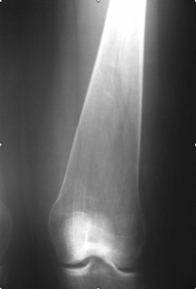
GAUCHER DISEASE
Autosomal recessive
1:500-1000 (Ashkenazi Jewish)
B-glucocerebrosidase deficiency
Sx:
Type I – Non-neuronopathic (NO CNS INVOLVEMENT)
(AJ carrier frequency 1:14)
HSM, anemia/bleeding tendencies, abdominal pain, skeletal deformities, bone pain
Tx: ERT (Cerezyme) – does not cross BBB!
Type II- Neuronopathic (Severe CNS)
HSM, ophthalmoplegia, spasticity -- progressive
No ethnic predominance
Fatal by 2 years of age
Type III – “Mild” neuronopathic
HSM, Horizontal supranuclear gaze palsy (IIIB), Cardiac calcifications (IIIC)
Dx:
Foam cells - histology
Type I
Type II
Bone Marrow Macrophage
Engorged with Glucosylceramide

Slide 53
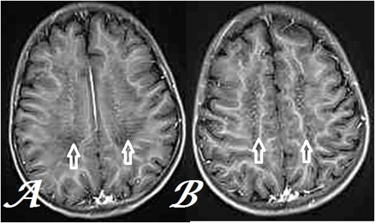
LEUKODYSTROPHIES
METACHROMATIC:
Autosomal recessive
Arylsulfatase A deficiency
Sx:
Developmental delay, ataxia, optic atrophy
Neuroregression
Dx:
Decreased ARSA – leukocytes
Increased sulfatides - urine
Tx:
Symptomatic
Notes:
lgwilliams.blogspot.com

Slide 54
LEUKODYSTROPHIES
KRABBE:
Galactocerebrosidase deficiency
Sx:
Onset <6 mo
Hypertonia, irritability
Deafness, blindness (optic atrophy)
Exaggerated startle reflex
Increased CSF protein, abnormal MRI
Tx:
Symptomatic

Slide 55
TAY SACHS DISEASE
Hexosamidase A Deficiency
Inability to degrade GM2 ganglioside
Sx:
6-12 months: slowing development, hyperacusis, apathy, cherry red macula, seizures, blindness, spasticity (exaggerated startle reflex)
Death by 2-5 years
Late onset with residual activity
Motor neuron dysfunction, ataxia but normal IQ and vision (although 1/3 have psychosis)

Slide 56
CAUSES OF CHERRY RED MACULA
Tay Sachs disease
Sandhoff
GM 1 Gangliosidosis
Niemann-Pick disease
Sialidosis
Mucolipidosis

Slide 57
PURINE/PYRIMIDINE
LESCH-NYHAN:
X-linked recessive
HGPRT deficiency
Sx:
Normal at birth
Intellectual disability
Choreiform movements
Self mutilation, gout
Dx:
Increased uric acid
MRI: basal ganglia abnormalities
Tx:
Allopurinol
Symptomatic

Slide 58
Metabolic Disorders
Classification
Clinical presentation
Newborn screen
Common metabolic disorders
Principles of treatment

Slide 59
ACUTE PHASE MANAGEMENT
Prompt and vigorous treatment of acidosis or hyperammonemia can lead to complete recovery and prove to be life saving
Arrange transfer to level three facility

Slide 60
ACUTE PHASE MANAGEMENT
IV benzoate and sodium phenylacetate or phenylbutyrate
Excretion of ammonia and waste nitrogen
Eliminate dietary intake of potentially toxic foods such as protein, galactose, or fructose
IV glucose
Positive caloric balance
Promote diuresis
Vitamins
Biotin, vitamin B6, cobalamin, thiamine, or riboflavin
Hemodialysis for life-threatening metabolic disturbances

Slide 61
LONG TERM MANAGEMENT
Augment the activity of an enzyme
Ex. Vitamin B12 supplementation in methylmalonic acidemia
Restrict dietary intake of protein or substrate
Dietary treatment of PKU and galactosemia
Increase excretion of toxic substrate
Glycine in isovaleric acidemia
Enzyme replacement
Gaucher, Hurler, Pompe, MPS IV, Hunter
Organ transplant
Liver transplant in hereditary tyrosinemia and OTC

Slide 62
CONCLUSION
Greater awareness:
Greater chance of successful treatment if diagnosed early → reduction in morbidity and mortality
The three common conditions we see are urea cycle, fatty acid oxidation and amino acid abnormalities
Greater index of suspicion:
Symptoms that are complex, persistent and/or unexplained by sepsis warrant prompt referral

Slide 63
Thank You

