Slide 1

GENERAL PEDIATRICS
Maria Victoria Milla, MD, MPH, FAAP
Section Chief of the Pediatric Care Centers
Nicklaus Children’s Health System
Nicklaus Children’s Hospital
Miami, Florida

Slide 2
Disclosure of Relevant Relationship
Dr. Milla has not had (in the past 24 months) any relevant conflicts of interest or relevant financial relationship with the manufacturers of products or services that will be discussed in this CME activity or in his presentation.
Dr. Milla will support this presentation and clinical recommendations with the “best available evidence” from medical literature.
Dr. Milla does not intend to discuss an unapproved/investigative use of a commercial product/device in this presentation.

Slide 3
Overview
Normal Growth and Physical Development
Anticipatory Guidance/Health Supervision
Common Screening Tests
Immunizations
Child Abuse
Common Problems in General Pediatrics
Ethics for Primary Care

Slide 4
Growth and Physical Development
Weight
  Maximum weight loss in first 2 weeks: 10%
  Birth Weight regained within 10-14 days (2 weeks)
  Doubles in 4 months
  Triples at 12 months
  Quadruples at 24 months
On average, infants gain 110 to 200 gm (4-6 oz) per week in the first 4-6 months and 85 to140 gm (3-5 oz) per week from ages 6-18 months

Slide 5
Growth and Physical Development
Weight at each visit
Plot growth on appropriate curve
Use the WHO growth charts to monitor growth from 0 to 2 years in the US (based on high quality data and use breastfed infants as the norm for growth)
Use the CDC growth charts to monitor growth for children age 2 years and older in the US
Transition to BMI by age 2; weight for length under age 2

Slide 6
Growth and Physical Development
Length/Height
Increase in 1st year: 50%
From birth to 6 months- grow approximately 2.5 cm (1inch) per month
From ages 6 to 12 months- grow approximately 1.25 cm (1/2 inch) per month
Doubles at 4 years
Triples by 13 years
All patients should have a length/height measurement
Length- measure in the recumbent position until age 2
Standing Height- after age 2
Plot on growth curve

Slide 7
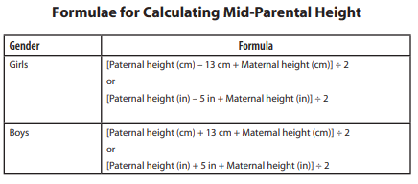
Mid-Parental Height

Slide 8
Growth and Physical Development
Head Circumference (HC)
  Measure until age 3 (period of maximal brain growth)
    Technique- use a measuring tape that cannot be stretched
    Securely wrap the tape around the widest possible circumference of the head
    Record the greatest of 3 measurements of occipital-frontal circumference

Slide 9
Growth and Physical Development
Head Circumference
  Microcephaly- head circumference <2 standard deviations below the mean (< 3 percentile), based on age and sex
    Associated conditions- Trisomies, Miller Dieker syndrome, Cornelia de Lange, Seckel syndrome, Rubenstein Taybi syndrome
  Macrocephaly- head circumference >2 standard deviations above the mean (>97 percentile), based on age and sex
    Associated conditions- Autism, Fragile X, metabolic conditions

Slide 10
Growth and Development
Failure to Thrive
  Decelerated or arrested physical growth (height and weight below 5th percentile or downward change in growth across two major growth percentiles).
  Associated with abnormal growth and development
  Inadequate nutrition is the cause of failure to thrive (not receiving enough calories or unable to properly use the calories given)
  The causes and effects of malnutrition are usually intertwined
  Organic FTT- has a medical disorder known to interfere with growth, including malabsorptive diseases, genetic syndromes, endocrine disorders, and neurologic dysfunction
  Nonorganic FTT- a diagnosis of exclusion to describe the child who has grown poorly and has no identified medical condition
  May be an expression of parental neglect/inadequacy

Slide 11
Growth and Development
Dietary associations with poor growth in young children
  Breastfeeding difficulties
  Improper formula mixing
  Poor transition to food (6 to 12 months of age)
  Excessive juice consumption
  Avoidance of high-calorie foods

Slide 12
Question 1
How soon does an infant regain birth weight?
10 to 14 days
4 to 7 days
3 to 4 days
An infant should not lose weight after birth

Slide 13
Question 1
How soon does an infant regain birth weight?
10 to 14 days
4 to 7 days
3 to 4 days
An infant should not lose weight after birth

Slide 14
Anticipatory Guidance/Health Supervision

Slide 15


Slide 16
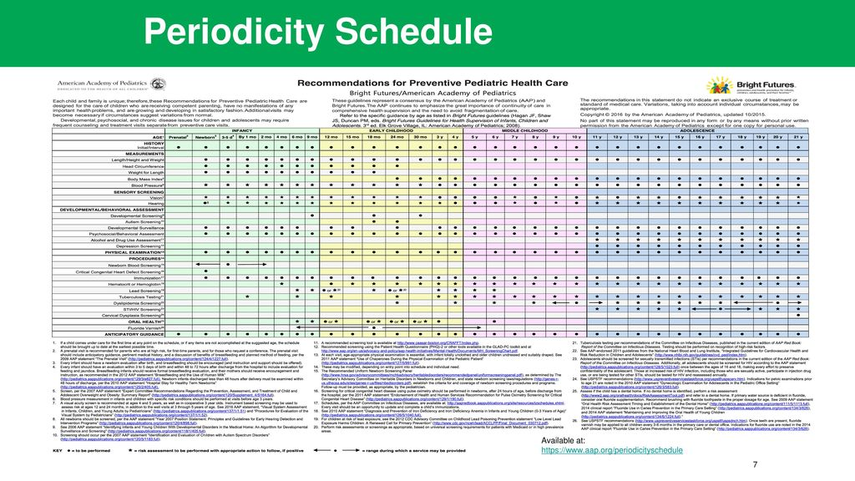

Slide 17
Question 2
When should the pediatrician provide health supervision or counseling?

Slide 18
Question 2
When should the pediatrician provide health supervision or counseling?
  AT EVERY VISIT

Slide 19
Anticipatory Guidance
Car Safety
Accidents are the leading cause of death through adolescence
Motor vehicle collisions are the leading cause of death and disability in children in America
The use of a child restraint system (CRS) reduces fatal injury by 71% in infants and 54% in children ages 1 to 4 years
Booster seats reduce the risk of injury by 59% in children ages 4 to 7 years
Preterm infants (<37 weeks gestational age) and infants who have a h/o respiratory issues should be observed and monitored for apnea, bradycardia, or oxygen desaturation when placed in a CRS before discharge
No straightforward recommendations if an infant fails this “car seat challenge” (AAP recommends repeat the test using different carseat or on a different day)
Options have included delaying hospital discharge, modifying the seat and retesting, using “car beds”, or prescribing stimulant medications for babies who have apnea

Slide 20
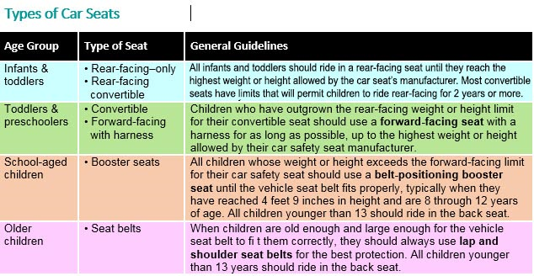

Slide 21
Question
During a well child visit, you are counseling the parents of a 9 month old child about the positioning and type of car seat that they should be using. The child weighs 25 lb. You advise the parents to use:
A. a rear-facing infant car seat
B. a forward-facing infant car seat
C. a rear-facing convertible car seat
D. a forward-facing convertible car seat
E. both A and C are correct

Slide 22
Question
During a well child visit, you are counseling the parents of a 9 month old child about the positioning and type of car seat that they should be using. The child weighs 25 lb. You advise the parents to use:
A. a rear-facing infant car seat
B. a forward-facing infant car seat
C. a rear-facing convertible car seat
D. a forward-facing convertible car seat
E. both A and C are correct

Slide 23
Anticipatory Guidance
Screen Time
  The AAP recommends that children older than 2 limit television and video viewing to no more than 1 hour of quality programming per day
  Use of TV, computer, tablet, and smartphone is discouraged under the age of 2
  There is a dose-response relationship between hours of media use and obesity in children
  Violent media exposure has been associated with increased fear and anxiety in children
  Ban devices and tvs an hour before bed and in bedrooms overnight. Associated with poor sleep hygiene
  Designate media-free places and times (such as dinner time) for all family members, including adults
  Continue to monitor what kids watch and talk to them about online bullying, sexting and other hazards

Slide 24
Anticipatory Guidance
Injury Prevention Topics
Head Injury Prevention
Bicycle Safety
Water Safety
Sun exposure
Firearms
Smoke detectors
Hot water heater temp (set at 120 F)
Animal bites
Storage of toxic substances
Choking hazards

Slide 25
Anticipatory Guidance
Injury Prevention Topics (continued)
Sports safety
Alcohol and drug use
Suicide prevention
Homicide prevention
Drowning prevention

Slide 26
Dental

Slide 27
Primary Teeth
Development begins between 4 and 15 months of age
20 primary teeth (usually by age 3 years)
Symptoms
  Drooling
  Disturbed sleep
  Irritability
  Swollen gums

Slide 28
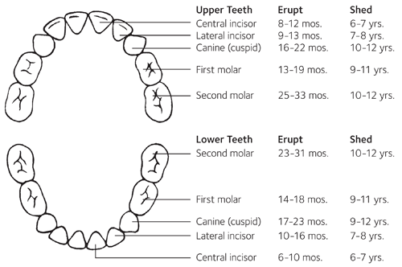

Slide 29
Dental Issues
Delayed Tooth Eruption
  Impacted teeth
  Radiation therapy
  Craniofacial anomalies
  Congenital hypopituitarism
  Congenital hypothyroidism
  Genetic disorders
    Trisomy 21
  If no teeth within 6 months of target- see Dentist

Slide 30
Dental Guidance
Early childhood caries is the number one chronic infectious disease of early childhood
Good oral health starts early
Children should receive preventive oral healthcare from a dentist or pediatrician by 1 year of age or 6 months (if high risk)
Children should be exposed to adequate levels of fluoride
  Water
  Toothpaste
  Other sources

Slide 31
Dental Guidance
Children should receive fluoride varnish from their dentist or pediatrician if dentist is not available
  Every 6 months (from tooth eruption through age 5)
  High risk every 3-4 months (those with established dental caries)
No bottles to bed
Introduce a cup as soon as an infant can sit unsupported (6 months). Eliminate the bottle by 1 year of age
Feed children healthy foods that are low in sugar
Bacteria can be transmitted from a Mother to a child by sharing utensils, cleaning pacifiers with the mouth, and pre-chewing food

Slide 32
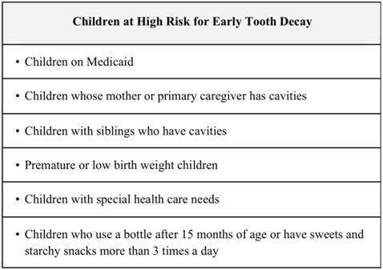

Slide 33
Common Screening Tests

Slide 34
Screenings
Vision
Hearing
Iron Deficiency
Lead
Blood Pressure
Hypercholesterolemia
Autism
Newborn Metabolic Screen
BMI

Slide 35
Screening
Vision
Visual Assessments/Eye Exam
Birth
All Well Child Visits
Visual Acuity (Snellen Chart)
Visual Acuity in healthy newborns is ~ 20/400
Earliest possible age to test is 3 years old
Cover/Uncover Test to look for misalignment (strabismus)

Slide 36
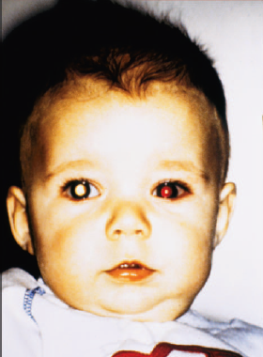
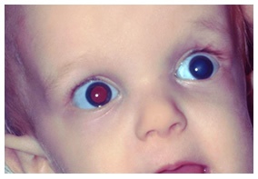
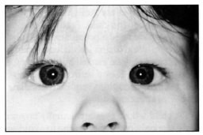
Strabismus
Opacified lens (cataract)
Abnormal red reflex
Pseudostrabismus

Slide 37
Screening
Hearing Screening
Hearing loss is divided into conductive, sensorineural, mixed, and central types
Conductive hearing loss (CHL)- more common in children
Results from interference with the mechanical transmission of sound through
the external and middle ear
Most common cause of CHL- Otitis Media with Effusion
Sensorineural hearing loss (SNHL)
Results from failure to transduce vibrations to neural impulses effectively
within the cochlea or transmit these impulses down the vestibular nerve
Mixed hearing loss
Involves a combination of these two types, usually due to damage throughout the middle ear
and the inner ear
Central hearing loss- results from defects in the brainstem or higher processing centers of the brain
Both CHL and SNHL may be caused by a wide variety of congenital and acquired factors

Slide 38
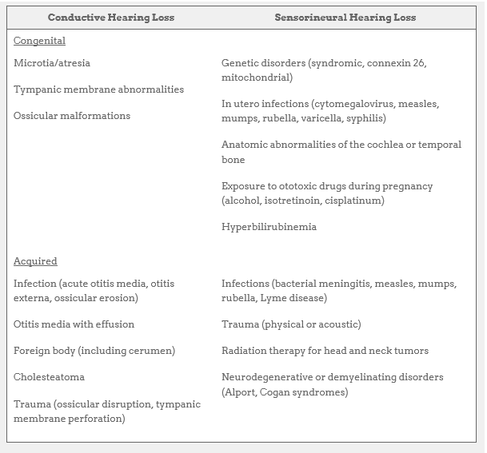

Slide 39
Screenings
Hearing Screening
AAP recommends Universal Newborn Hearing Screen (UNHS) for all newborns before 1 month of age. Abnormal UNHS should be confirmed by 3 months of age
Goal: 100% screened by age 3 months
1-3/1000 children are born deaf
Otoacoustic Emmisions (OAE) measures sound waves produced in the inner ear via a probe placed in the ear canal
Brainstem evoked response audiometry involves electroencephalographic response to auditory stimulus
Early hearing loss detections and intervention can lead to better vocabulary and intellectual development

Slide 40
Screenings
Iron Deficiency
Screen all infants (routine hemoglobin test) at 12 months of age
High Risk
Prematurity
Low birth weight
Cow’s milk before 1 year of age
Menstruating females
Ages 1-3- Additional screening can be performed if inadequate dietary iron intake or risk of iron deficiency anemia
Ages 3-10 years- Screen if child is high risk
Adolescence-targeted screening based on history. Menstruating females at high risk

Slide 41
Screenings
Lead
CDC recommends screening between 6 months- 6 years
Minimum at 1 and again at 2 years of age
Peak occurs at 2 years
Venous is preferred over capillary (fingerstick)
Threshold for intervention continues to drop (any lead level can be harmful)
Currently the threshold for intervention is 3.5 mcg/dl

Slide 42
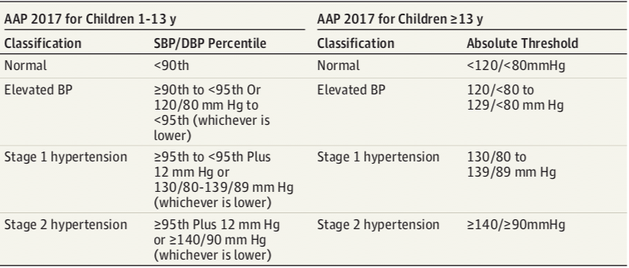
Screenings
Blood Pressure (BP)
Annually after 3 years of age
Before age 3 years, BP should be obtained if risk is present (renal or cardiovascular condition)
Hypertension (HTN) is defined as 3 separate readings over a period of at least several days
High normal BP (90-95% based on height percentile and age)
HTN is a blood pressure over 95% (same age,sex,and height)

Slide 43
Screenings
Newborn Metabolic Screen
  State-dependent
  Timing- not before 24 hours of life (not enough metabolite built up in order for test to pick it up)

Slide 44
Screenings
Autism Screening
  Ages 18 and 24 months
  Early recognition is important
  Areas of concern
    Social interaction (poor eye contact, resists physical contact, prefers to play alone)
    Language (not talking, loses previous skill)
    Behavior (repetitive movements, rituals, sensitivity to sound)

Slide 45
Cholesterol and Lipid Screening
AAP recommends nonfasting screening for dyslipidemia between 9 and 11 years of age and again between 17 and 21 years of age.
Routine lipid screening is not recommended in children 2-8 and between 12 and 16 years of age.
Overweight/obese children are treated primarily with weight management.
Pharmacotherapy is generally not recommended in children <10 unless the following are present:
  A high-risk CVD condition exists
  LDL-C levels >400mg/dL (familial hypercholesterolemia)
  TG>500mg/dL (familial hypertriglyceridemia)

Slide 46
BMI Screening
Most practical method to track overweight and obesity
BMI= weight (Kg)/height (m2)
BMI assessment recommended yearly beginning at age two
  BMI<5th percentile: underweight
  BMI 5th to 84th percentile: healthy weight
  BMI 85th to 95th percentile: overweight
  BMI>95th percentile: obese

Slide 47
Immunizations

Slide 48
Immunizations
Recommendations made by the Advisory Committee on Immunization Practices (ACIP)
Latest schedule on CDC website- http:cdc.gov/vaccines/recs/acip/
Pearl- If not given when recommended, give at first subsequent visit

Slide 49
Immunizations
Focus on:
Immunization schedule
Rationale for schedule
Catch-up immunizations
Immunization side effects
Contraindications to immunization
Types of vaccines (live vs inactivated)
Timing when using other products (immunoglobulin, PPD, etc)

Slide 50
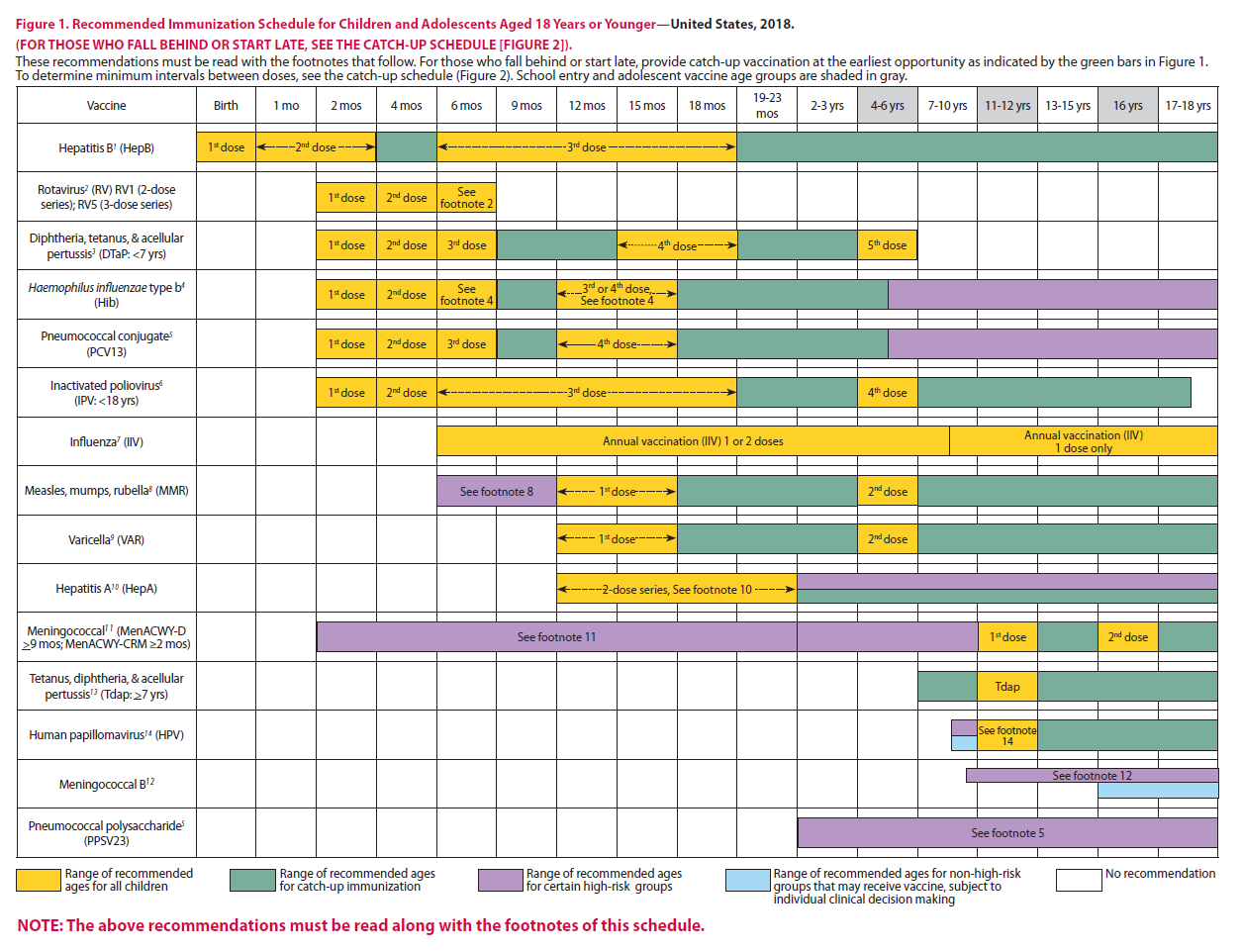

Slide 51
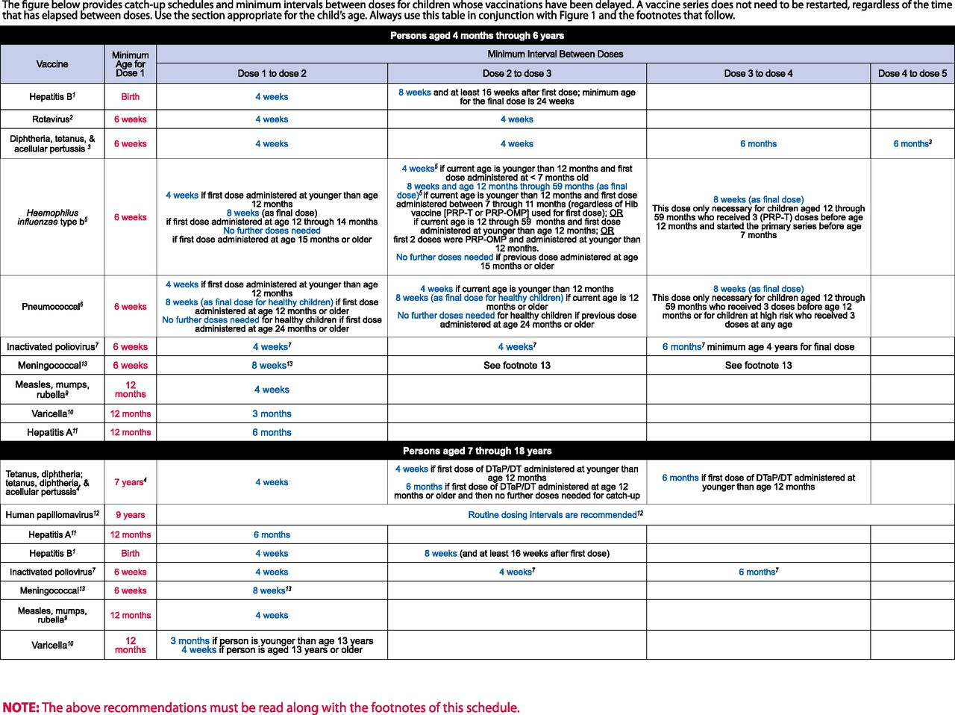

Slide 52
Question
Which of the following vaccines are live?
HBV
IPV
DTaP
Hib
PCV
Rota

Slide 53
Question
Which of the following vaccines are live?
HBV
IPV
DTaP
Hib
PCV
Rota

Slide 54
Immunization
3 live vaccines
MMR
Varicella
Rota
Other live vaccines only given to travelers
Oral Typhoid
Yellow Fever
Rota is the only live vaccine given before 1 year of age

Slide 55
Rotavirus

Slide 56
Rotavirus
Most common cause of gastroenteritis in infants and young children
A lot of morbidity associated with it
Vaccine: Live, Oral
RotaTeq: 2, 4, 6 mo
Rotarix: 2, 4 mo
Minimum age for first dose: 6 weeks
Minimum interval: 4 weeks
Rotarix-Complete by 24 weeks of age
Rotateq-Complete by 32 weeks of age, maximum interval between doses is 10 weeks

Slide 57
Influenza

Slide 58
Influenza
Recommended for all beginning at 6 months of age
High Risk Groups in particular
  6-23 months of age
  Pulmonary or Cardiovascular disease (asthma)
  Residents of chronic care facilities

Slide 59
Influenza
Give annually (beginning at 6 months)
2 doses (separated by 4 weeks) given to those receiving the vaccine for the first time (under 9 years old)
Subsequent season: 1 dose

Slide 60
Influenza
Contraindications
  Egg allergy does not impart an increased risk of anaphylaxis (Flucelvax is cell-culture based and egg-free)
  Severe reaction to previous vaccine
  Guillain-Barre (within 6 weeks of getting the flu vaccine)

Slide 61
Measles-Mumps-Rubella (MMR)

Slide 62
MMR
Measles-Mumps-Rubella (MMR)
Live attenuated vaccine
2 dose series given at 12-15 months and at 4-6 years
Catch-up: 2 doses at least 4 weeks apart
If given at <12 months old, needs to be repeated due to lack of immunogenicity
Can be given as early as 6 months, but must be revaccinated at 12 months of age
During an outbreak, MMR given within 72 hours of exposure to measles may provide some protection and is preferred to immune globulin

Slide 63
MMR
Contraindications
  Pregnant women
  Previous anaphylactic reaction to measles vaccine
  Persons with severe immunocompromising conditions
  Can be given to children with egg allergy (risk of anaphylaxis is low)

Slide 64
Hepatitis B

Slide 65
Hepatitis B
Recombinant DNA-produced HBsAg Vaccine
First dose in nursery before discharge
3 doses
Minimum intervals between doses
  Dose 1 and 2: 4 weeks
  Dose 2 and 3: 8 weeks
  Dose 1 and 3: 16 weeks
4th dose allowed if using combination vaccines
If mother HBsAg+
  HBV and Hep B immune globulin within 12 hours of birth
  If maternal status is unknown, should receive at birth and HBIG within 7 days if mom then found to be positive

Slide 66
Question
The following are all acceptable regimens for Hepatitis B vaccine EXCEPT:
Birth, 2 months, 4 months
Birth, 1 month, 6 months
2 months, 4 months, 6 months
2 months, 4 months, 1 year
1 year, 2 years, 5 years

Slide 67
Question
The following are all acceptable regimens for Hepatitis B vaccine EXCEPT:
Birth, 2 months, 4 months
Birth, 1 month, 6 months
2 months, 4 months, 6 months
2 months, 4 months, 1 year
1 year, 2 years, 5 years

Slide 68
Question
An infant born to a mother whose HBsAg status at birth is unknown should receive:
A first dose of Hep B vaccine sometime within the 1st 12 months of life.
Hep B vaccine within 12 hrs of birth; the infant should then also be given HBIG within 7 days if mother found to be HBsAg positive.
HBIG and first dose of Hep B vaccine between 3 and 6 months of life.
Hep B vaccine and HBIG within the 1st 12 hours of life.

Slide 69
Question
An infant born to a mother whose HBsAg status at birth is unknown should receive:
A first dose of Hep B vaccine sometime within the 1st 12 months of life.
Hep B vaccine within 12 hrs of birth; the infant should then also be given HBIG within 7 days if mother found to be HBsAg positive.
HBIG and first dose of Hep B vaccine between 3 and 6 months of life.
Hep B vaccine and HBIG within the 1st 12 hours of life.

Slide 70
Pneumococcal Vaccine

Slide 71
Pneumococcal Vaccine
Pneumococcal Vaccines
    Developed to prevent invasive pneumococcal disease in children <2 years
    Prevention of pneumococcal pneumonia and meningitis, less effective in prevention of otitis media
    Recommended for children 24 to 59 months if high risk
      Cochlear implant
      Cardiac or pulmonary disease
      Immunocompromised
        Sickle cell disease, asplenia, HIV, diabetes, cancer
      Long term use of steroids
  Schedule
    2,4,6 and 12-15 months of age

Slide 72
Pneumococcal Vaccine
PS23- 23 valent polysaccharide vaccine
  Not immunogenic in children <2 years
  Given to high risk children>2 years for broader coverage

Slide 73
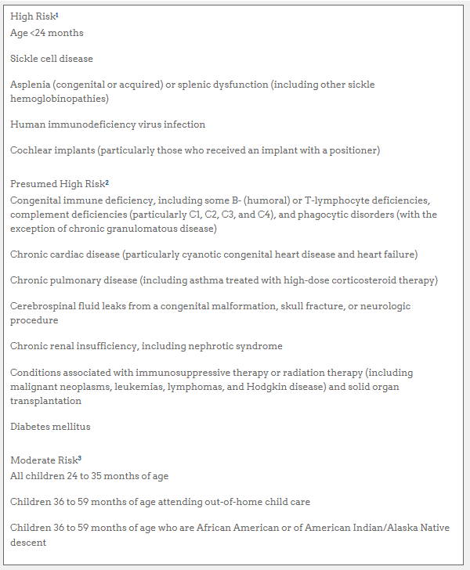

Slide 74
Haemophilus Influenzae Type B Vaccine
Vaccine does not cover non-typeable Haemophilus
  Otitis media
  URI
Hib Schedule
  2,4,6,12-15 months
  Minimum age: 6 weeks
Hib not recommended for those over 5 years except if they are high risk
  Sickle cell
  Leukemia
  HIV
  Splenectomy

Slide 75
Hepatitis A

Slide 76
Hepatitis A
All children over age 1 year
2 doses at least 6 months apart
Also recommended for older children who live in areas of increased risk of infection

Slide 77
Meningococcal Vaccine

Slide 78
Meningococcal Vaccine
Two vaccines
  Meningococcal conjugate vaccine (MCV)- protects against serogroups A,C,W, and Y
  Meningococcal Serotype B (MenB)
For patients not in high-risk group
  Vaccinate at 11-12 year well visit with MCV
  Booster of MCV at 16 years of age
  MenB between 16-18 years old
For high-risk patients
  May vaccinate as early as 2 years of age. Revaccinate 3-5 years later if risk remains
  High risk groups
    Complement deficiency, anatomic or functional asplenia
    Travelers to high-risk countries

Slide 79
Varicella

Slide 80
Question
The following are all true about the varicella vaccine EXCEPT:
It is a live vaccine
One dose is required
It contains small amounts of neomycin and gelatin
The vaccine can be given as early as 12 months
5% of recipients get a mild case of the chicken pox

Slide 81
Question
The following are all true about the varicella vaccine EXCEPT:
It is a live vaccine
One dose is required
It contains small amounts of neomycin and gelatin
The vaccine can be given as early as 12 months
5% of recipients get a mild case of the chicken pox

Slide 82
Varicella
First dose: 12-15 months
Second dose: 4-6 years
2 doses should be administered to all
  Minimum interval for children 12 months to 12 years: 3 months
  Minimum interval for Adolescents and Adults 13 and over: 4 weeks
Vaccinate older kids if no history of disease
  May check titers
Vaccinate
  Kids on low dose steroids (less than 2 mg/kg/day)
  Children of pregnant women
Do Not Vaccinate
  Children on high-dose steroids
  Pregnant women

Slide 83
Varicella
Varicella and MMR need to be given together.
If not given together, need to wait 1 month.

Slide 84
Polio

Slide 85
Polio
Use Inactivated Polio Vaccine
Inactivated much less likely to cause disease compared to oral polio vaccine (OPV-no longer used in the US)
OPV doses given before April 2016 can count towards a child's US vaccination requirements. Doses given after that will not count.
Schedule
  2, 4, 6-18 mo and 4-6 years
  4th dose MUST be given after 4th birthday

Slide 86
Human Papilloma Virus Vaccine
(HPV)

Slide 87
HPV
Human Papilloma Virus is the most common cause of cervical cancer
Two doses of the HPV vaccine are recommended for all boys and girls starting at age 9.
If the vaccine is started on or after the age of 15, 3 doses are recommended (over a 6 month period. 0,2,and 6 months)

Slide 88
Common Pediatric Conditions
Otitis Media
Sinusitis
Orbital/Periorbital Cellulitis
Conjunctivitis
Neck Masses
Enuresis

Slide 89
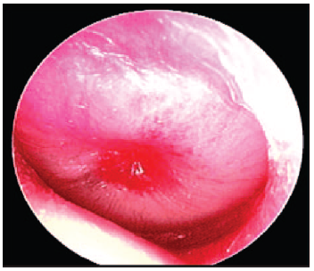
Otitis Media
Risk factors for the development of AOM and/or OME
  Less than 2 years of age
  Atopy
  Sinus disease
  Ciliary dysfunction
  Cleft palate/craniofacial abnormalities
  First OM before 6 months of age
  Immunocompromised

Slide 90
Otitis Media
Criteria for treatment
  No bulging or MEE: No AOM
  Severe symptoms- always treat
  Mild symptoms
    Less than 2 years of age
      Unilateral disease- observe & follow-up in 48-72 hours
      Bilateral disease-treat
    Over 2 years of age
      Observe & follow-up in 48-72 hours

Slide 91
Otitis Media
Treatment
  First line
    High dose Amoxicillin
      If no Amoxicillin in the past 30 days
    High dose Amox/Clavulanic Acid
      If received Amoxicillin in past 30 days
  Alternatives
    Cefdinir, Cefuroxime, Cefpodoxime, Ceftriaxone
  Treatment failure
    High dose Amoxicillin/Clavulanic Acid, Ceftriaxone
    Clindamycin +3rd generation Cephalosporin+ ENT and/or ID

Slide 92
Otitis Media
Chronic Suppurative Otitis Media
  Pseudomonas, Staph
Cholesteatoma
  TM retraction pockets. Presents with hearing loss and otorrhea. Recurrence after resection
Bullous myringitis
  Blister in TM associated to AOM
Mastoiditis
  Strep Pneumo, S. Pyogenes, Staph aureus, and H.Influenzae. CT for diagnosis. Most common suppurative complication of AOM

Slide 93
Sinusitis
Anatomy
  Ethmoids and maxillary sinus are developed in small children, sphenoids 3-5 years, frontal 6-10 years
Symptoms criteria
  URI with persistent illness for 10 days without improvement
  URI worsening after initial improvement
  Severe onset of symptoms: high fever, purulent nasal discharge > 3 days
Pathogens
  Strep pneum, M. catarrhalis, H. Influenzae, Strep pyogenes, Anaerobes

Slide 94
Sinusitis
Imaging studies
  Contrast CT: seizures, severe headache, photophobia, eye swelling or pain with EOM, proptosis
Treatment plan (10-28 days)
Amoxicillin or Amoxicillin/Clavulanic Acid
Alternatives: Ceftriaxone
  Cefdinir, Cefuroxime if PCN allergy
  Clindamycin, Linezolid, Cefixime for severe disease

Slide 95
Preseptal vs Orbital Cellulitis
It is important to distinguish preseptal/periorbital from orbital cellulitis
Preseptal cellulitis is an infection of the eyelid (not involving the orbit)
Only orbital cellulitis causes swelling and inflammation of the extraocular muscles leading to pain with eye movements, proptosis and in some cases ophtalmoplegia with diplopia
Both can have fever and leukocytosis, but more common in orbital cellulitis
Orbital cellulitis is less common than preseptal cellulitis, but far more consequential and life threatening

Slide 96
Orbital vs Periorbital Cellulitis
Clinical features of preseptal and orbital cellulitis
Clinical feature | Preseptal cellulitis | Orbital cellulitis
Eyelid swelling with or without erythema | Yes | Yes
Eye pain/tenderness | May be present | Yes; may cause deep eye pain
Pain with eye movements | No | Yes
Proptosis | No | Usually, but may be subtle
Ophthalmoplegia +/- diplopia | No | May be present
Vision impairment | No | May be present*
Chemosis | Rarely present | May be present
Fever | May be present | Usually present
Leukocytosis | May be present | May be present

Slide 97
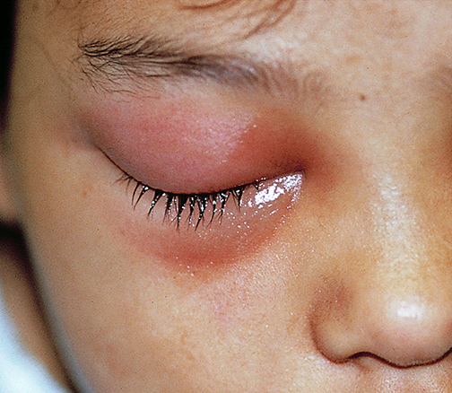
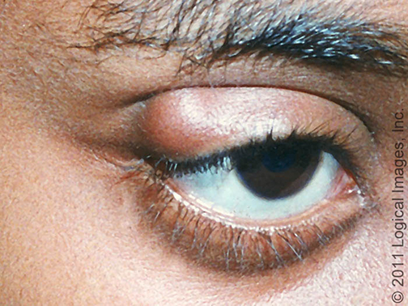
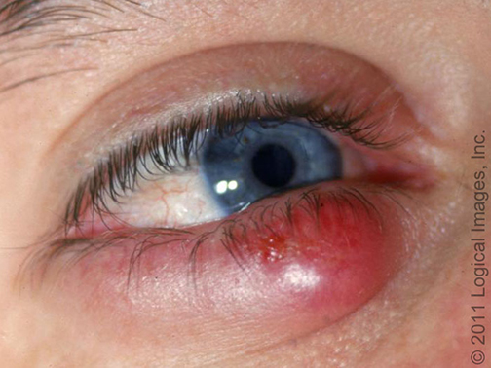
Preseptal/Orbital Cellulitis Chalazion Hordeolum/Stye

Slide 98
Enuresis
Primary nocturnal enuresis
  Nocturnal wetting in a child that has never been dry longer than 6 months
  Expected to be dry by age 6 years, resolves at a rate of 15%/year
  Genetics, vasopressin secretion, sleep factors, abnormal bladder dynamics, psychosocial, maturational delay
Secondary enuresis
  New onset nighttime wetting after being dry for 6 months

Slide 99
Enuresis
Screening Urinalysis
Treatment
  Behavioral modification- limit fluid intake before bed
  Alarm therapy- most successful
  Medication-Desmopressin acetate, anticholinergics, imipramine
  Acupuncture and hypnosis- little data to support

Slide 100
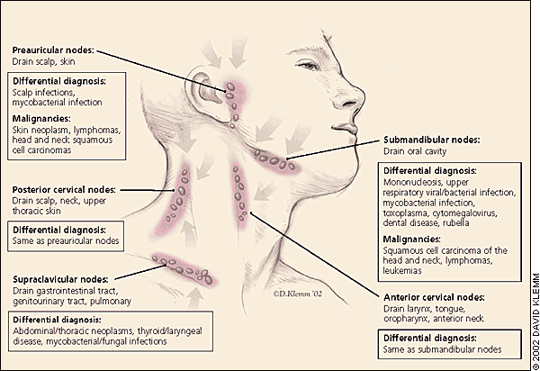
Neck mass by location
Submental nodes:
Thyroglossal duct cyst,
cystic hygroma,
dermoid cyst, lymphadenitis
Upper face and scalp infections,
cystic hygroma,
parotitis, TB, lymphoma
URI, mononucleosis,
cystic hygroma,
hemangioma,
mycobacterial Infections,
Toxo, CMV, lymphoma,
leukemia
Lymphadenitis, Lymphoma,
metastatic from
nasopharynx
Mycobacterial and fungal infections,
lymphoma, metastatic disease
Similar to submandibular,
brachial cleft, lymphoma

Slide 101
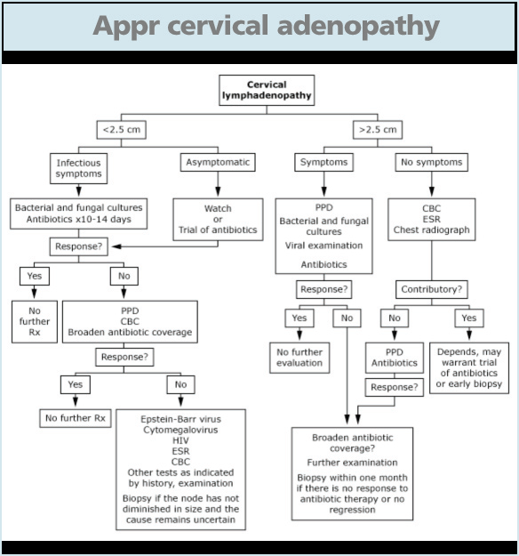

Slide 102
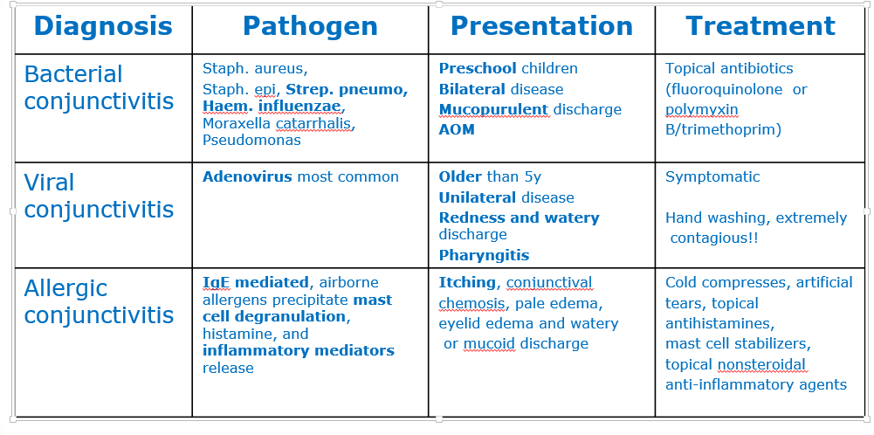
Conjunctivitis

Slide 103
Psychosocial Issues
DEATH AND GRIEF
  A child’s understanding of death and expression of grief are influenced by his developmental level, his experience with death, and the family’s cultural and religious beliefs.

Slide 104
Psychosocial Issues
DEATH AND GRIEF
  Preschool Children
    Persistent separation anxiety more than 6 months after a predictable home life has been established
    Continuing or worsening regressive behavior beyond 6 months from the death

Slide 105
Psychosocial Issues
DEATH AND GRIEF
  School Age Children
    Persistent or worsening school phobia or academic performance 3 months after the death
    Detachment from peers or development of new social phobias
    Increasing behavioral concerns (depression, moodiness, anger) 3 to 6 months after the death
    Physical complaints without organic cause 3 months after the death

Slide 106
Psychosocial Issues
DEATH AND GRIEF
  Adolescents
    Increasing “high risk behaviors” with drugs, alcohol, delinquency, or precocious sexual activity
    Withdrawal from peer interactions or group activities
    Persistent somatic complaints for 3 months after the death

Slide 107
Child Abuse/Neglect
Nearly 90% of the perpetrators of child maltreatment are related caregivers
Siblings of abused children are at increased risk of abuse
Abusive parents often have unrealistic expectations for their children’s behavior (expecting a newborn not to cry or an 8-month-old infant to be toilet trained).

Slide 108
Child Abuse/Neglect
Factors that increase risk of abuse
  Child stresses- disability, hyperactivity
  Social/situational stresses- poverty, isolation, family discord, multiple births, parent-child conflicts
  Parent stress- abused as a child, depression, substance abuse

Slide 109
Child Abuse/Neglect
Common fractures in child abuse
  Spiral fractures of long bones- humerus, femur
  Metaphyseal fractures- femur, tibia, humerus
  Rib fractures- posterior, lateral
  Vertebral bodies

Slide 110
Ethics
Concepts to review
  End-of-life care
  Withdrawal/Withholding care
  Medical futility
  Euthanasia
  Confidentiality
  Informed consent/assent/dissent
  Minors as decision makers

Slide 111
Good Luck!!!

