Slide 1
IMMUNOLOGY
Vivian Hernandez-Trujillo, MD
Allergy & Immunology Care Center of South Florida
Miami Lakes, Florida
Medical Director, Division of Allergy-Immunology
Fellowship Training Program Director
Nicklaus Children’s Hospital
Miami, Florida

Slide 2
Disclosure of Relevant Relationship
Dr. Hernandez-Trujillo disclosed relevant conflicts of interests (COIs) and/or financial relationships in the past 24 months with the following ineligible companies:
All COIs have been mitigated prior to this activity
Dr. Hernandez-Trujillo will support this presentation and clinical recommendations with the “best available evidence” from medical literature.
Dr. Hernandez-Trujillo does not intend to discuss an unapproved/investigative use of a commercial product/device in this presentation.
Role/ Type of Relationship | Ineligible Company(ies)
Advisory Board | Takeda, CSL, Regeneron/Sanofi, ARS, Bryn, Kaleo, Pfizer, Enzyvant/ SMPA, Genentech, Bayer
Consultant | Enzyvant, Kaleo, Takeda, Pharming
Speaker | CSL, Takeda, Genentech, Kaleo
Medical Advisory Committee | Immune Deficiency Foundation
Consultant | National Peanut Board

Slide 3

READY, SET, GO…
1
Click the “Join ARS Sessions” button in the Course Portal “OR”
Text NCHCME to 37607 “OR”
Go to pollev.com/nchcme
2
3

Slide 4
Disclosure
Advisory Board Takeda, CSL, Regeneron/Sanofi, ARS, Bryn, kaleo, Pfizer, Enzyvant/ SMPA, Genentech, Bayer
Consultant Enzyvant, Kaleo, Takeda, Pharming
Speaker CSL, Takeda, Genentech, kaleo
Medical Advisory Committee Immune Deficiency Foundation
Consultant for National Peanut Board

Slide 5

Immunodeficiency (ID)
Definition: ID is the result of a diverse group of abnormalities of the immune system resulting primarily in an increased incidence of infection
Primary: Congenital and hereditary
Secondary: Acquired on a transient or permanent basis

Slide 6
PRIMARY ID
  COMMON:
  Selective IgA deficiency (1:500)
  Selective antibody deficiency
  DiGeorge anomaly
  Transient hypogammaglobulinemia of infancy
  UNCOMMON:
  -B-cell disorders: XLA 1-4:1,000,000,
  CVID 1:75,000
  -T-cell disorders: SCID 1:100,000
  -Phagocytic disorders: CGD 1:500,000
  -Complement disorders

Slide 7


Primary ID General Considerations
  58% of cases diagnosed in children less than 15 years old
  83% of these are male
  Mode of transmission:
    X-linked
    Autosomal dominant
    Autosomal recessive
    Sporadic inheritance patterns observed

Slide 8
Importance of Early Detection
Prevention of life-threatening infection
Avoidance of non-irradiated blood transfusions
Avoidance of live viral vaccines
Genetic Counseling
Earlier diagnosis and improve therapeutic interventions allowing more children to survive in adulthood

Slide 9
Development of the Immune System
B and T Cell Function begin in the late first Trimester
Lymphocyte counts in neonates and infants > 3000***
Only maternal IgG present at birth**
Even premature infants capable of synthesizing antibody at birth

Slide 10
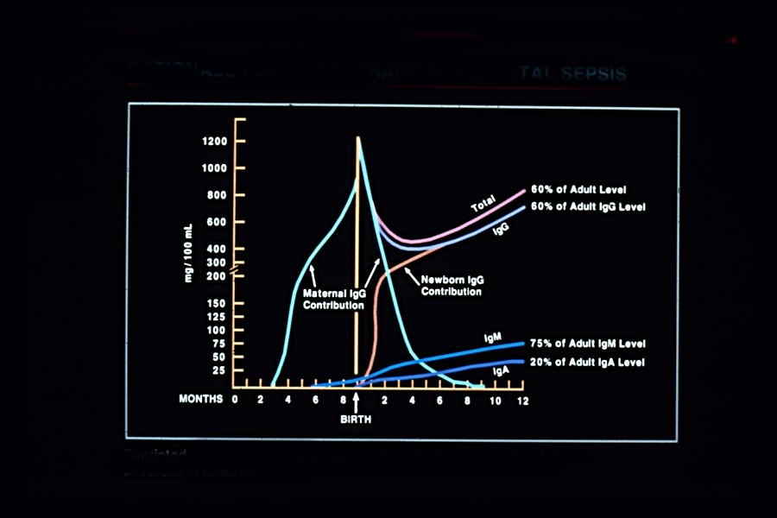

Slide 11
Development of Immune System
Immunoglobulin Production:
IgM > IgG > IgA
Response to protein antigens present at birth
Response to unmodified carbohydrate (polysaccharide) antigens develops after 2 years of age
Response to polysaccharide antigens not fully mature until 7-10 years of age

Slide 12
Clinical Features of Primary ID
Increased frequency, severity and duration of infection
Unexpected complications or unusual manifestations of infections
Infections with organisms normally considered of low pathogenicity
Noninfectious manifestations in gastrointestinal, endocrinologic and hematologic systems

Slide 13
Common Clinical Findings in Primary ID
Recurrent respiratory infections
Persistent sinus infection
Paucity of lymphoid tissue**
Failure to thrive (FTT) in infants**
Skin lesions (rash, pyoderma, eczema)
Oral & perianal candidiasis
Diarrhea and malabsorption**

Slide 14
Indications to Evaluate Humoral Immune System
Recurrent Sinopulmonary Infections
Recurrent Meningitis, Sepsis
Chronic Diarrhea
Infections with Unusual organisms

Slide 15
Indications to Evaluate Cellular Immune System
Persistent Fungal Infection
Viral Infections (HSV, VZ, CMV, EBV, enterovirus)
  Protozoa (Cryptosporidium, toxoplasmosis)
  Mycobacteria
  Fungal (Candida, PCP)
  Bacteria, gram negative enteric
Persistent Diarrhea
Failure to thrive
Lymphocytopenia**- Risk for GVHD

Slide 16
Case study
11 year old male with recurrent sinus infections. Also, history of “reaction” with blood transfusion in past. Otherwise, growing well. Active. Good appetite.

Slide 17

Question: What diagnosis does this patient have?
No Primary Immunodeficiency
Selective Antibody Deficiency
Selective IgA deficiency
X linked Agammaglobulinemia
0
0

Slide 18
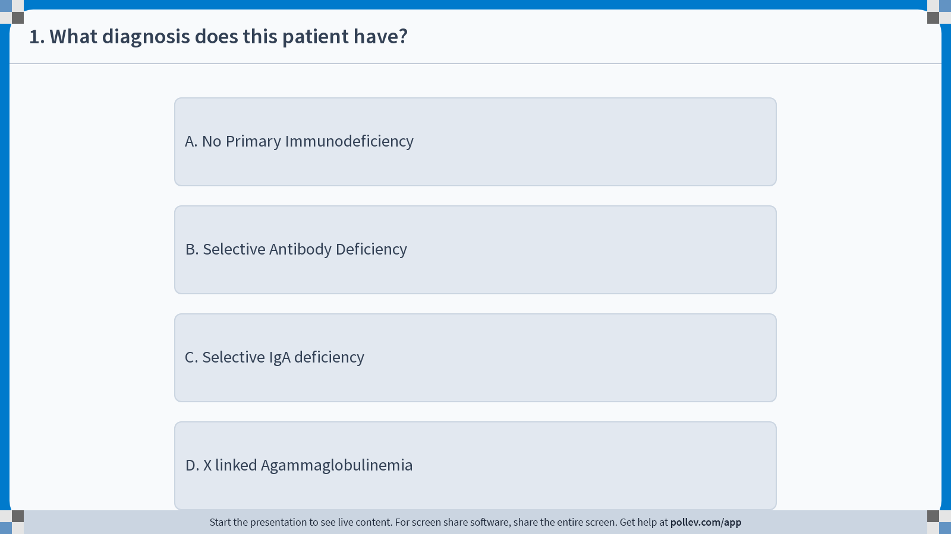
Notes:
Poll Title: Do not modify the notes in this section to avoid tampering with the Poll Everywhere activity.
More info at polleverywhere.com/support
1. What diagnosis does this patient have?
https://www.polleverywhere.com/multiple_choice_polls/Zx4nzkMnUEeGyK7YULPCA?display_state=instructions&activity_state=opened&state=opened&flow=Instructor&onscreen=persist

Slide 19
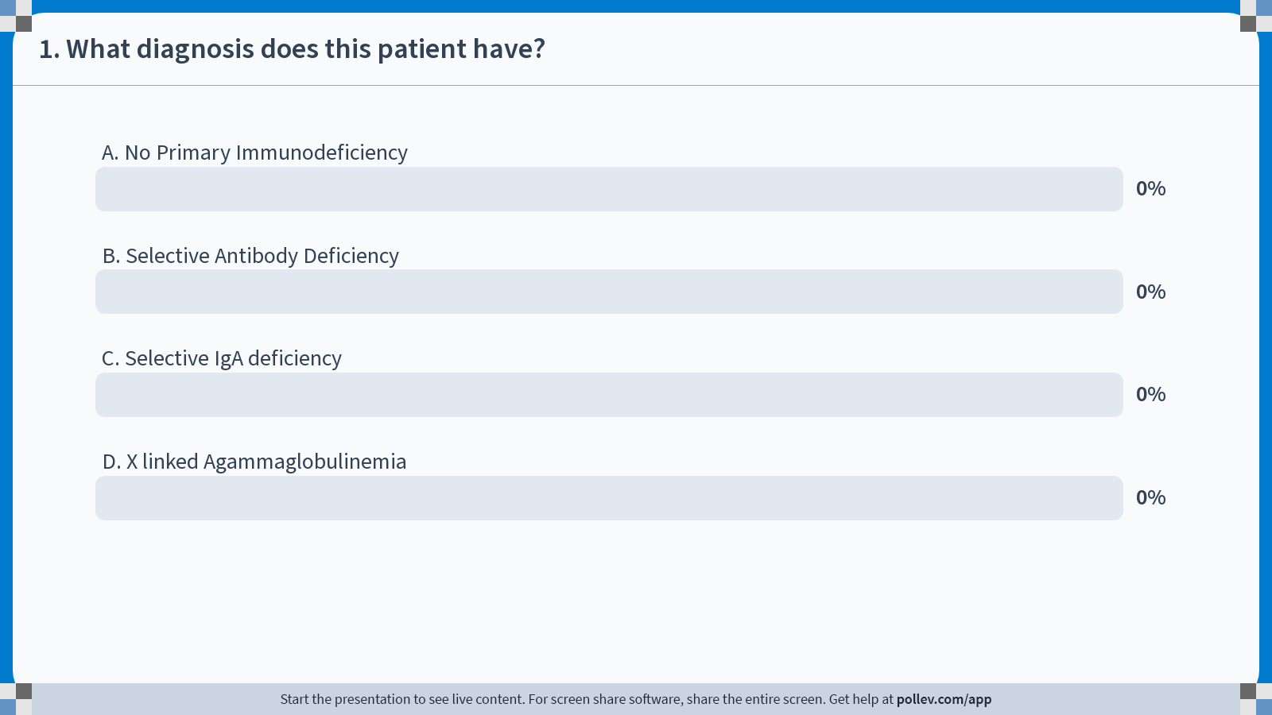
Notes:
Poll Title: Do not modify the notes in this section to avoid tampering with the Poll Everywhere activity.
More info at polleverywhere.com/support
1. What diagnosis does this patient have?
https://www.polleverywhere.com/multiple_choice_polls/Zx4nzkMnUEeGyK7YULPCA?display_state=chart&activity_state=closed&state=closed&flow=Instructor&onscreen=persist

Slide 20
Notes:
Poll Title: Do not modify the notes in this section to avoid tampering with the Poll Everywhere activity.
More info at polleverywhere.com/support
1. What diagnosis does this patient have?
https://www.polleverywhere.com/multiple_choice_polls/Zx4nzkMnUEeGyK7YULPCA?display_state=chart&activity_state=closed&display=correctness&state=closed&flow=Instructor&onscreen=persist

Slide 21

Question: What diagnosis does this patient have?
No Primary Immunodeficiency
Selective Antibody Deficiency
Selective IgA deficiency
X linked Agammaglobulinemia
0
0

Slide 22
Selective IgA deficiency
Most frequently occurring ID
Serum IgA < 10mg/dL
Most patients are asymptomatic
Assoc. with recurrent sinopulmonary infection, autoimmune, GI & endocrine disorders
Development of anti-IgA Ab may lead to severe anaphylactic reactions with blood transfusions- need IgA depleted blood products***
Treatment – Observation; prophylactic antibiotics

Slide 23
Case study
8 month old child with frequent upper respiratory infections (URI). One episode of otitis media. Otherwise, good appetite and growing well.
Labs reveal IgG of 180 (low for age) Normal IgA and IgM

Slide 24
Question: What diagnosis does this patient have?
Selective Antibody Deficiency
Transient Hypogammaglobulinemia of Infancy
Selective IgA deficiency
X linked Agammaglobulinemia
0

Slide 25
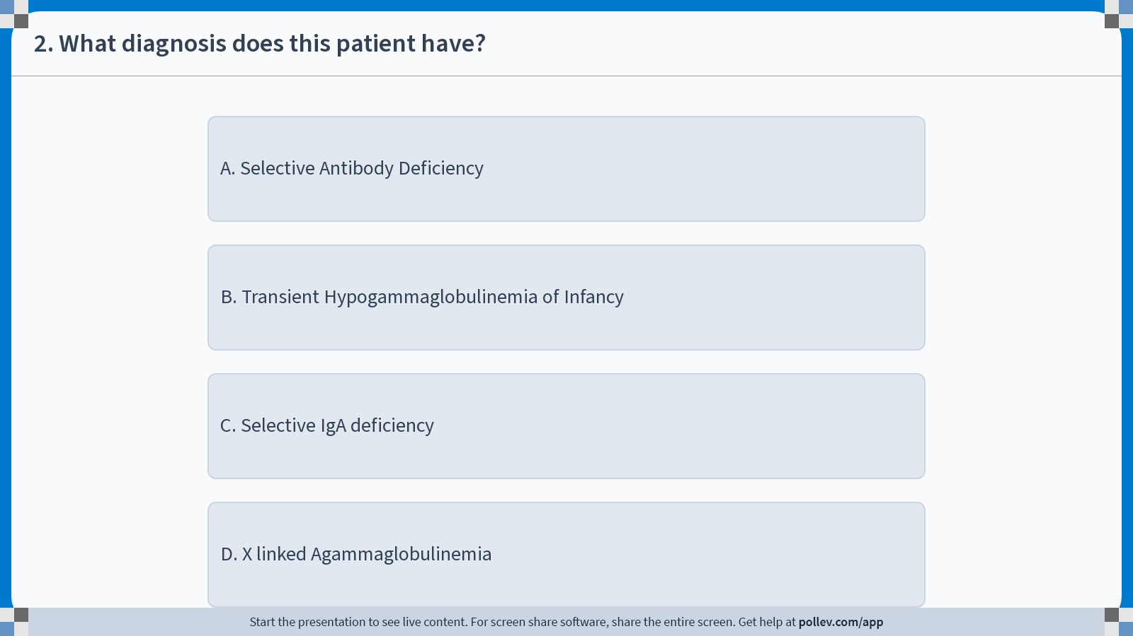
Notes:
Poll Title: Do not modify the notes in this section to avoid tampering with the Poll Everywhere activity.
More info at polleverywhere.com/support
2. What diagnosis does this patient have?
https://www.polleverywhere.com/multiple_choice_polls/bbChnbvyDeOetceDwLkql?display_state=instructions&activity_state=opened&state=opened&flow=Instructor&onscreen=persist

Slide 26
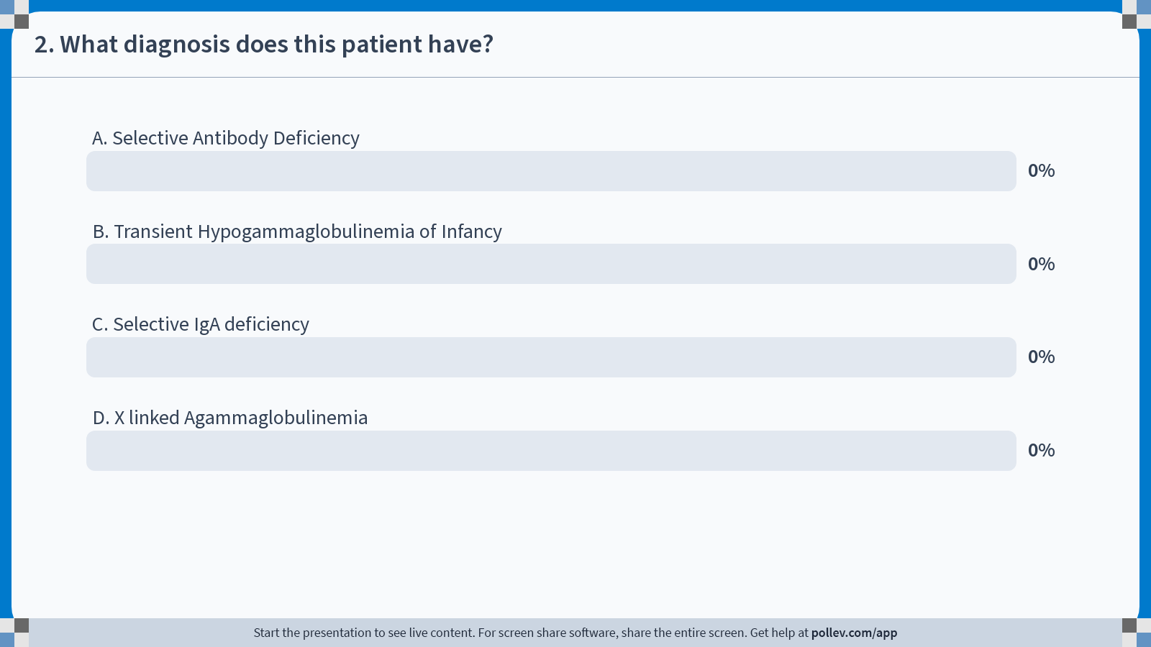
Notes:
Poll Title: Do not modify the notes in this section to avoid tampering with the Poll Everywhere activity.
More info at polleverywhere.com/support
2. What diagnosis does this patient have?
https://www.polleverywhere.com/multiple_choice_polls/bbChnbvyDeOetceDwLkql?display_state=chart&activity_state=closed&state=closed&flow=Instructor&onscreen=persist

Slide 27
Notes:
Poll Title: Do not modify the notes in this section to avoid tampering with the Poll Everywhere activity.
More info at polleverywhere.com/support
2. What diagnosis does this patient have?
https://www.polleverywhere.com/multiple_choice_polls/bbChnbvyDeOetceDwLkql?display_state=chart&activity_state=closed&display=correctness&state=closed&flow=Instructor&onscreen=persist

Slide 28
Question: What diagnosis does this patient have?
Selective Antibody Deficiency
Transient Hypogammaglobulinemia of Infancy
Selective IgA deficiency
X linked Agammaglobulinemia
0

Slide 29
Transient Hypogammaglobulinemia of Infancy
Begins in infants below the age of one year. IgG typically within normal limits by the age of 5 years.
Usually children grow well
Frequent URI
Laboratory evaluation reveals decreased IgG, normal IgM and IgA. Normal specific antibody responses.
Treatment: Observation for most; in the case of severe infections requiring hospitalization, consider IVIG/SCIG

Slide 30
Case study
30 month old male with recurrent sinusitis. As a 9 month old infant, episode of Hemophilus Influenza type B meningitis despite routine immunizations. Growing well. Development milestones normal.
Poor response to pneumococcal vaccines.

Slide 31
Question: What diagnosis does this patient have?
Selective Antibody Deficiency
Transient Hypogammaglobulinemia of Infancy
Selective IgA deficiency
X linked Agammaglobulinemia
0

Slide 32

Notes:
Poll Title: Do not modify the notes in this section to avoid tampering with the Poll Everywhere activity.
More info at polleverywhere.com/support
3. What diagnosis does this patient have?
https://www.polleverywhere.com/multiple_choice_polls/u70BWhtv5MzCnyZQRw7QM?display_state=instructions&activity_state=opened&state=opened&flow=Instructor&onscreen=persist

Slide 33

Notes:
Poll Title: Do not modify the notes in this section to avoid tampering with the Poll Everywhere activity.
More info at polleverywhere.com/support
3. What diagnosis does this patient have?
https://www.polleverywhere.com/multiple_choice_polls/u70BWhtv5MzCnyZQRw7QM?display_state=chart&activity_state=closed&state=closed&flow=Instructor&onscreen=persist

Slide 34
Notes:
Poll Title: Do not modify the notes in this section to avoid tampering with the Poll Everywhere activity.
More info at polleverywhere.com/support
3. What diagnosis does this patient have?
https://www.polleverywhere.com/multiple_choice_polls/u70BWhtv5MzCnyZQRw7QM?display_state=chart&activity_state=closed&display=correctness&state=closed&flow=Instructor&onscreen=persist

Slide 35
Question: What diagnosis does this patient have?
Selective Antibody Deficiency
Transient Hypogammaglobulinemia of Infancy
Selective IgA deficiency
X linked Agammaglobulinemia
0

Slide 36
Specific Antibody Deficiency
Present with recurrent infections with Otitis Media, Sinusitis and Pneumonia.
Grow well.
Patients unable to respond to polysaccharide antigens, specifically pneumococcus and Hemophilus influenza type B. Less than fourfold increase in titers post-vaccine.
Treatment: Require close monitoring. If recurrent infections, likely need IVIG/SCIG.

Slide 37
IgG subclass Deficiency
Deficiency in IgG subclasses has been reported in some individuals
Recurrent pyogenic infection has been assoc. with some individuals
Most individuals with IgG subclass deficiency are asymptomatic
Relationship of IgG2 deficiency to IgA deficiency
Clinical significance of IgG subclass deficiency is variable- controversial***
If assoc with specific antibody deficiency, may treat with IVIG

Slide 38
Case Study
18 year old female presents with history of recurrent sinus infections and “bronchitis.” Chronic cough. Responds well to antibiotics. Otherwise unremarkable medical history as young child.

Slide 39
Question: What diagnosis does this patient have?
Selective Antibody Deficiency
Common Variable Immunodeficiency
Selective IgA deficiency
X linked Agammaglobulinemia
0

Slide 40
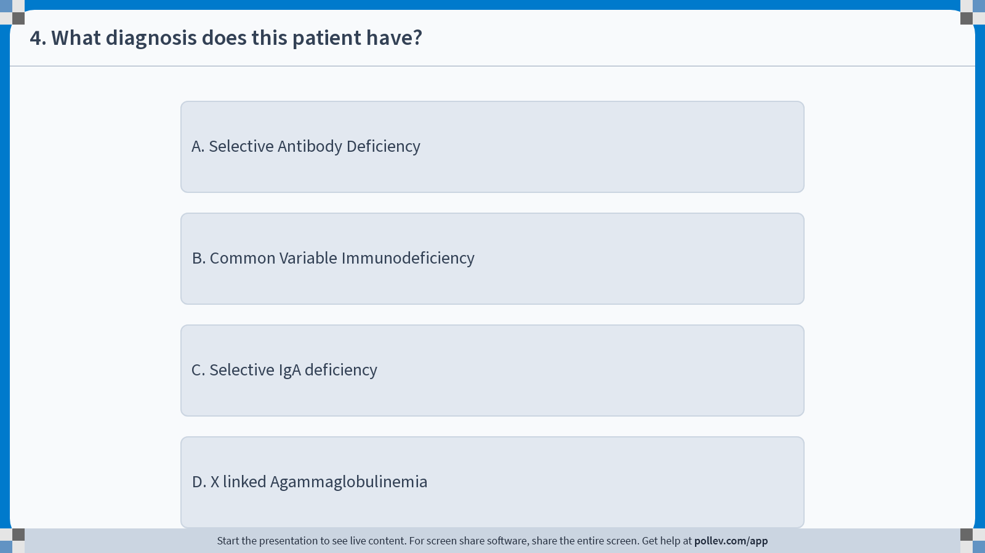
Notes:
Poll Title: Do not modify the notes in this section to avoid tampering with the Poll Everywhere activity.
More info at polleverywhere.com/support
4. What diagnosis does this patient have?
https://www.polleverywhere.com/multiple_choice_polls/YvqhYRcftbZpO60CMsQmQ?display_state=instructions&activity_state=opened&state=opened&flow=Instructor&onscreen=persist

Slide 41
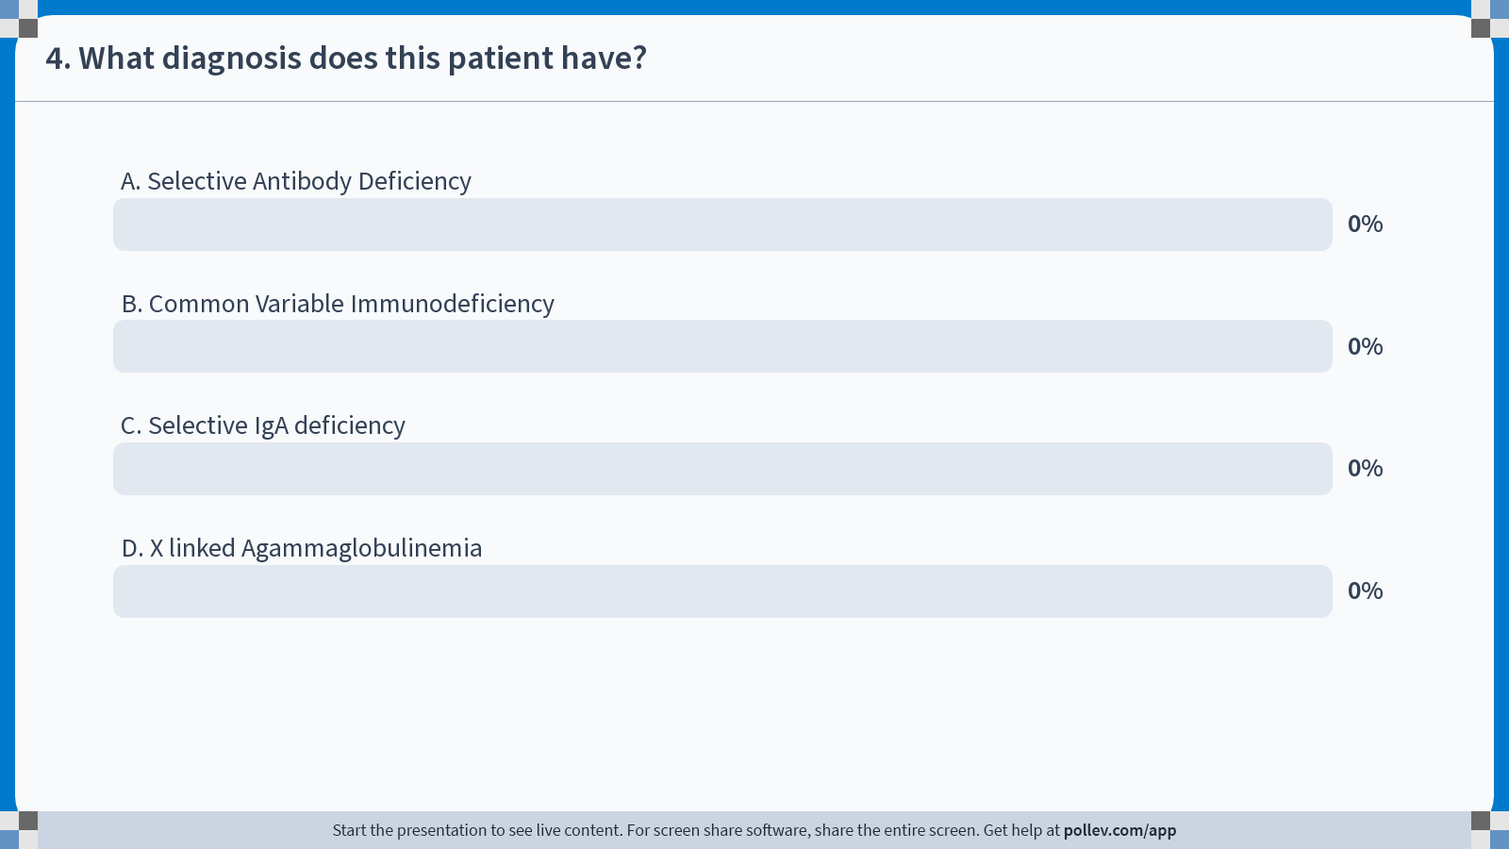
Notes:
Poll Title: Do not modify the notes in this section to avoid tampering with the Poll Everywhere activity.
More info at polleverywhere.com/support
4. What diagnosis does this patient have?
https://www.polleverywhere.com/multiple_choice_polls/YvqhYRcftbZpO60CMsQmQ?display_state=chart&activity_state=closed&state=closed&flow=Instructor&onscreen=persist

Slide 42
Notes:
Poll Title: Do not modify the notes in this section to avoid tampering with the Poll Everywhere activity.
More info at polleverywhere.com/support
4. What diagnosis does this patient have?
https://www.polleverywhere.com/multiple_choice_polls/YvqhYRcftbZpO60CMsQmQ?display_state=chart&activity_state=closed&display=correctness&state=closed&flow=Instructor&onscreen=persist

Slide 43
Question: What diagnosis does this patient have?
Selective Antibody Deficiency
Common Variable Immunodeficiency
Selective IgA deficiency
X linked Agammaglobulinemia
0

Slide 44
Common Variable ID (CVID)
Onset usually in 2nd or 3rd decade of life**
Slow decline in all classes of immunoglobulin (IgG,A,M,E)
Recurrent sinopulmonary infections (usually bacterial in origin)
May follow Epstein-Barr infection
Can be assoc. with GI (sprue & colitis), endocrine (hypothyroidism) & hematologic disorders (lymphoma)

Slide 45
CVID (cont)
Increased Incidence of Autoimmune Disease
High Incidence of Chronic Diarrhea and Malabsorption
May be Associated with Lymphadenopathy, Hepatosplenomegaly, Interstitial Pneumonia
Treatment- IVIG/SCIG, prophylactic antibiotics

Slide 46
Case study
7 month old male with history of failure to thrive beginning at 4 months of age. Chronic diarrhea. Hypoproteinemia. Losing milestones- no longer rolls, smiles.
Family history of two unexplained infant male deaths.

Slide 47
Question: What diagnosis does this patient have?
Autosomal recessive Agammaglobulinemia
Transient Hypogammaglobulinemia of Infancy
Selective IgA deficiency
X linked Agammaglobulinemia
0

Slide 48
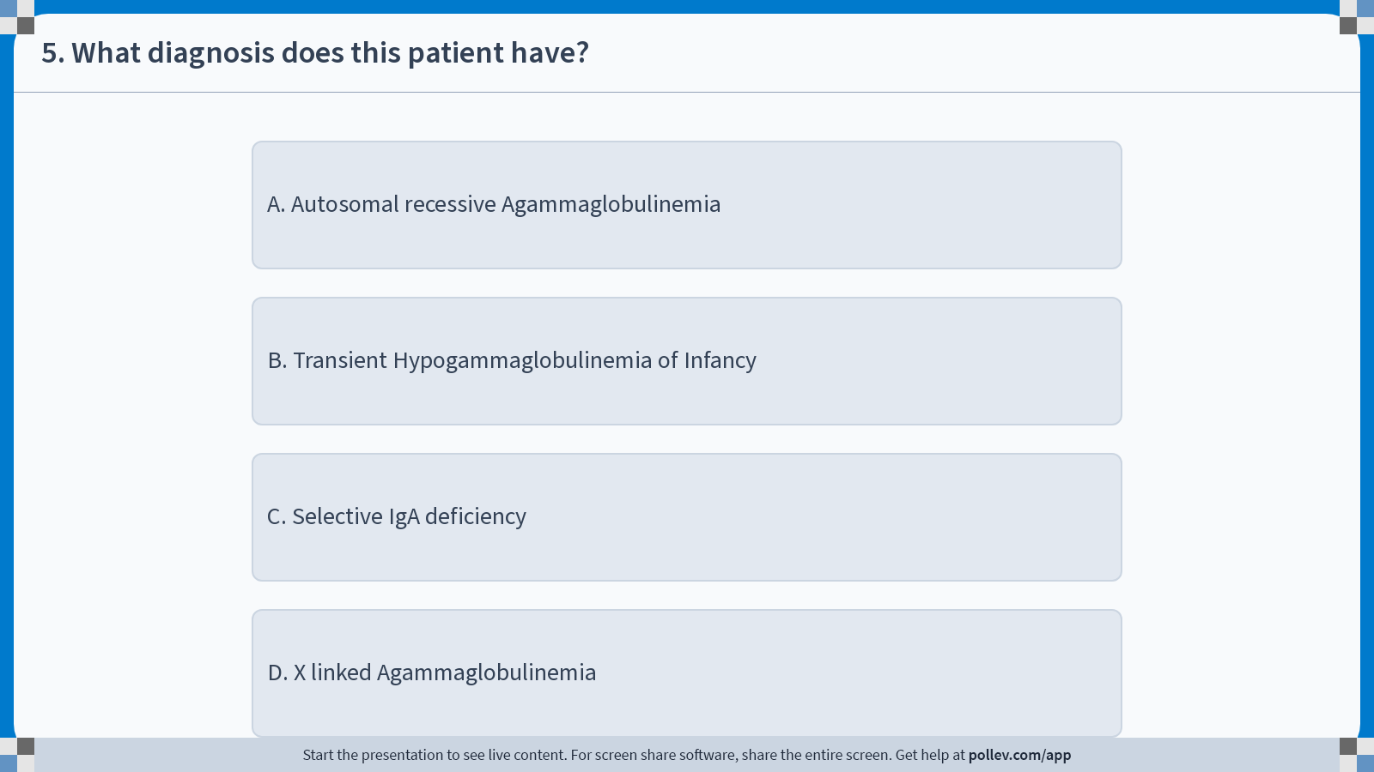
Notes:
Poll Title: Do not modify the notes in this section to avoid tampering with the Poll Everywhere activity.
More info at polleverywhere.com/support
5. What diagnosis does this patient have?
https://www.polleverywhere.com/multiple_choice_polls/Ln8KdZetQ138bAqMPB19j?display_state=instructions&activity_state=opened&state=opened&flow=Instructor&onscreen=persist

Slide 49
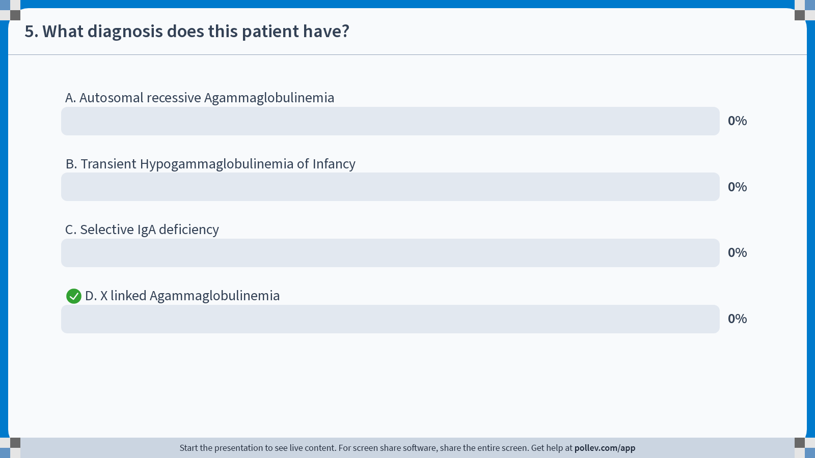
Notes:
Poll Title: Do not modify the notes in this section to avoid tampering with the Poll Everywhere activity.
More info at polleverywhere.com/support
5. What diagnosis does this patient have?
https://www.polleverywhere.com/multiple_choice_polls/Ln8KdZetQ138bAqMPB19j?display_state=chart&activity_state=closed&state=closed&flow=Instructor&onscreen=persist

Slide 50
Notes:
Poll Title: Do not modify the notes in this section to avoid tampering with the Poll Everywhere activity.
More info at polleverywhere.com/support
5. What diagnosis does this patient have?
https://www.polleverywhere.com/multiple_choice_polls/Ln8KdZetQ138bAqMPB19j?display_state=chart&activity_state=closed&display=correctness&state=closed&flow=Instructor&onscreen=persist

Slide 51
Question: What diagnosis does this patient have?
Autosomal recessive Agammaglobulinemia
Transient Hypogammaglobulinemia of Infancy
Selective IgA deficiency
X linked Agammaglobulinemia
0

Slide 52
X-Linked Agammaglobulinemia (XLA or Bruton’s )
Gene defect chromosome on Xq21.3-22; B-cell tyrosine kinase deficiency
Infections begin 6 weeks to 6 months
Absent circulating mature B-cells <1% (Block from Pro B cell to Pre B Cell stage, some patients block after Pre B cell)
All major classes of immunoglobulin affected (IgG, IgM, IgA, IgE)
To diagnose an infant, obtain lymph subsets- maternal Ab production will obscure immunoglobulins**

Slide 53
XLA
Pyogenic infections, Giardia,*** Enteroviral –red flag if loss of milestones- R/O meningitis***
PCP
May Have Family History of Males with Infections or Death in Infancy
Paucity of Lymphoid Tissue on Exam-absent tonsils and lymph nodes***
Treatment- Lifelong IVIG/SCIG, prophylactic antibiotics

Slide 54
Case study
5 year old male with history of recurrent infections. Recurrent lymphadenopathy. Has had “enlarged liver.” Also, developed autoimmune hemolytic anemia and thrombocytopenia at 2 years old.

Slide 55
Question: What diagnosis does this patient have?
Chronic Granulomatous Disease
Hyper IgE syndrome
Hyper IgM syndrome
Wiskott Aldrich
0

Slide 56
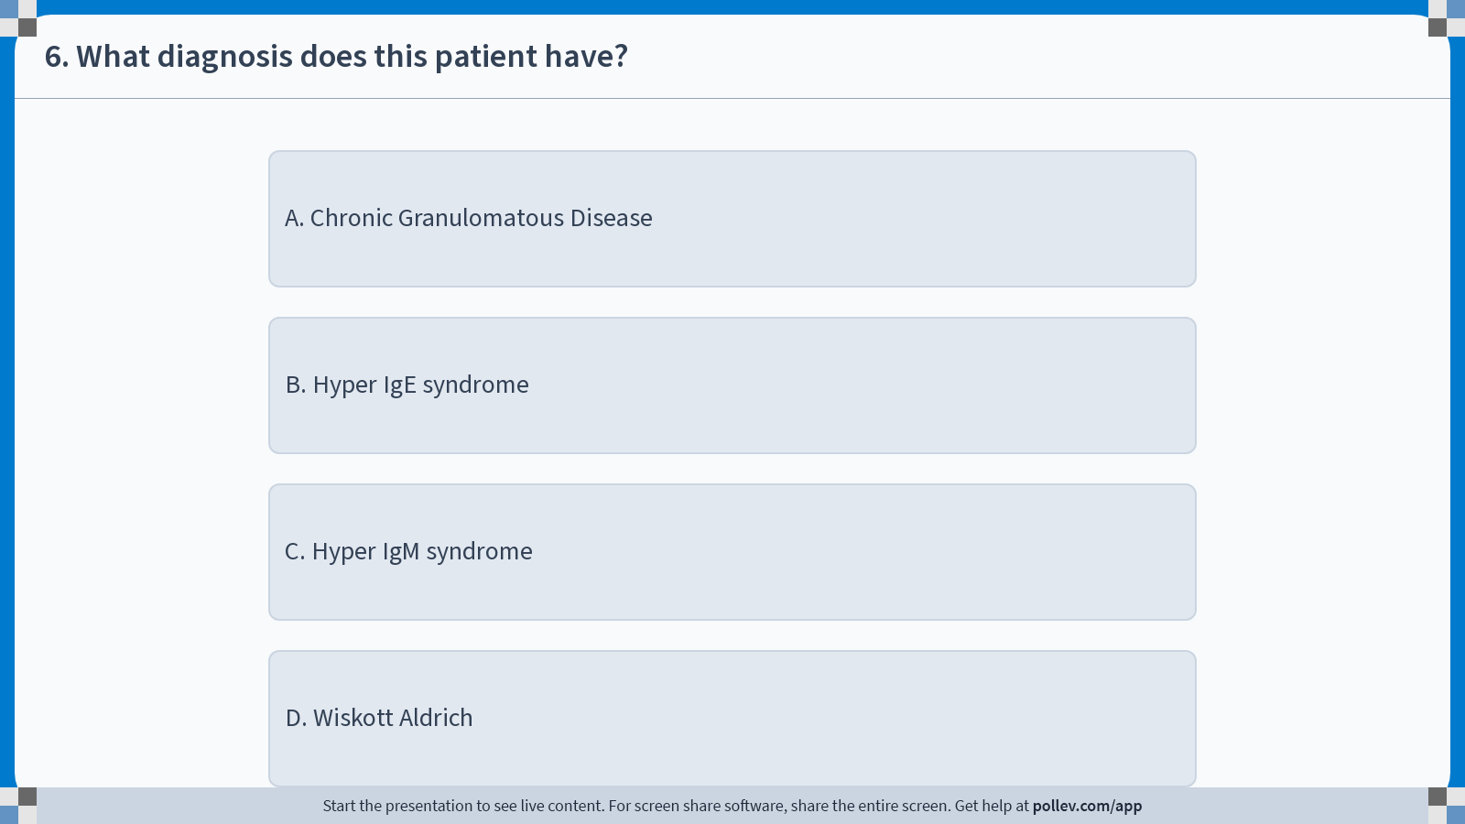
Notes:
Poll Title: Do not modify the notes in this section to avoid tampering with the Poll Everywhere activity.
More info at polleverywhere.com/support
6. What diagnosis does this patient have?
https://www.polleverywhere.com/multiple_choice_polls/1Ki36q54Y6sGzmbUrL97E?display_state=instructions&activity_state=opened&state=opened&flow=Instructor&onscreen=persist

Slide 57
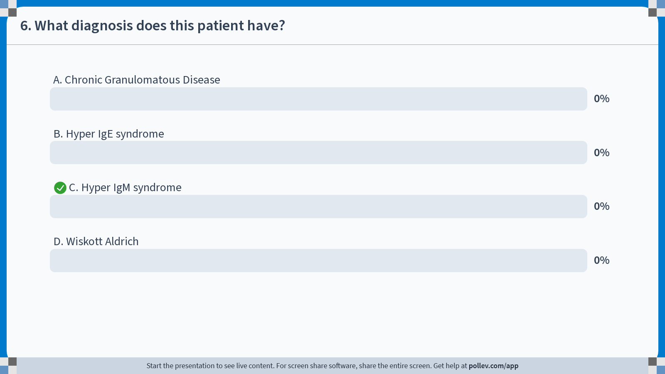
Notes:
Poll Title: Do not modify the notes in this section to avoid tampering with the Poll Everywhere activity.
More info at polleverywhere.com/support
6. What diagnosis does this patient have?
https://www.polleverywhere.com/multiple_choice_polls/1Ki36q54Y6sGzmbUrL97E?display_state=chart&activity_state=closed&state=closed&flow=Instructor&onscreen=persist

Slide 58
Notes:
Poll Title: Do not modify the notes in this section to avoid tampering with the Poll Everywhere activity.
More info at polleverywhere.com/support
6. What diagnosis does this patient have?
https://www.polleverywhere.com/multiple_choice_polls/1Ki36q54Y6sGzmbUrL97E?display_state=chart&activity_state=closed&display=correctness&state=closed&flow=Instructor&onscreen=persist

Slide 59
Question: What diagnosis does this patient have?
Chronic Granulomatous Disease
Hyper IgE syndrome
Hyper IgM syndrome
Wiskott Aldrich
0

Slide 60
Hyper IgM Syndrome
Multiple causes- CD40 (B cells) deficiency, CD40 ligand (T cells) deficiency, Activation Induced Deaminase (AID) deficiency, Uracil DNA Glycosylase (UNG), NF kappa beta essential modulator (NEMO); no isotype switching occurs
Polyclonal normal to increased IgM**, lack IgG,A,E
Infection from encapsulated bacteria
Autoantibody production (hemolytic anemia, thrombocytopenia, neutropenia)
Lack of immune surveillance: hepatocellular carcinoma**
Treatment- BMT- haplo-identical sibling, IVIG/SCIG, prophylactic antibiotics

Slide 61
Case study
8 year old male with recurrent “abscesses” of the skin. “Problems” with lung infections. Face looks “coarse.” Had history of “eczema” since infancy. Retained primary teeth.
Bony abnormalities and pneumatoceles on chest film.

Slide 62
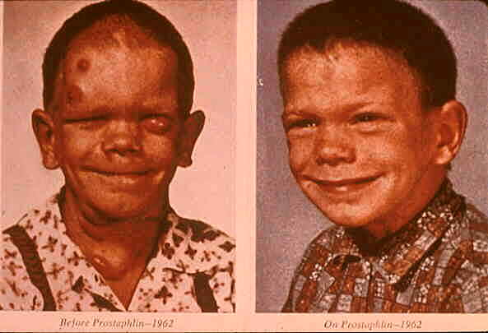

Slide 63
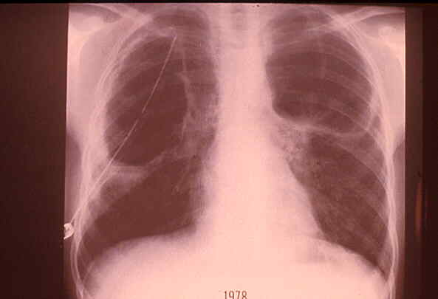

Slide 64
Question: What diagnosis does this patient have?
Chronic Granulomatous Disease
Hyper IgE syndrome
Chronic Mucocutaneous Candidiasis
Wiskott Aldrich

Slide 65
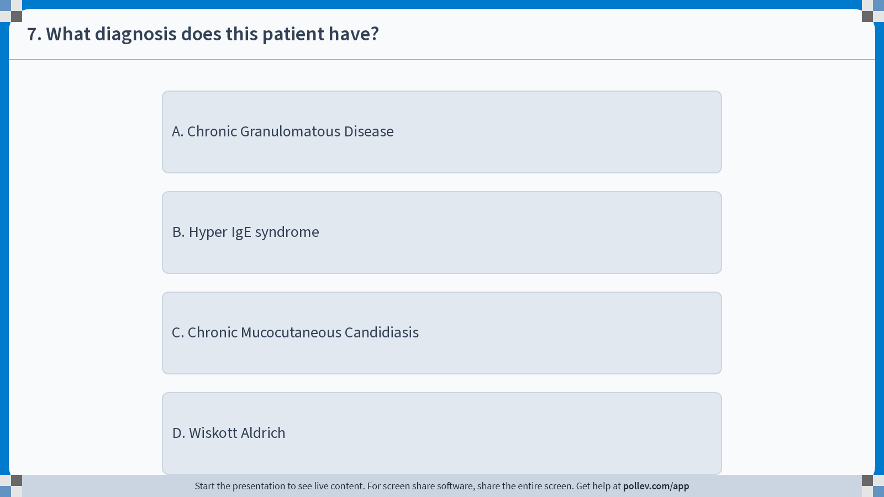
Notes:
Poll Title: Do not modify the notes in this section to avoid tampering with the Poll Everywhere activity.
More info at polleverywhere.com/support
7. What diagnosis does this patient have?
https://www.polleverywhere.com/multiple_choice_polls/NHeCsjo4SE5HumV1PrHbm?display_state=instructions&activity_state=opened&state=opened&flow=Instructor&onscreen=persist

Slide 66
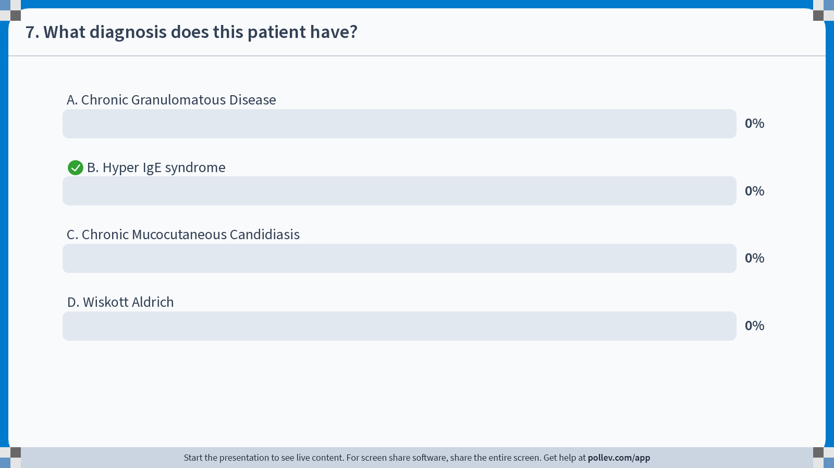
Notes:
Poll Title: Do not modify the notes in this section to avoid tampering with the Poll Everywhere activity.
More info at polleverywhere.com/support
7. What diagnosis does this patient have?
https://www.polleverywhere.com/multiple_choice_polls/NHeCsjo4SE5HumV1PrHbm?display_state=chart&activity_state=closed&state=closed&flow=Instructor&onscreen=persist

Slide 67
Notes:
Poll Title: Do not modify the notes in this section to avoid tampering with the Poll Everywhere activity.
More info at polleverywhere.com/support
7. What diagnosis does this patient have?
https://www.polleverywhere.com/multiple_choice_polls/NHeCsjo4SE5HumV1PrHbm?display_state=chart&activity_state=closed&display=correctness&state=closed&flow=Instructor&onscreen=persist

Slide 68
Question: What diagnosis does this patient have?
Chronic Granulomatous Disease
Hyper IgE syndrome
Chronic Mucocutaneous Candidiasis
Wiskott Aldrich
0

Slide 69
Hyper IgE Syndrome
(Job Syndrome)
Most sporadic, AD (STAT 3) and AR (DOCK8) forms exist
Severe recurrent abscesses (Staph) in skin, lungs, viscera**
Increased IgE; Low to normal IgG, A, M
Increased blood and sputum eosinophilia
Pruritic Dermatitis-face, scalp, neck**
Coarse facial features**
Delayed or lack of shedding primary teeth
Chronic lung disease and lymphoreticular malignancy
Treatment- prophylactic antibiotics- Anti-Staph

Slide 70
Case study
10 day old male with history of seizures 3 days after birth. Congenital heart disease diagnosed prenatally, requiring surgical repair. Fish-shaped mouth with posteriorly rotated ears. Chest films shows absent sail sign (no thymus).

Slide 71
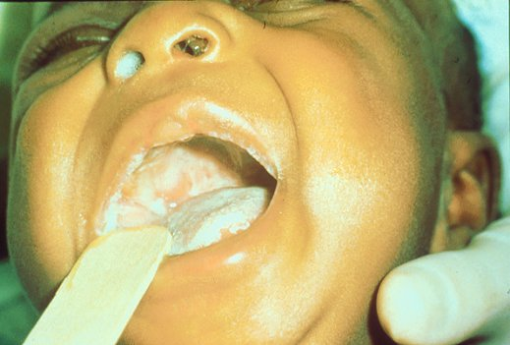

Slide 72
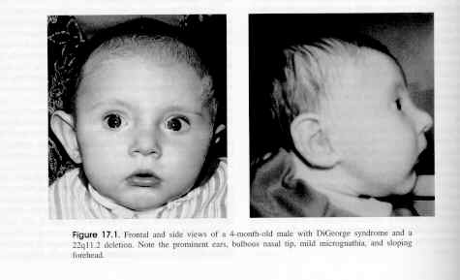

Slide 73
Question: What diagnosis does this patient have?
Chronic Granulomatous Disease
DiGeorge Syndrome
Chronic Mucocutaneous Candidiasis
Wiskott Aldrich
0

Slide 74

Notes:
Poll Title: Do not modify the notes in this section to avoid tampering with the Poll Everywhere activity.
More info at polleverywhere.com/support
8. What diagnosis does this patient have?
https://www.polleverywhere.com/multiple_choice_polls/mgDtZA8FzIfweF0ewahmK?display_state=instructions&activity_state=opened&state=opened&flow=Instructor&onscreen=persist

Slide 75
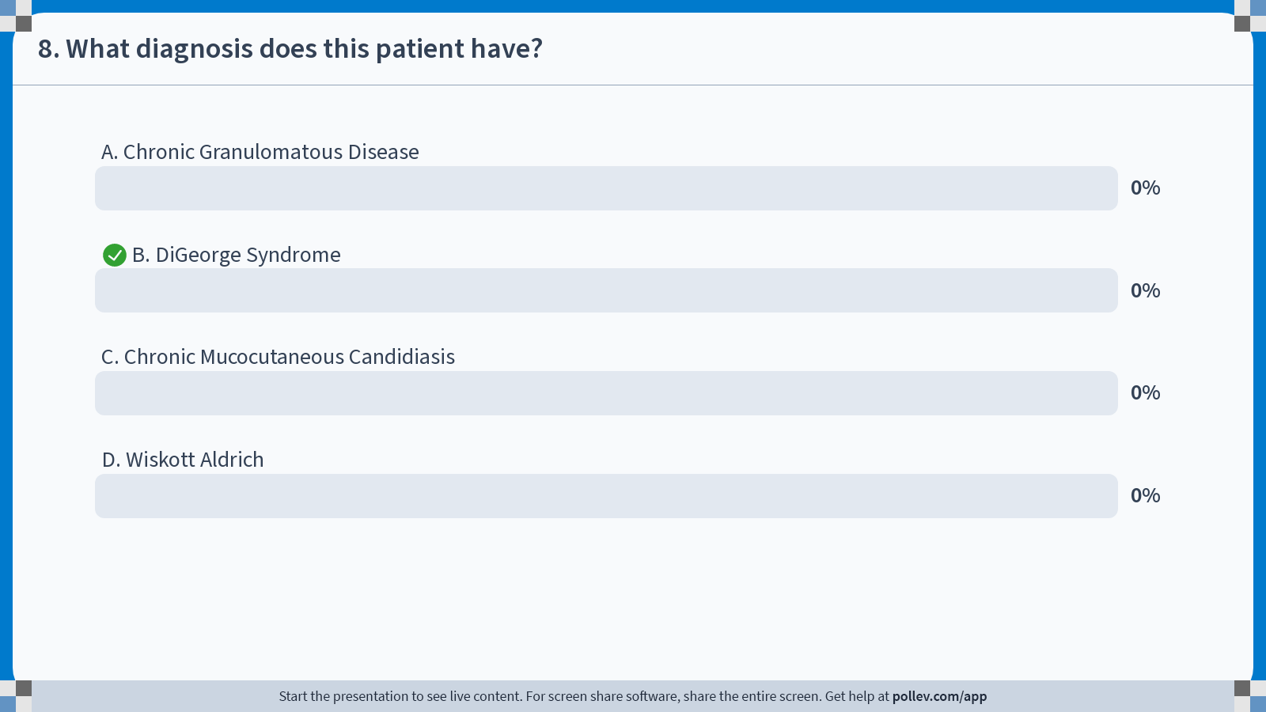
Notes:
Poll Title: Do not modify the notes in this section to avoid tampering with the Poll Everywhere activity.
More info at polleverywhere.com/support
8. What diagnosis does this patient have?
https://www.polleverywhere.com/multiple_choice_polls/mgDtZA8FzIfweF0ewahmK?display_state=chart&activity_state=closed&state=closed&flow=Instructor&onscreen=persist

Slide 76
Notes:
Poll Title: Do not modify the notes in this section to avoid tampering with the Poll Everywhere activity.
More info at polleverywhere.com/support
8. What diagnosis does this patient have?
https://www.polleverywhere.com/multiple_choice_polls/mgDtZA8FzIfweF0ewahmK?display_state=chart&activity_state=closed&display=correctness&state=closed&flow=Instructor&onscreen=persist

Slide 77
Question: What diagnosis does this patient have?
Chronic Granulomatous Disease
DiGeorge Syndrome
Chronic Mucocutaneous Candidiasis
Wiskott Aldrich
0

Slide 78
DiGeorge Syndrome (DGS)
Defect in embryogenesis, 3rd & 4th pharyngeal pouches
Chromosomal abnormality: 22q11.2
Presents in first few days of life (tetany)**
CXR, absence of thymic shadow
Clinical features:
  Dysmorphic facies (micrognathia)
  Hypocalcemia (lack of parathyroid glands)**
  Depressed T-cell immunity- T cell numbers and lymphocyte function decreased**
  Congenital heart disease- most common Tet of Fallot, interrupted aortic arch, VSD***

Slide 79
DGS (cont)
  Treatment- Prophylactic antibiotics (Trimethoprim/Sulfa), Thymic implantation for complete DGS, Observation for most

Slide 80
Case study
Infant born at 10 lbs.
Now, 3 month old with chronic diarrhea. Weighs 6 lbs. Poor appetite. Not smiling or cooing. Frog leg position. Weak.

Slide 81
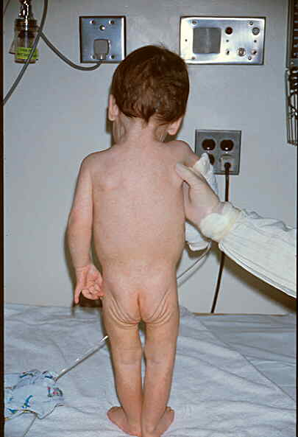

Slide 82
Question: What diagnosis does this patient have?
Chronic Granulomatous Disease
Wiskott Aldrich
Chronic Mucocutaneous Candidiasis
Severe Combined Immunodeficiency
0

Slide 83
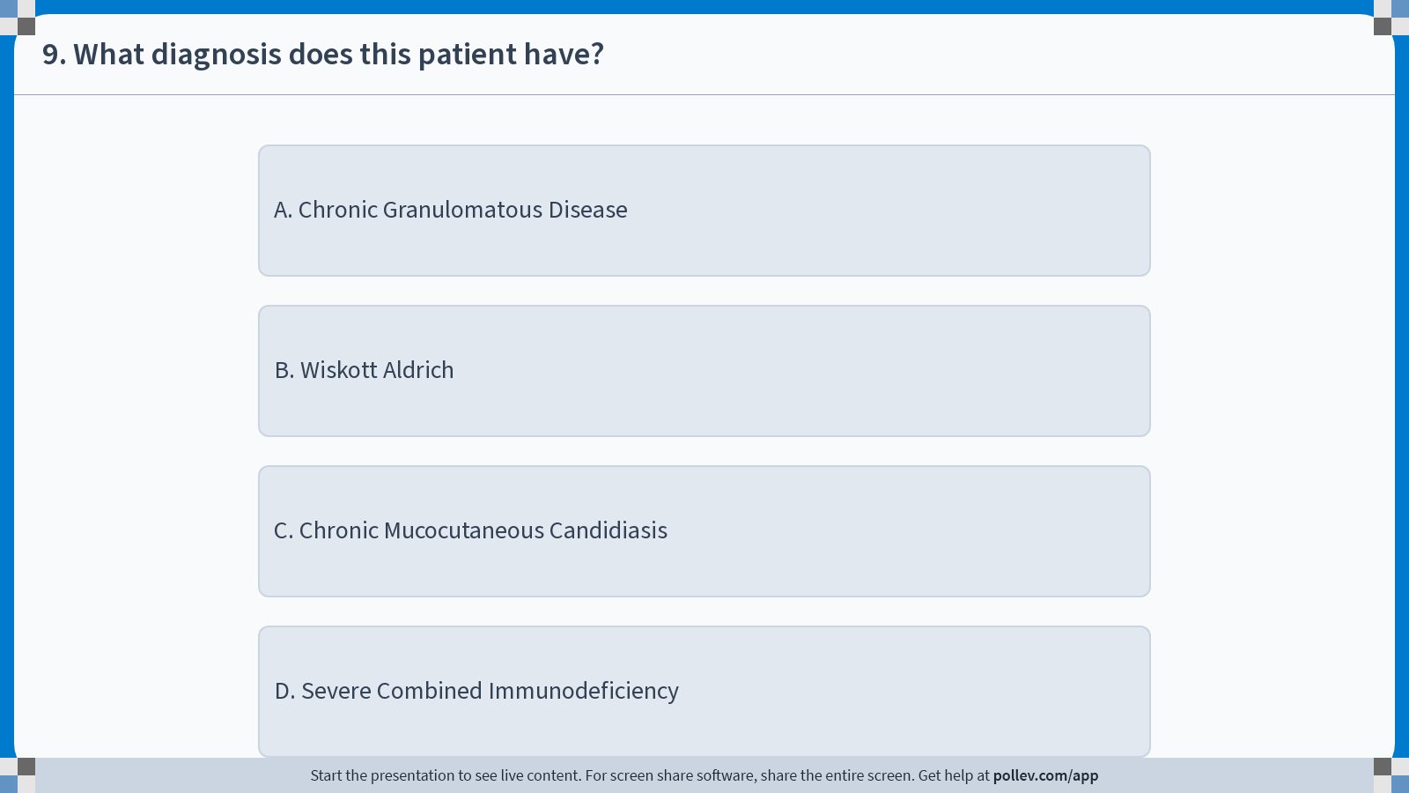
Notes:
Poll Title: Do not modify the notes in this section to avoid tampering with the Poll Everywhere activity.
More info at polleverywhere.com/support
9. What diagnosis does this patient have?
https://www.polleverywhere.com/multiple_choice_polls/CgGiNRBx2JDqMhJ0iIsJg?display_state=instructions&activity_state=opened&state=opened&flow=Instructor&onscreen=persist

Slide 84
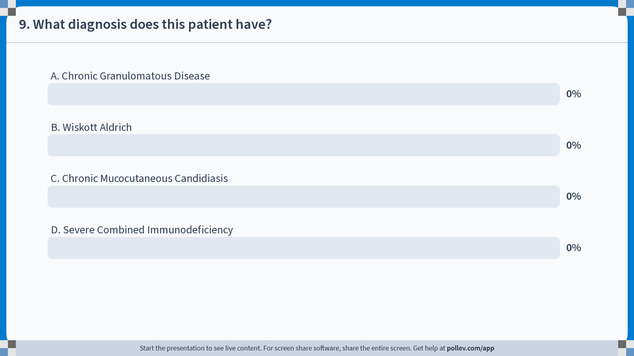
Notes:
Poll Title: Do not modify the notes in this section to avoid tampering with the Poll Everywhere activity.
More info at polleverywhere.com/support
9. What diagnosis does this patient have?
https://www.polleverywhere.com/multiple_choice_polls/CgGiNRBx2JDqMhJ0iIsJg?display_state=chart&activity_state=closed&state=closed&flow=Instructor&onscreen=persist

Slide 85
Notes:
Poll Title: Do not modify the notes in this section to avoid tampering with the Poll Everywhere activity.
More info at polleverywhere.com/support
9. What diagnosis does this patient have?
https://www.polleverywhere.com/multiple_choice_polls/CgGiNRBx2JDqMhJ0iIsJg?display_state=chart&activity_state=closed&display=correctness&state=closed&flow=Instructor&onscreen=persist

Slide 86
Question: What diagnosis does this patient have?
Chronic Granulomatous Disease
Wiskott Aldrich
Chronic Mucocutaneous Candidiasis
Severe Combined Immunodeficiency
0

Slide 87
Severe Combined ID (SCID)
NK-cells –
B-cells –
NK-cells +
T-cells –
NK-cells –
B-cells +
NK-cells +
T-cells + B-cells low NK-cells +
(clonal)
Adapted from AAAAI Primary ID Presentation www.AAAAI.org

Slide 88
SCID
Usually present with failure to thrive, persistent diarrhea
Respiratory symptoms +/- thrush between 2-7 months of age
Recurrent infections, severe infections (ie: meningitis)
Infections due to opportunistic organisms- Commonly, Pneumocystis jirovecii
Absent thymic shadow on chest X-ray-infants
**Absent tonsils/ lymph nodes**

Slide 89
SCID (cont)
Important to remember that normal absolute lymphocyte numbers in infants are higher than in other age groups (3,000 though 11,000)
Calculate absolute lymphocyte number (total white blood cell count multiplied by the percentage of lymphocytes)
Absent or nonfunctional lymphocytic cells
Decreased IgG, IgA and IgM
Absent antibody responses to specific antigens
**If lymphopenic on CBC, obtain lymphocyte subsets (T, B, NK cell numbers)**

Slide 90
SCID (cont)
Treatment- Aggressive feeding, prophylactic antibiotics, Gamma globulin replacement, leading to BMT- haplo-identical sibling or parental transplant as earlier as possible- prior to infections

Slide 91
Case Report
5 year old began with difficulty walking as young child.
Eye blood vessels are prominent. Recurrent upper respiratory infections.

Slide 92
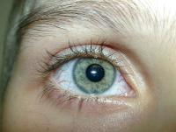

Slide 93
Question: What diagnosis does this patient have?
X-linked Lymphoproliferative Disease
Chediak Higashi
X linked Agammaglobulinemia
Ataxia Telangiectasia
0

Slide 94
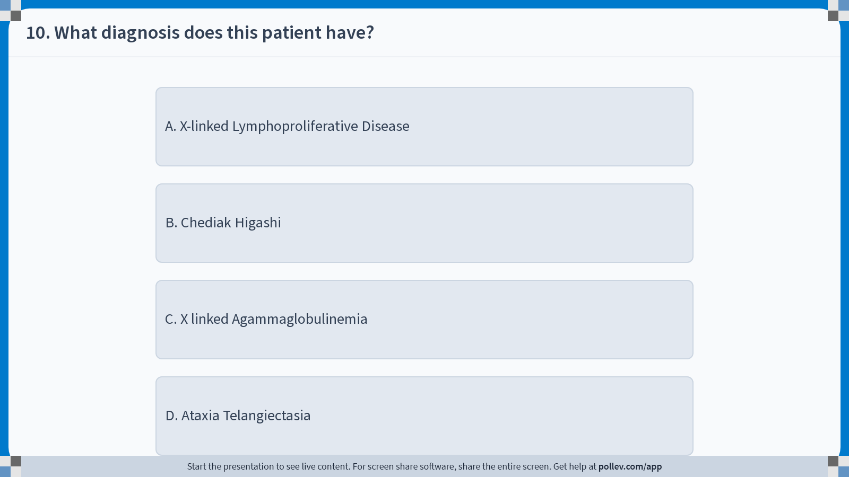
Notes:
Poll Title: Do not modify the notes in this section to avoid tampering with the Poll Everywhere activity.
More info at polleverywhere.com/support
10. What diagnosis does this patient have?
https://www.polleverywhere.com/multiple_choice_polls/kBzi6KPXTMgZdhMMJcyAu?display_state=instructions&activity_state=opened&state=opened&flow=Instructor&onscreen=persist

Slide 95
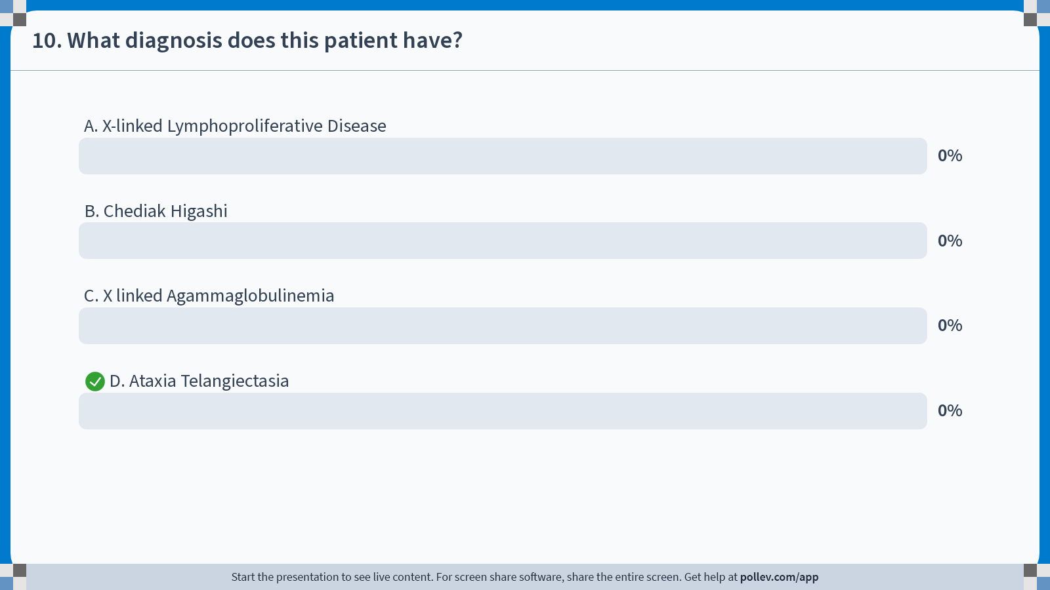
Notes:
Poll Title: Do not modify the notes in this section to avoid tampering with the Poll Everywhere activity.
More info at polleverywhere.com/support
10. What diagnosis does this patient have?
https://www.polleverywhere.com/multiple_choice_polls/kBzi6KPXTMgZdhMMJcyAu?display_state=chart&activity_state=closed&state=closed&flow=Instructor&onscreen=persist

Slide 96
Notes:
Poll Title: Do not modify the notes in this section to avoid tampering with the Poll Everywhere activity.
More info at polleverywhere.com/support
10. What diagnosis does this patient have?
https://www.polleverywhere.com/multiple_choice_polls/kBzi6KPXTMgZdhMMJcyAu?display_state=chart&activity_state=closed&display=correctness&state=closed&flow=Instructor&onscreen=persist

Slide 97
Question: What diagnosis does this patient have?
X-linked Lymphoproliferative Disease
Chediak Higashi
X linked Agammaglobulinemia
Ataxia Telangiectasia
0

Slide 98
Ataxia Telangiectasia/ Louis- Bar syndrome
Progressive neurologic disorder: cerebellar ataxia, oculocutaneous telangiectasia, chronic respiratory infections, a high incidence of malignancy, and variable humoral and cellular immunodeficiency
Cerebellar ataxia starts usually in childhood, telangiectasias appear later
Recurrent sinopulmonary infections
Serum IgM, IgA, IgE levels are diminished in some patients
Treatment- Observation; Prophylactic antibiotics

Slide 99
Case study
3 year old female with multiple episodes of liver abscesses, requiring drainage. Culture +Staph. Also, history of multiple draining abscesses of the skin. History of lymphadenopathy.

Slide 100
Question: What diagnosis does this patient have?
Chronic Granulomatous Disease
Wiskott Aldrich
STAT 3 Deficiency
WHIM syndrome
0

Slide 101
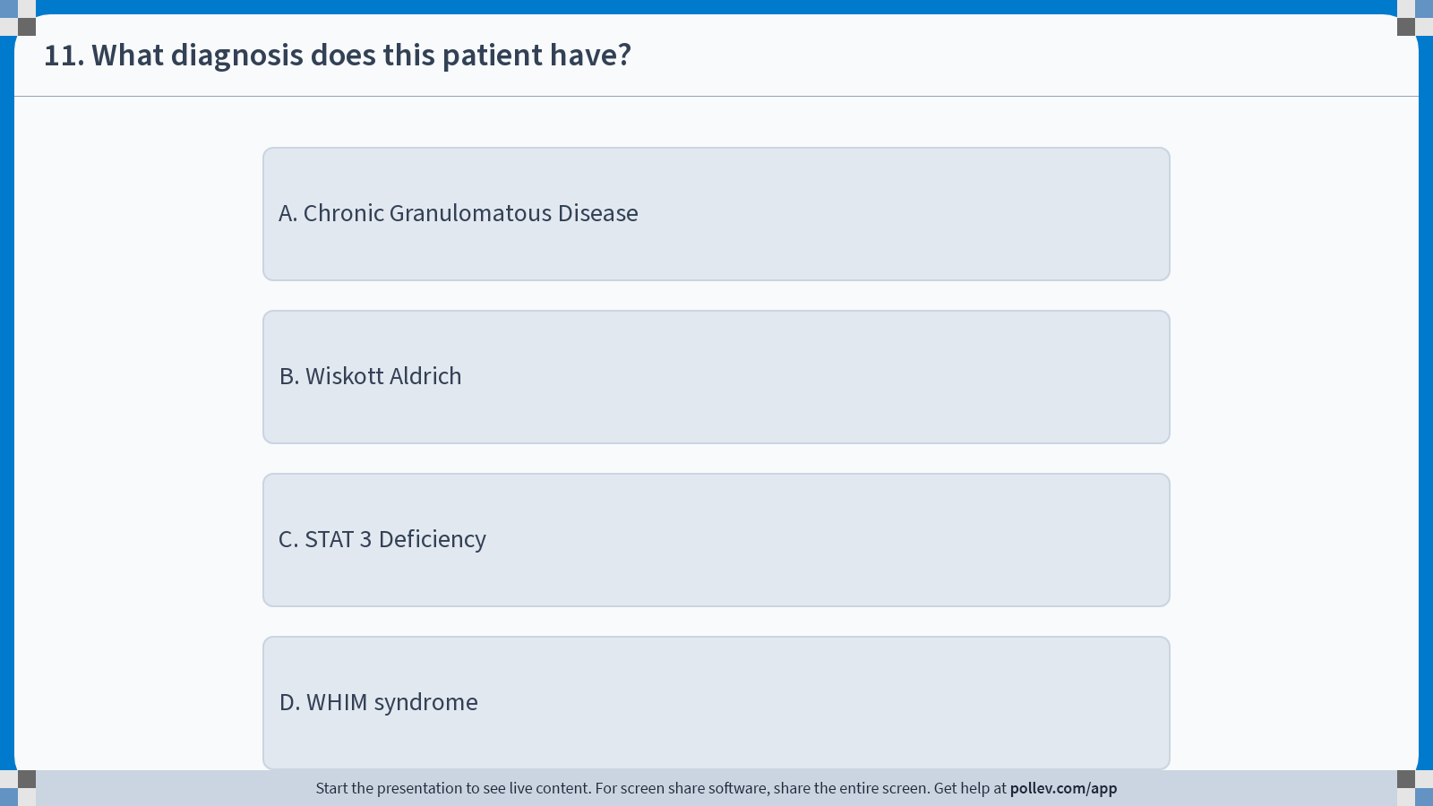
Notes:
Poll Title: Do not modify the notes in this section to avoid tampering with the Poll Everywhere activity.
More info at polleverywhere.com/support
11. What diagnosis does this patient have?
https://www.polleverywhere.com/multiple_choice_polls/CaUJo5ettPy6w7oOXXtfm?display_state=instructions&activity_state=opened&state=opened&flow=Instructor&onscreen=persist

Slide 102
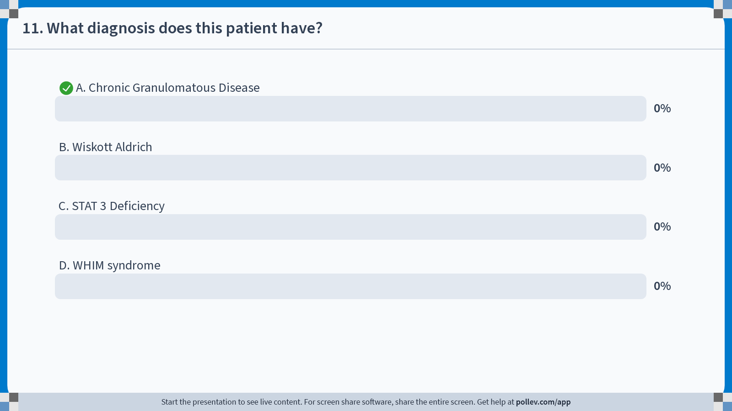
Notes:
Poll Title: Do not modify the notes in this section to avoid tampering with the Poll Everywhere activity.
More info at polleverywhere.com/support
11. What diagnosis does this patient have?
https://www.polleverywhere.com/multiple_choice_polls/CaUJo5ettPy6w7oOXXtfm?display_state=chart&activity_state=closed&state=closed&flow=Instructor&onscreen=persist

Slide 103
Notes:
Poll Title: Do not modify the notes in this section to avoid tampering with the Poll Everywhere activity.
More info at polleverywhere.com/support
11. What diagnosis does this patient have?
https://www.polleverywhere.com/multiple_choice_polls/CaUJo5ettPy6w7oOXXtfm?display_state=chart&activity_state=closed&display=correctness&state=closed&flow=Instructor&onscreen=persist

Slide 104
Question: What diagnosis does this patient have?
Chronic Granulomatous Disease
Wiskott Aldrich
STAT 3 Deficiency
WHIM syndrome
0

Slide 105
Chronic Granulomatous Disease (CGD)
Recurrent bacterial infections
Granulomas of skin, lungs, LN and liver- Staph Aspergillus and Nocardia**
Phagocytic cells ingest but not kill bacteria due to failure to form oxygen radicals
1:500,000, 65% X-linked
Gene defect chromosome location:
  gp91 phox (X-linked)
  P22 phox (AR)
  P47 phox (AR)
  P67 phox (AR)

Slide 106
CGD (cont)
Diagnosis- NBT, Oxidative burst, 1,2,3, dihydrorhodamine***
Treatment- Prophylactic antibiotics, antifungals; some patients may be treated with Interferon gamma; BMT- if HLA-identical sibling

Slide 107
Case Study
5 year old patient with recurrent candidal infections of extremities. Also, recently developed hypothyroidism. Otherwise, well. No hospitalizations.

Slide 108
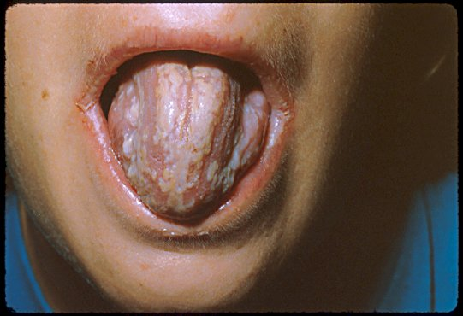

Slide 109
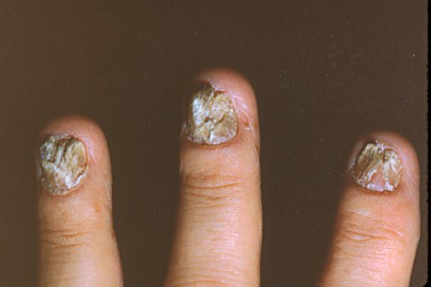

Slide 110
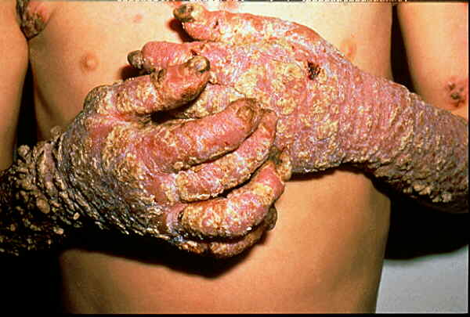

Slide 111
Question: What diagnosis does this patient have?
Chronic Granulomatous Disease
Wiskott Aldrich
Chronic Mucocutaneous Candidiasis
Severe Combined Immunodeficiency
0

Slide 112
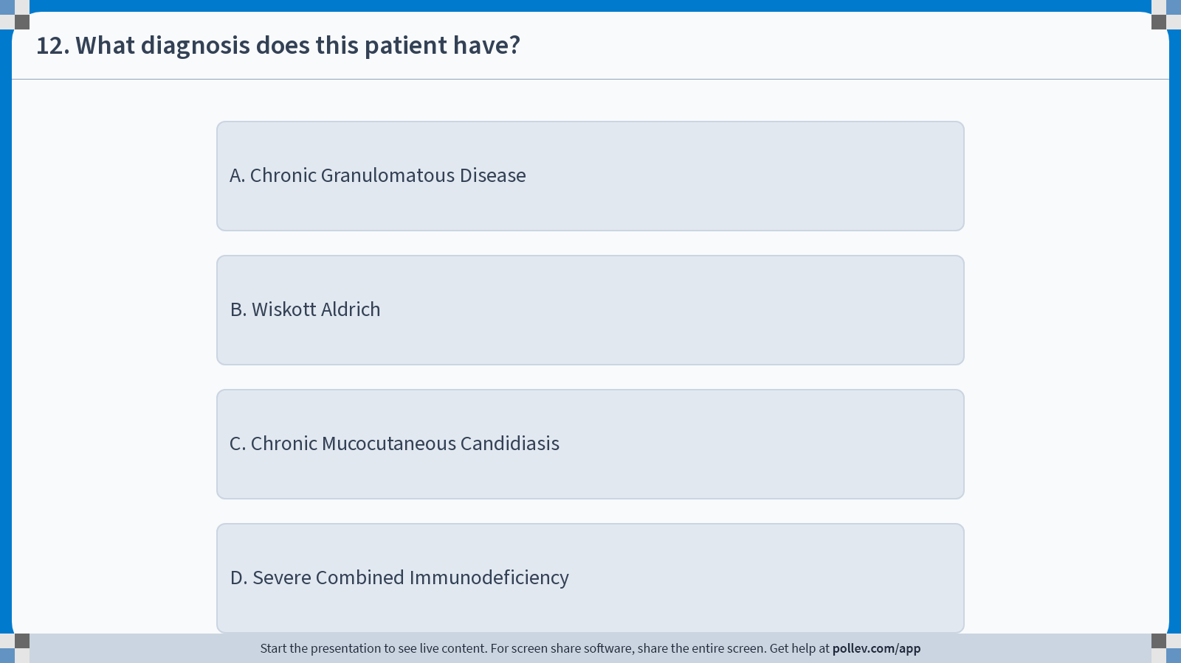
Notes:
Poll Title: Do not modify the notes in this section to avoid tampering with the Poll Everywhere activity.
More info at polleverywhere.com/support
12. What diagnosis does this patient have?
https://www.polleverywhere.com/multiple_choice_polls/byYkmMHBnGHBfaW9WtSgY?display_state=instructions&activity_state=opened&state=opened&flow=Instructor&onscreen=persist

Slide 113
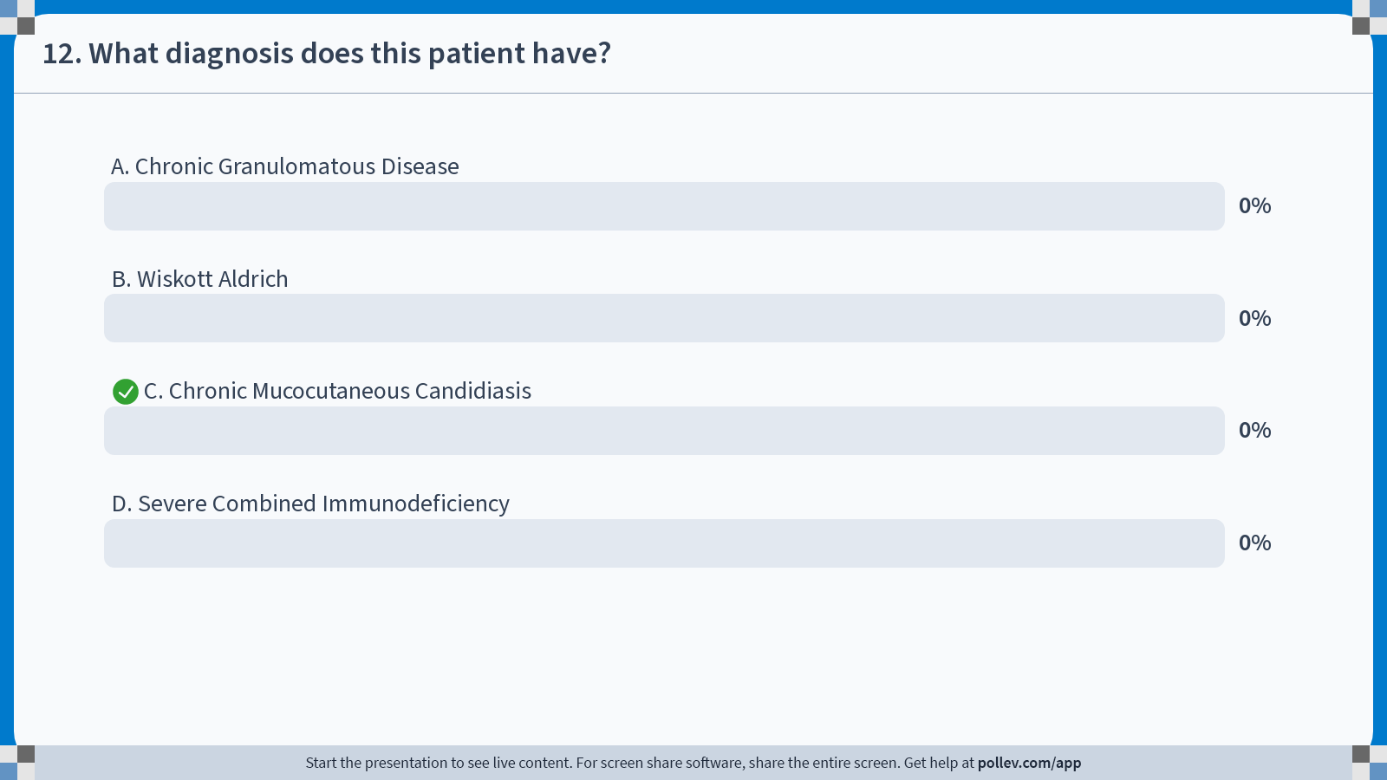
Notes:
Poll Title: Do not modify the notes in this section to avoid tampering with the Poll Everywhere activity.
More info at polleverywhere.com/support
12. What diagnosis does this patient have?
https://www.polleverywhere.com/multiple_choice_polls/byYkmMHBnGHBfaW9WtSgY?display_state=chart&activity_state=closed&state=closed&flow=Instructor&onscreen=persist

Slide 114
Notes:
Poll Title: Do not modify the notes in this section to avoid tampering with the Poll Everywhere activity.
More info at polleverywhere.com/support
12. What diagnosis does this patient have?
https://www.polleverywhere.com/multiple_choice_polls/byYkmMHBnGHBfaW9WtSgY?display_state=chart&activity_state=closed&display=correctness&state=closed&flow=Instructor&onscreen=persist

Slide 115
Question: What diagnosis does this patient have?
Chronic Granulomatous Disease
Wiskott Aldrich
Chronic Mucocutaneous Candidiasis
Severe Combined Immunodeficiency
0

Slide 116
Chronic Mucocutaneous Candidiasis
Chronic and Recurrent Candida Infections
Fungemia Rare***
High incidence of endocrinopathies
  More common in familial cases
  If associated with polyendocrinopathy, look for AIRE mutation
Cellular immune studies usually normal
Many children have non-Candidal infections
Treatment- Antifungal treatment

Slide 117
Case study
8 week old male infant with “umbilical cord that won’t come off.” Had surgical repair of inguinal hernia- poor wound healing. No pus. No family history of immune deficiency.
CBC revealed WBC 25k.

Slide 118
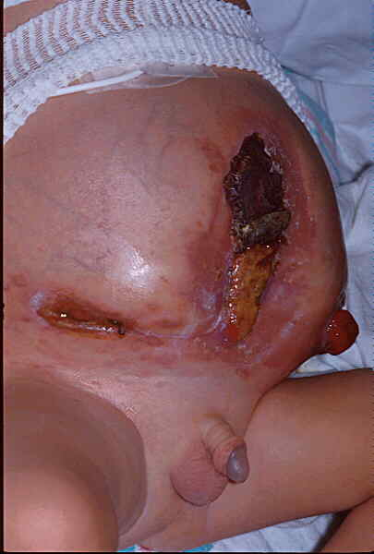

Slide 119
Question: What diagnosis does this patient have?
Interferon Gamma Receptor Deficiency
Wiskott Aldrich
WHIM syndrome
Leukocyte Adhesion Defect
0

Slide 120
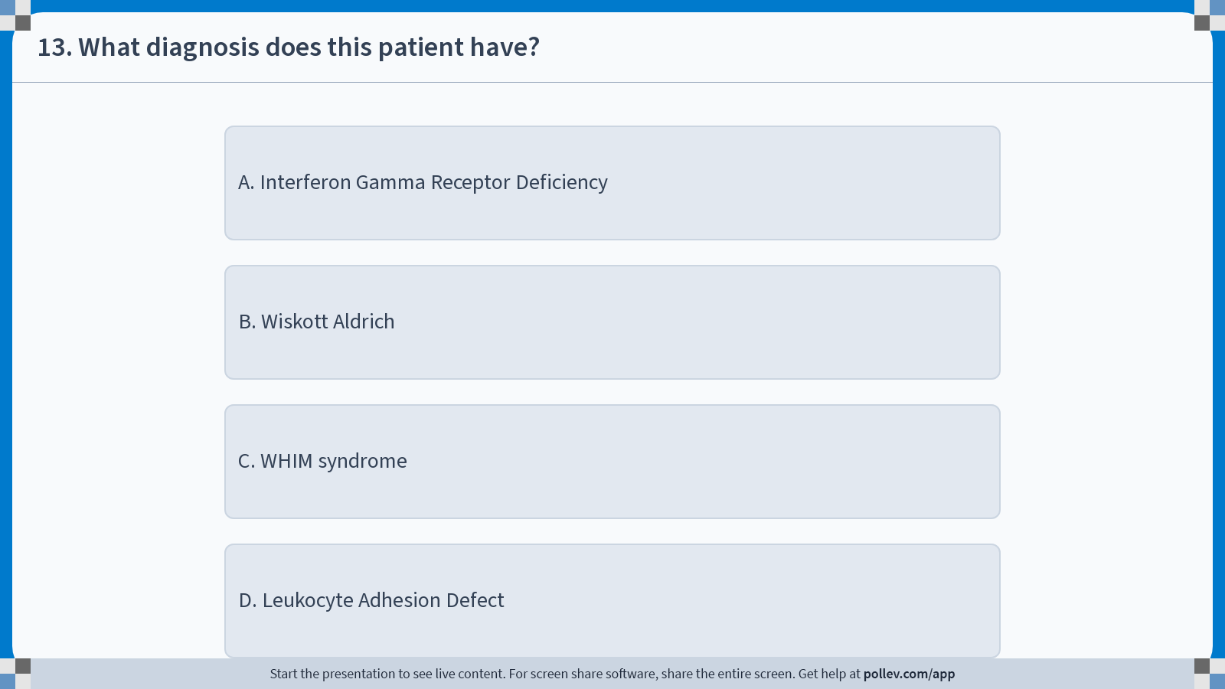
Notes:
Poll Title: Do not modify the notes in this section to avoid tampering with the Poll Everywhere activity.
More info at polleverywhere.com/support
13. What diagnosis does this patient have?
https://www.polleverywhere.com/multiple_choice_polls/DcMz2Ud2S2asnmanA2UWX?display_state=instructions&activity_state=opened&state=opened&flow=Instructor&onscreen=persist

Slide 121
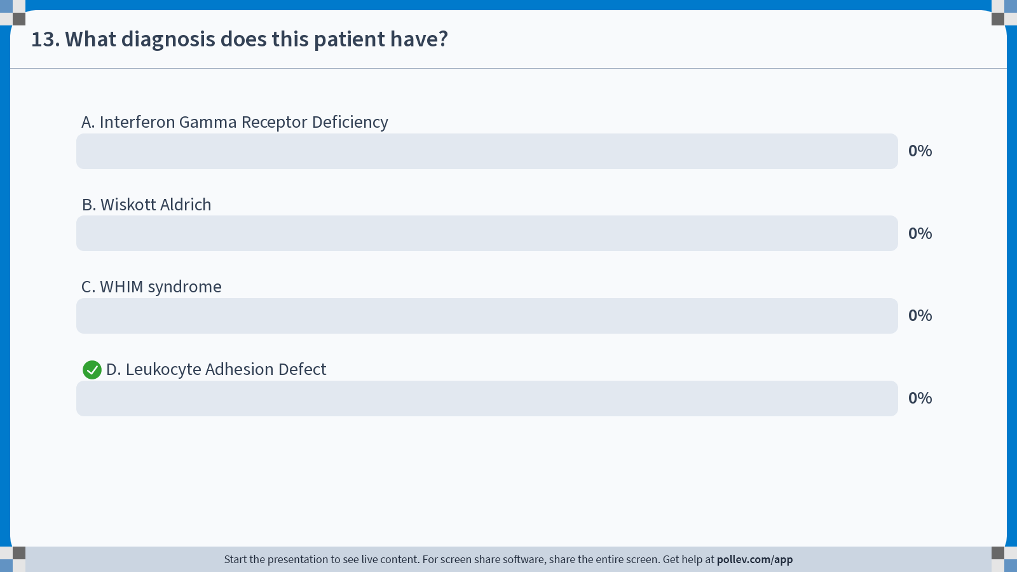
Notes:
Poll Title: Do not modify the notes in this section to avoid tampering with the Poll Everywhere activity.
More info at polleverywhere.com/support
13. What diagnosis does this patient have?
https://www.polleverywhere.com/multiple_choice_polls/DcMz2Ud2S2asnmanA2UWX?display_state=chart&activity_state=closed&state=closed&flow=Instructor&onscreen=persist

Slide 122
Notes:
Poll Title: Do not modify the notes in this section to avoid tampering with the Poll Everywhere activity.
More info at polleverywhere.com/support
13. What diagnosis does this patient have?
https://www.polleverywhere.com/multiple_choice_polls/DcMz2Ud2S2asnmanA2UWX?display_state=chart&activity_state=closed&display=correctness&state=closed&flow=Instructor&onscreen=persist

Slide 123
Question: What diagnosis does this patient have?
Interferon Gamma Receptor Deficiency
Wiskott Aldrich
WHIM syndrome
Leukocyte Adhesion Defect
0

Slide 124
Leukocyte Adhesion Defect (LAD)
Absent beta subunit (CD18) on cell surface glycoproteins (CD11 family)
Neutrophils cannot migrate toward inflammatory stimuli or adhere to vascular endothelium
Clinically:
  Recurrent soft tissue infections
  Delayed umbilical separation**
  Severe peridontal disease**
  No pus formation despite high WBC counts**

Slide 125
LAD (cont)
  Diagnosis- Obtain lymphocyte subsets with CD11/ CD18 numbers
  Treatment- BMT

Slide 126
Case study
3 year old male with pale skin and silvery hair. Has had recurrent lung infections. He also has a history of nystagmus.
On blood smear, large granules are seen.

Slide 127
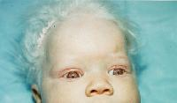

Slide 128
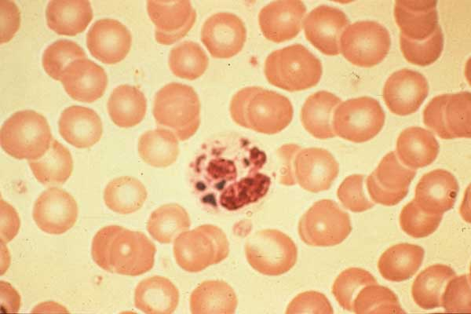

Slide 129
Question: What diagnosis does this patient have?
Chediak Higashi
Wiskott Aldrich
STAT 3 Deficiency
WHIM syndrome
0

Slide 130
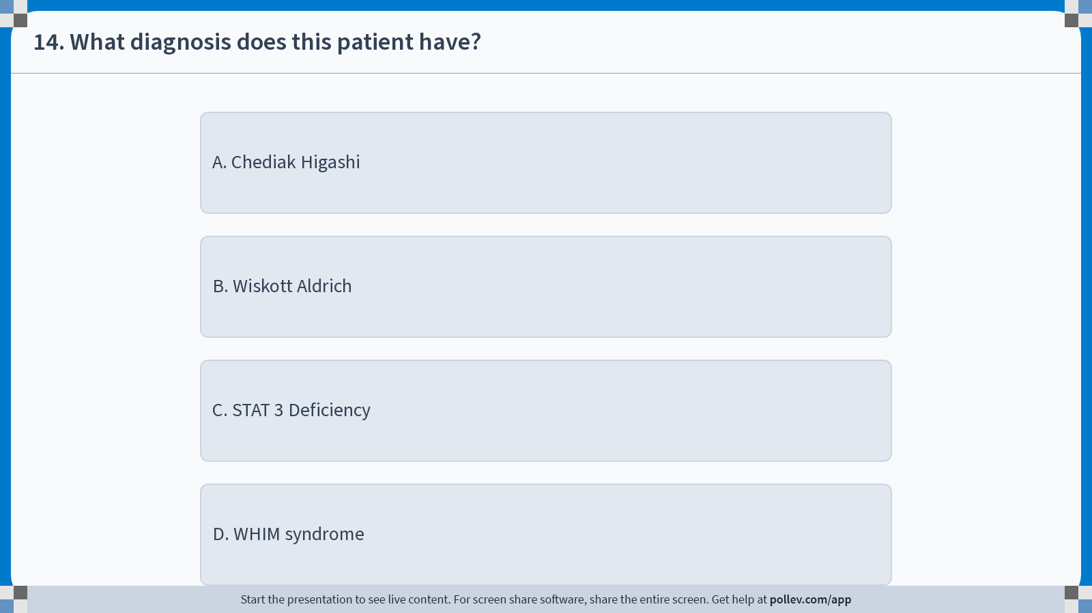
Notes:
Poll Title: Do not modify the notes in this section to avoid tampering with the Poll Everywhere activity.
More info at polleverywhere.com/support
14. What diagnosis does this patient have?
https://www.polleverywhere.com/multiple_choice_polls/MhWhPh9MzzBq9xj9Ew8iS?display_state=instructions&activity_state=opened&state=opened&flow=Instructor&onscreen=persist

Slide 131
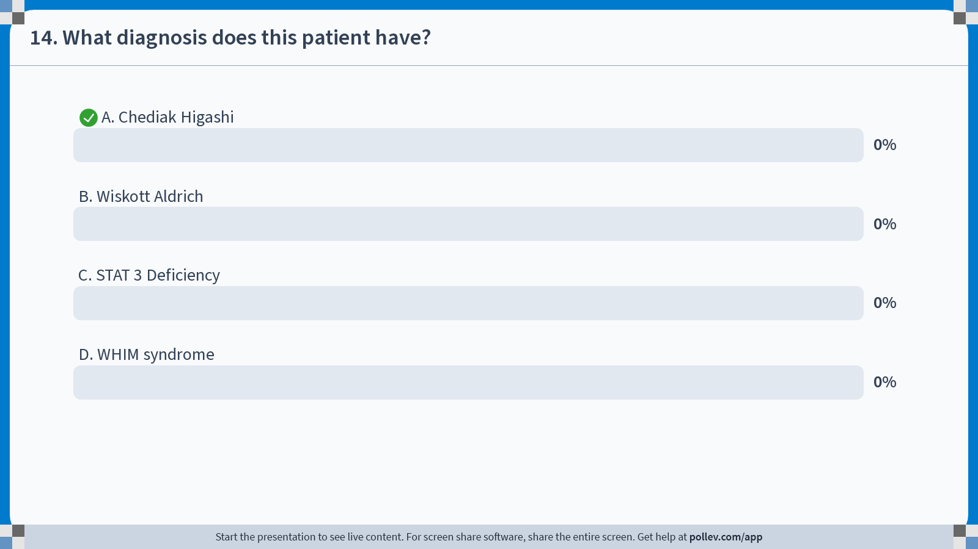
Notes:
Poll Title: Do not modify the notes in this section to avoid tampering with the Poll Everywhere activity.
More info at polleverywhere.com/support
14. What diagnosis does this patient have?
https://www.polleverywhere.com/multiple_choice_polls/MhWhPh9MzzBq9xj9Ew8iS?display_state=chart&activity_state=closed&state=closed&flow=Instructor&onscreen=persist

Slide 132
Notes:
Poll Title: Do not modify the notes in this section to avoid tampering with the Poll Everywhere activity.
More info at polleverywhere.com/support
14. What diagnosis does this patient have?
https://www.polleverywhere.com/multiple_choice_polls/MhWhPh9MzzBq9xj9Ew8iS?display_state=chart&activity_state=closed&display=correctness&state=closed&flow=Instructor&onscreen=persist

Slide 133
Question: What diagnosis does this patient have?
Chediak Higashi
Wiskott Aldrich
STAT 3 Deficiency
WHIM syndrome
0

Slide 134
Chediak Higashi Syndrome
Autosomal recessive disease.
Disease of hematologic, immune and neurological systems. Platelet dysfunction leads to bleeding. Defect in leukocytes, neutropenia and decreased NK cell numbers. Patients have oculocutaneous albinism. Hair appears silvery. As adults, develop ataxia and peripheral neuropathy. EBV can lead to fatal lymphoma.
Treatment: Prophylactic antibiotics; BMT

Slide 135
Case study
4 year old with history of two Neisseria meningitis infections. Otherwise healthy. Growing well. Active.

Slide 136
Question: What diagnosis does this patient have?
Wiskott Aldrich
Complement Deficiency
STAT 3 Deficiency
WHIM syndrome
0

Slide 137
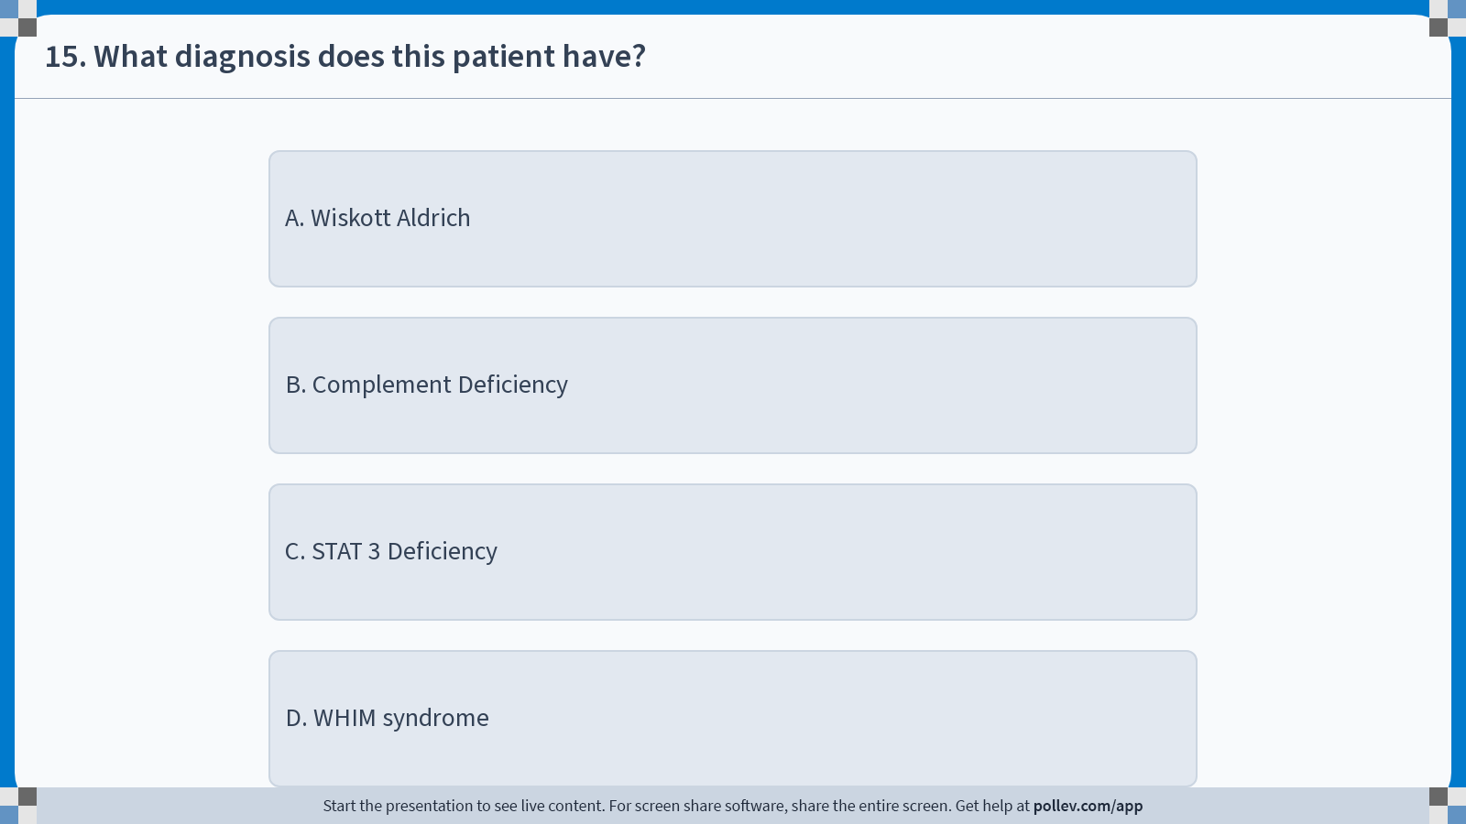
Notes:
Poll Title: Do not modify the notes in this section to avoid tampering with the Poll Everywhere activity.
More info at polleverywhere.com/support
15. What diagnosis does this patient have?
https://www.polleverywhere.com/multiple_choice_polls/7QHLcZydG3cRiz7e5TIaS?display_state=instructions&activity_state=opened&state=opened&flow=Instructor&onscreen=persist

Slide 138
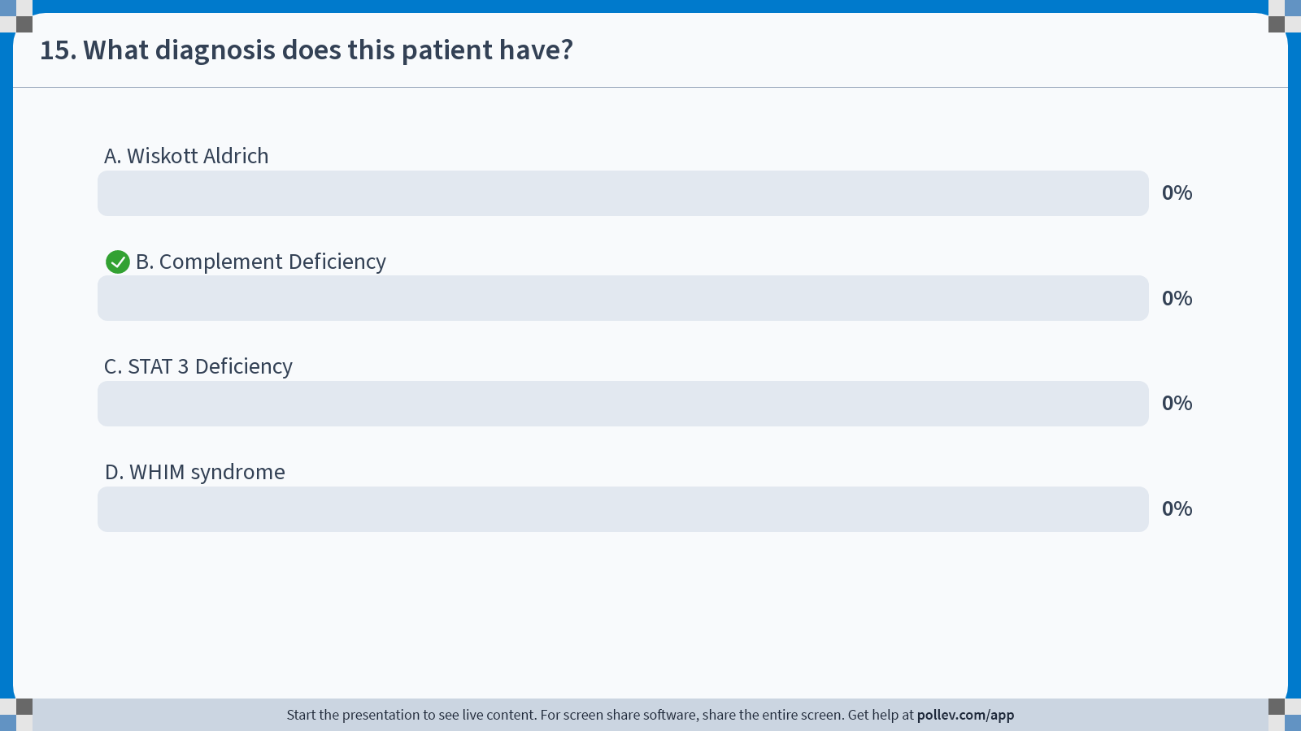
Notes:
Poll Title: Do not modify the notes in this section to avoid tampering with the Poll Everywhere activity.
More info at polleverywhere.com/support
15. What diagnosis does this patient have?
https://www.polleverywhere.com/multiple_choice_polls/7QHLcZydG3cRiz7e5TIaS?display_state=chart&activity_state=closed&state=closed&flow=Instructor&onscreen=persist

Slide 139
Notes:
Poll Title: Do not modify the notes in this section to avoid tampering with the Poll Everywhere activity.
More info at polleverywhere.com/support
15. What diagnosis does this patient have?
https://www.polleverywhere.com/multiple_choice_polls/7QHLcZydG3cRiz7e5TIaS?display_state=chart&activity_state=closed&display=correctness&state=closed&flow=Instructor&onscreen=persist

Slide 140
Question: What diagnosis does this patient have?
Wiskott Aldrich
Complement Deficiency
STAT 3 Deficiency
WHIM syndrome
0

Slide 141
Complement Deficiency
Reported deficiency of all complement components, still uncommon ID
Associated with recurrent pyogenic infections and CT diseases (esp. C2 & C4)
Deficiency of C5-8 associate with recurrent Neisseria species infection- meningitis (C6)**
Deficiency of C1 esterase inhibitor assoc. with angioedema (hereditary- HAE)
Treatment- Late components C5-C9- Penicillin
  HAE-Fresh Frozen Plasma, Danazol/Stanazol, C1 Esterase Inhibitor- prophylaxis or treatment

Slide 142
Case study
2 year old male with eczema, recurrent infections and easy bruising. As an infant, bloody diarrhea and “pink tears.”
Other male infants in family with similar presentation.

Slide 143
Question: What diagnosis does this patient have?
Chediak Higashi
WHIM syndrome
STAT 3 Deficiency
Wiskott Aldrich
0

Slide 144

Notes:
Poll Title: Do not modify the notes in this section to avoid tampering with the Poll Everywhere activity.
More info at polleverywhere.com/support
16. What diagnosis does this patient have?
https://www.polleverywhere.com/multiple_choice_polls/BprtDnM9gjEKQokcILm4V?display_state=instructions&activity_state=opened&state=opened&flow=Instructor&onscreen=persist

Slide 145
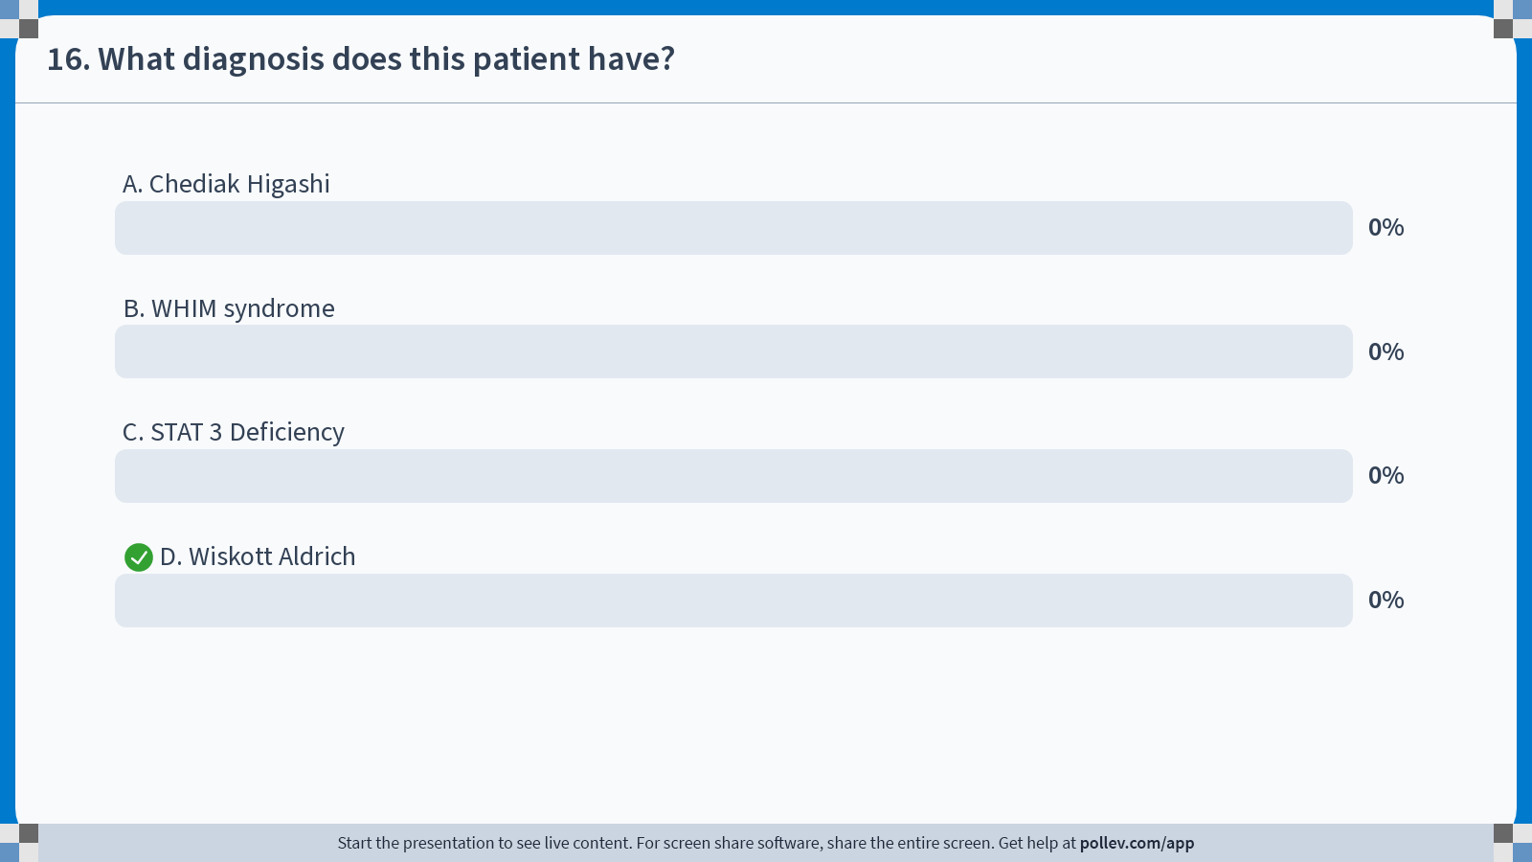
Notes:
Poll Title: Do not modify the notes in this section to avoid tampering with the Poll Everywhere activity.
More info at polleverywhere.com/support
16. What diagnosis does this patient have?
https://www.polleverywhere.com/multiple_choice_polls/BprtDnM9gjEKQokcILm4V?display_state=chart&activity_state=closed&state=closed&flow=Instructor&onscreen=persist

Slide 146
Notes:
Poll Title: Do not modify the notes in this section to avoid tampering with the Poll Everywhere activity.
More info at polleverywhere.com/support
16. What diagnosis does this patient have?
https://www.polleverywhere.com/multiple_choice_polls/BprtDnM9gjEKQokcILm4V?display_state=chart&activity_state=closed&display=correctness&state=closed&flow=Instructor&onscreen=persist

Slide 147
Question: What diagnosis does this patient have?
Chediak Higashi
WHIM syndrome
STAT 3 Deficiency
Wiskott Aldrich
0

Slide 148
Wiskott Aldrich Syndrome (WAS)
X-linked recessive X 11.22-11.23; lack WASP – important in cell signaling in lymphoid and megakaryocytic cells
Triad: Eczema, thrombocytopenia (<20,000 & small)**, increased susceptibility to infections
Presentation: bloody diarrhea/bloody tears, prolonged bleeding from circumcision, excessive bruising; later P. jirovecii, herpes virus, autoimmune cytopenias, vasculitis
Treatment: BMT
Cause of death: infection, bleeding, EBV induced lymphoreticular malignancy

Slide 149
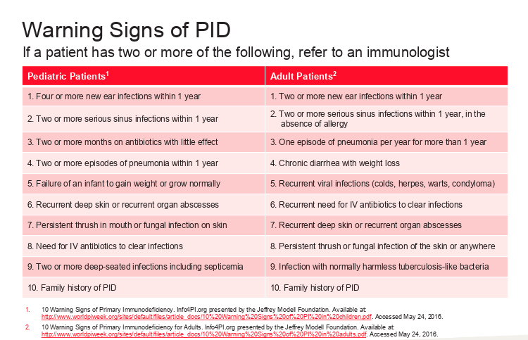
When to think about ID diagnosis?

Slide 150
Physical Exam
Growth measurements***
Inspection of tonsils-if absent, Ask about history of tonsillectomy****
Palpation of LN****
Organomegaly
Skin lesions

Slide 151

Laboratory Testing
Antibody mediated immunity
  Quantitative serum immunoglobulins
  Iso-hemagglutinins (Anti A, Anti B)
  Antibodies to Tetanus and Diphtheria (protein antigens)
  Antibodies to H influenza B and Pneumococcal (polysaccharide antigens)

Slide 152

Laboratory Testing
  T-cell immunity
  CBC with differential- calculate ALC
  Cell surface markers/ subsets
  Mitogen proliferation studies
  Delayed hypersensitivity skin tests-candida, tetanus (individuals > 2 y/o)

Slide 153

Laboratory Testing
Neutrophil function:
  Nitroblue tetrazolium dye test (NBT)
  Oxidative burst assay
  1,2,3 Dihydrorrhodamine
Complement function:
  Total hemolytic complement test, C3, C4
  Quantitative measurements of components
  Functional assays for components

Slide 154
Treatment
Antibody deficiency (XLA, Hyper IgM, Hyper IgE)
  IVIG (400mg/kg/dose every 4 weeks) or SCIG (100-150 mg/kg weekly, every other week or more often)
  Prophylactic antibiotics (not universal)
  Bone marrow transplantation in some patients- Hyper IgM
  Frequent follow-up q 4-6 months

Slide 155
Treatment
T cell disorders/ Combined Immunodeficiency (SCID, WAS, DGA, XLP)
  Stem cell transplantation/BMT
  Enzyme replacement (ADA)
  Thymic implant (Di George)
  IVIG (400mg/kg/dose every 4 weeks) or SCIG (100-150 mg/kg weekly, every other week or more often)
  Prophylactic po antibiotics
  Avoidance of live viral vaccines
  Irradiation and leuko-depleted blood products
  Frequent follow-up

Slide 156
Treatment
Phagocytic cell deficiency:
  Prophylactic antimicrobials-Bactrim/Itraconazole
  Gamma interferon in CGD
  Avoidance of live viral vaccines
  Bone marrow transplantation in some patients
  Frequent follow-up

Slide 157
Treatment
Complement deficiency:
  Prophylactic antibiotics-Penicillin
  Immunizations with bacterial polysaccharide vaccines
  Frequent use of IV antibiotics
  Frequent follow-up

Slide 158
Thank You
Questions?

