Slide 1

FLUIDS & ELECTROLYTES
Nicole Christin, MD
Pediatric Nephrology
Nicklaus Children’s Pediatric Specialists
Nicklaus Children’s Hospital
Miami, FL

Slide 2
Disclosure of Relevant Relationship
Dr. Christin has not had (in the past 24 months) any relevant conflicts of interest or relevant financial relationship with the manufacturers of products or services that will be discussed in this CME activity or in his presentation.
Dr. Christin will support this presentation and clinical recommendations with the “best available evidence” from medical literature.
Dr. Christin does not intend to discuss an unapproved/investigative use of a commercial product/device in this presentation.

Slide 3
Fluids and Electrolytes
Nicole Christin, MD
Pediatric Nephrologist
Nicklaus Children’s Hospital

Slide 4
Disclosure Statement
I, Nicole Christin, have no relevant financial relationships with the manufacturer(s) of any commercial products(s) and/or providers(s) of commercial services discussed in this CME activity to disclose.
I, Nicole Christin, do not intend to discuss an unapproved/investigative use of a commercial product/device in my presentation.

Slide 5
Topics to be Discussed
Metabolic Acidosis
Metabolic Alkalosis
Sodium and Water balance
  Hyponatremia
  Hypernatremia
Potassium Imbalance
Calcium Imbalance

Slide 6
Metabolic Acidosis
  Net gain of acid
  Loss of base (bicarbonate)
  Know your normals!
First step in determining the etiology of confirmed primary metabolic acidosis is to calculate the ANION GAP
Notes:
As you will hear me say a lot. First CONFIRM as lab technique, factors can affect many components of a chemistry.
Infants have lower serum bicarbonate levels (18 – 22 mEq/Lt) compared to adults due to transient immaturity of the proximal tubule

Slide 7
Metabolic Acidosis
Serum Anion Gap
  Na – (Cl + HCO₃) = 10-14 (normal)
  Important to correct for hypoalbuminemia (an unmeasured anion)
  Causes of Positive Anion Gap Metabolic Acidosis:
    Methanol
    Uremia
    Diabetic Ketoacidosis
    Paraldehyde
    INH
    Lactic Acidosis
    Ethylene Glycol
    Salicylates
Notes:
Formula:

Slide 8
Non Anion Gap Metabolic Acidosis
  Diarrhea
    Colonic bicarbonate loss
  Renal Tubular Acidosis
    Type 1: Distal: Inability to secrete and excrete acid
    Type 2: Proximal: Inability to reabsorb bicarbonate
      Most Common Cause is Cystinosis
    Type 4: Hyperkalemic: Aldosterone resistance

Slide 9
Renal Tubular Acidosis
A hyperchloremic non-anion gap metabolic acidosis
Urinary Anion Gap (helpful; not diagnostic)
  Assessment of distal production/secretion of NH4Cl via random urine electrolytes
  [Na + K] – Cl
  In distal RTA the urine anion gap is POSITIVE
    The urine pH is > 5.5
    This means there is no distal acid secretion
  In proximal RTA the urine anion gap is NEGATIVE
    This means distal acid secretion is intact
Notes:
Urinary Cl is an indirect measurement of urinary NH4 (acid)

Slide 10
Lab Value | Type 1 RTA | Type 2 RTA | Type 4 RTA
Plasma K | Low-normal | Low-normal | Elevated
Urine pH | >5.5 | <5.5 | Variable
Urine AG | + | --- | +
Stones/NC | Yes | No | No
Treatment | Responds | Challenging | Variable
Adapted from Soriano JR. Renal Tubular Acidosis: The Clinical Entity. JASN. 2002
Notes:
All have poor growth
Treatment

Slide 11
Metabolic Alkalosis
Net gain of base
Loss of acid

Slide 12
Common Causes Include:
  Vomiting (pyloric stenosis) or NG suction
  Diuretic Use
  Salt losing tubulopathy
  Post-hypercapnea
  Licorice
  Primary hyperaldosteronism
  Mineralocorticoid excess
  Cushings Syndrome
  Liddle Syndrome
  Excessive blood product transfusion (citrate)
First Step is to order…… a URINE CHLORIDE!

Slide 13
Salt ResponsiveAlkalosis UrCl< 20 mEq/L | Salt Resistant Alkalosis UrCl>20 mEq/L
Contraction Alkalosis Vomiting/Suction Post-hypercapnea Chronic Diuretic Use (after depletion) Cystic Fibrosis Congenital CL diarrhea | With Normal BP -- Acute diuretic use ---Salt wasting tubulopathy With Elevated BP ---Mineralocorticoid ---Cushing’s Syndrome ---Licorice (large amounts) ---Liddle’s Syndrome

Slide 14
Salt-Water Imbalance
Again do not let the lab plays tricks on you
  Adjust for hyperlipidemia, hyperglycemia, hyperproteinemia
Free Water Deficit Equation:
  Nacurrent/Nadesired0.6kg – 0.6kg
Salt Deficit Equation
  0.6kg x (Desired Na- Actual Na)

Slide 15
Hyponatremia Defined
Definition: Serum Na+ <135 mmol/L
  Associated with decreased measured osmolality to <275
Usually caused by retention of water
  A drop in osmolality SHOULD suppress ADH to allow excretion of the excess water via dilute urine
  Most forms of hyponatremia are associated with elevated ADH (whether appropriate or inappropriate), which concentrates urine (via water reabsorption)

Slide 16
Signs & Symptoms
More profound when the decrease in sodium is very large or occurs rapidly
  Generally asymptomatic if Na+ level >125 mmol/L
Symptoms include:
  Headache, nausea, vomiting
  Disorientation, depressed reflexes, lethargy, restlessness, seizure, coma
Important things to know
  Recent fluid intake or losses
  Changes in patients weight
  Vital signs

Slide 17
Approach to Hyponatremia
Assess measured osmolality (via chemistry)
Assess the patients volume status
Assess random urinary sodium excretion and FeNa
Notes:
*Remember VOU – volume status, osmolality, and urine studies
Measured vs Calculated

Slide 18
Osmolality
  Hypertonic - >295
    hyperglycemia, mannitol, glycerol
    Check for osmolar gap
  Isotonic - 280-295
    pseudo-hyponatremia from elevated lipids or protein
  Hypotonic - <280
    excess fluid intake, low solute intake, SIADH, hypothyroidism, adrenal insufficiency, CHF, cirrhosis, nephrotic syndrome, etc..
    This REQUIRES further work up and evaluation
Notes:
Serum Osmolality: lab value or calculation – in mosm/kg
=(2 x Na+) + (glucose/18) + (BUN/2.8)

Slide 19
Volume Status
Hypotonic hyponatremia has 3 main etiologies:
  Hypovolemic – both H2O and Na decreased (Na > H20)
    Diarrhea, vomiting, dehydration, malnutrition, burns
  Euvolemic – H20 increased and Na stable
    Consider SIADH, thyroid disease, cortisol deficiency, primary polydipsia
  Hypervolemic – H20 increased and Na increased (H2O > Na)
    Consider CHF, cirrhosis, Renal Failure and Nephrotic Syndrome

Slide 20
Urine Studies
For euvolemic hyponatremia, check urine osmolality
  Urine osmolality <100 - excess water intake
  Urine osmolality >100 - impaired renal concentration
    SIADH, hypothyroidism, cortisol deficiency
Check urine sodium & calculate FeNa %
  A low urine sodium (<10) and low FeNa (<1%) implies the kidneys are appropriately reabsorbing sodium
  A high urine sodium (>20) and high FeNa (>1%) implies the kidneys are not functioning as they should

Slide 21
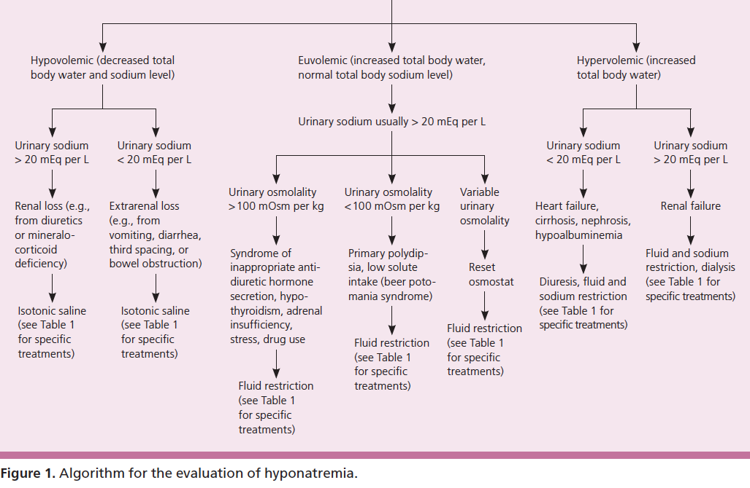

Slide 22
Treatment of Hyponatremia
Depending on the cause:
  Water restriction
  Saline
  Saline and Lasix
  3% NS IF symptomatic
Be CAUTIOUS with correction:
  Do not increase Na more than 10-12 meq/L in 24 hrs
    Central pontine demyelination syndrome
Notes:
NEED FREQUENT LABS
Hypovolemic: Na and H20 replacement
Euvolemic: Water restriction
Hypervolemia: Salt and H20 restriction

Slide 23
Hypernatremia
Serum Na > 150 mmol/L
Intact thirst and free access to water should prevent this
Causes include
  Water losses from kidneys, GI system, skin
    Weight loss
    GI losses are the most common cause
  Salt loading/ high solute load

Slide 24
Most Important Lab Test
After assessing volume status → Urine Na and Urine osmolality
 | Urine Na > 20 mEq/L | Urine Na < 20meq/L
Hypovolemic | Renal losses --Dysplasia --Post-obstructive diuresis | Extrarenal losses --burns, sweat --diarrhea
Hypervolemic | Salt Loading
Notes:
After VOLUME assessment

Slide 25
Hypernatremia WITH Euvolemia
Concentrated Urine
  Treat with water replacement
Dilute Urine (Ur osm <300)
  Diabetes Insipidus
    Depending on results of water deprivation test
      If respondes →Central DI (treat with DDAVP)
      No response → Nephrogenic DI (treat with water, thiazides)

Slide 26
Hypokalemia
Etiology
  Urine losses
    Diuretics
    Tubular dysfunction (Fanconi Syndrome, Barter/Gitelman Syndrome)
  GI losses
    Diarrhea, NG suction
  Magnesium depletion
  Displacement (transcellular shifts)
  Abnormal RAS pathway (usually associated with elevated BP)
  Alkalosis
Manifestations
  EKG: U waves, flat and inverted T waves
  Muscle weakness, cramping, paresthesia
  Paralytic ileus
Treatment
  Replace: oral if possible
  Avoid medications that push K intracellularly
Notes:
K <3.5
Obtain urine K level (<20 vs > 20)

Slide 27
Hyperkalemia
Etiology
  Renal failure
  Cell lysis /muscle injury
  Medications (K sparing diuretics, ACEI/ARB, BB, NSAIDs)
  Metabolic acidosis
  Adrenal insufficiency
  Fictitious ( heel stick / tourniquet)***
EKG Findings
  Wide QRS, peaked T waves, prolonged PR interval

Slide 28
Hyperkalemia
Treatment:
  Calcium→ does not treat but stabilizes the myocardium
  Temporary Treatment/Shifters (fast acting)
    Triple albuterol neb
    Insulin (need to give dextrose prior)
    Bicarbonate
    Stop K containing IVF/TPN, wash blood products
  True Removal (these take time)
    Sodium polystyrene sulfonate (increase GI losses)
    Diuretics (urine urine K losses +/- fluids)
    Dialysis

Slide 29
Hypocalcemia
Etiology:
  False; Hypoalbuminemia: corrected calcium:
  Hypoparathyroidism
    Transient in neonates (especially infant of diabetic mother)
    DiGeorge anomaly (22q11)
    Hypomagnesemia (impairs PTH secretion/CaSR resistance)
  Vitamin D insufficiency (exclusively breastfed, measure 25OH Vitamin D level)
  Chelation or precipitation (hyperphosphatemia, tumor lysis syndrome)
  Alkalosis (increased albumin binding)
Manifestations:
  Neuromuscular: tetany, paresthesia, weakness, seizures, muscle spasm.
  Cardiovascular: depressed myocardial contractility (prolonged QT)
  Respiratory: laryngo/brochospasm
Notes:
This neuromuscular instability can also be displayed through the elicitation of Chvostek's sign and Trousseau's sign

Slide 30
Hypocalcemia
Work Up (prior to treatment)
  ical
  CMP (albumin for correction), Phosphorus, Magnesium
  PTH (appropriate response is for it to be elevated)
  Vitamin D levels (25OH, 1,25 OH)
Treatment:
  Replace (IV is very caustic)
    May need: Vitamin D or calcitriol (IV or PO)
    Do not give oral calcium with food (then it becomes a phosphorus binder!)

Slide 31
Hypercalcemia
Manifestations:
  Anorexia, nausea
  Polyuria (nephrocalcinosis)
  Hypertension
  Bone pain
  Pyschosis
Work Up
  Same as hypocalcemia
    If PTH suppressed there is an “exogenous” source

Slide 32
Etiology
Suppressed PTH | Normal/Elevated PTH
Neoplasm (PTHrp mediated) Granulomatous Disease (+1,25 VitD) Immobility (bone resorption) Hypervitaminosis A and D Fat necrosis (newborns) | Familial hypocalciuric hypercalcemia (no treatment needed) Hyperparathyroidism (transient neonatal, primary, tertiary)
Notes:
Williams Syndrome→ suppressed PTH.

Slide 33
Hypercalcemia
Treatment:
  Volume expansion (induce calciuria)
  Loop diuretics ONLY (induce calciuria)
  Calcitonin (SQ) or biphosphonates (IV) (inhibit osteoclastic activity)
  Dialysis (low calcium bath to induce removal)

Slide 34
Question 1
A 5 week old male infant presents to the emergency department with a vomiting x 4 days. His mother states that the vomiting has gotten progressively worse and now seems to "shoot out of his mouth.” The vomitus is non-bilious and non-bloody. He is exclusively bottle fed with formula. There is no history of fever, URI symptoms, or diarrhea. He is less active than normal. He is making fewer wet diapers and less stool than usual. You suspect pyloric stenosis. What constellation of labs findings to most expect to find on the BMP in process?
  A: Hyperkalemic, hypochloremic, metabolic acidosis
  B: Normokalemic, normochloremic, metabolic acidosis
  C: Hyperkalemic, hyperchloremic, metabolic acidosis
  D.: Hypokalemic, hypochloremic, metabolic alkalosis

Slide 35
Question 1
A 5 week old male infant presents to the emergency department with a vomiting x 4 days. His mother states that the vomiting has gotten progressively worse and now seems to "shoot out of his mouth.” The vomitus is non-bilious and non-bloody. He is exclusively bottle fed with formula. There is no history of fever, URI symptoms, or diarrhea. He is less active than normal. He is making fewer wet diapers and less stool than usual. You suspect pyloric stenosis. What constellation of labs findings to most expect to find on the BMP in process?
  A: Hyperkalemic, hypochloremic, metabolic acidosis
  B: Normokalemic, normochloremic, metabolic acidosis
  C: Hyperkalemic, hyperchloremic, metabolic acidosis
  D.: Hypokalemic, hypochloremic, metabolic alkalosis

Slide 36
Question # 2
A 10 year old boy presents with new onset bed wetting after previously being dry for the last 5 years. He denies dysuria or hematuria but does have increased urinary frequency and morning headaches. No stooling issues. He has recently started a new school but grades are above average. His vitals are normal. In office UA demonstrates a SG 1.002, no RBC, no WBC, no glucose, no protein
  The most likely cause of his new symptoms is:
  A. UTI
  B. Stress
  C. Urine concentration defect
  D. Constipation

Slide 37
Question # 2
A 10 year old boy presents with new onset bed wetting after previously being dry for the last 5 years. He denies dysuria or hematuria but does have increased urinary frequency and morning headaches. No stooling issues. He has recently started a new school but grades are above average. His vitals are normal. In office UA demonstrates a SG 1.002, no RBC, no WBC, no glucose, no protein
  The most likely cause of his new symptoms is:
  A. UTI
  B. Stress
  C. Urine concentration defect
  D. Constipation

Slide 38
Questions #3
Which of the following is most consistent with renal tubular acidosis?
  A. Low anion gap
  B. Height above the 75%
  C. Hyperchloremic
  D. Hyperphosphatemia

Slide 39
Questions #3
Which of the following is most consistent with renal tubular acidosis?
  A. Low anion gap
  B. Height above the 75%
  C. Hyperchloremic
  D. Hyperphosphatemia

Slide 40
Question #4
A mother brings her 6 month old exclusively breastfed boy to the office for constipation and extreme fussiness. The mother has not had any recent diet changes and the infant does not have a fever, emesis or recent exposure to a sick contact. The mother states she recently has started giving Vitamin D to avoid him getting sick during the Flu season. What lab findings to you expect to see in this patient?
  A: Hypercalcemia, high PTH, high 25 Vitamin D
  B: Hypercalcemia, low PTH, high 25 Vitamin D
  C: Normocalcemic, normal PTH, high 25 Vitamin D
  D: Hypocalcemic, high PTH, high 25 Vitamin D

Slide 41
Question #4
A mother brings her 6 month old exclusively breastfed boy to the office for constipation and extreme fussiness. The mother has not had any recent diet changes and the infant does not have a fever, emesis or recent exposure to a sick contact. The mother states she recently has started giving Vitamin D to avoid him getting sick during the Flu season. What lab findings to you expect to see in this patient?
  A: Hypercalcemia, high PTH, high 25 Vitamin D
  B: Hypercalcemia, low PTH, high 25 Vitamin D
  C: Normocalcemic, normal PTH, high 25 Vitamin D
  D: Hypocalcemic, high PTH, high 25 Vitamin D

Slide 42
Thank You!

